Slide 1
B.A.II Sem III Paper No. 4
Ancient Indian Political Thought
ANCIENT INDIA
The Aryans And vedic age
डॉ मधुरा प्र. मोहिते
सहयोगी प्रध्यापक,
महिला महाविद्यालय,कराड

Slide 2
Ancient India

Slide 3
INTRODUCTION
The Aryans : 1. Early Vedic Period
2. Later Vedic Period
The Vedic Literature : 1. The Vedas
2. The Upanishadas
3. The Brahmanas
4. The Aranyakas
Epics : Mahabharata, Ramayana, Puranas

Slide 4
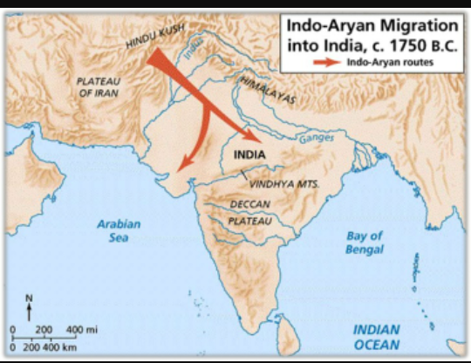
Vedic Period : The Aryans
The Aryans were semi-nomadic pastoral people and originated from area around the Caspian Sea in Central Asia.
The Central Asian theory is given by Max Muller.
Entered India probably through the Khyber Pass (Hindukush Mountains) around 1500 BC.

Slide 5
Early Vedic Age (1500-1000 BC)
Political Organisation : Monarchial form. Tribe was known as Jan and its King as Rajan.
Family was the basic unit of society. The family was patriarchial in nature.

Slide 6
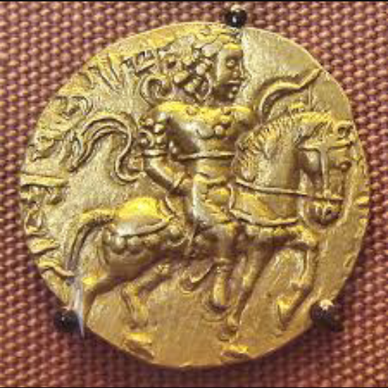
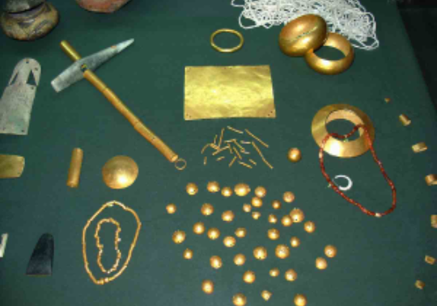
Early Vedic Age
Economy : Aryans followed a mixed economy-pastoral and agricultural in which cattle played a predominant part.
Standard unit of exchange was cow. At the same time coins were also there.

Slide 7
Early Vedic Age
Religion :
Aryans laid the foundation of Hinduism.
Hinduism is the world’s oldest organized religion.
It began as nature for favors. Thus, it has ,illions gods and goddesses representing natural forces and personified gods to suit human needs.
They believe in karma(destiny) and reincarnation( a good soul is reborn after each into a higher status: a bad soul into a lower status or animal).

Slide 8
Early Vedic Age: Gods they worshipped

Slide 9
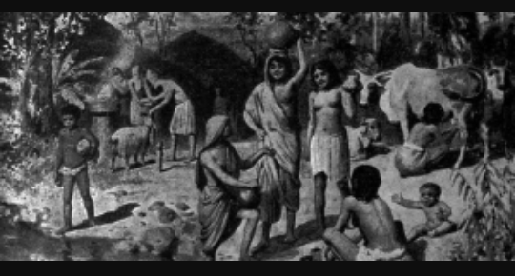
Later Vedic Age (1000-600 BC)
Political Organisation : Tiny tribal settlements were replaced by strong kingdoms.

Slide 10
Later Vedic Age
Social Life : The four fold division of society became clear initially based on occupation, which later became hereditary : Brahmins (priests), Kshatriyas (Warriors), Vaishyas (agriculturists, cattle-rearers, traders) and Shudras (servers of the upper three). The institution of gotra appeared for the first time in this Age.

Slide 11
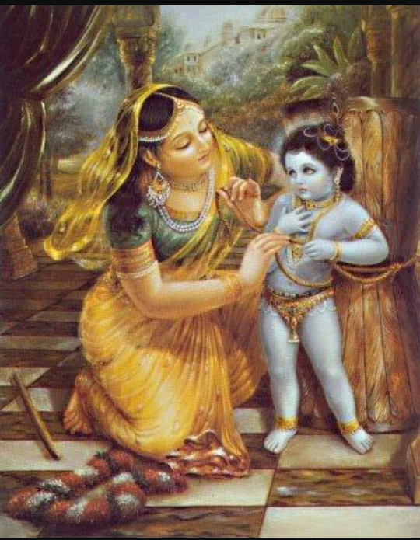
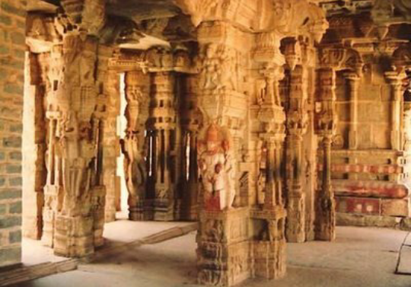
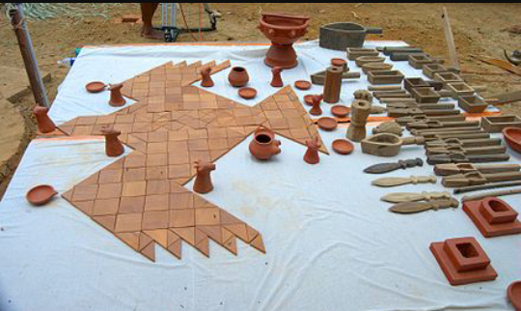
Later Vedic Age
Traditional Life : Turbans were also commonly used by them. Adorned their persons with gold & silver ornaments garlands & wreaths of flowers jewels etc. Ornaments were worn by men & women.

Slide 12
Later Vedic Age
Caste System :
The caste System has become part of Indian life due to the religious approval given to it by Hinduism.
It divides people into rigid caste or classes:
Brahmans – Priests and scholars
Kshatriyas – rulers and warriors
Vaishyas – farmers, artists and merchants
Sudras – workers and slaves
Untouchable - persons who do not belong to any class and the dirtiest work like cleaning toilets and collecting garbage.

Slide 13
Later Vedic Age
Gurukul system of education : Entrance in gurukul at the age of 7
receive education till 25 years
gurukuls – deep in the forest
Students like guru’s children
Guru- spiritual father
Simple, disciplined lives
Students cleaned house, drew water, gathered wood, worked in the fields
oral method of teaching, learning
Guru dakshina according to means, women not allowed

Slide 14
The Vedic Literature
The Vedic Literature reflects the life and culture of the ancients Aryans of India.
It consists of four literary works :
Vedas : are composed of hymns, prayers, rituals, magic and poetry. They were the earliest sacred books of Hindus.
Brahmanas : are prose texts containing observations on religious rites. Also include legends of the exploits of ancient kings and heroes.
Aranyakas : are books of instructions for the hermits in the forests. Contains elaborate rules for the performance of religious ceremonies.
Upanishads : also books of instructions given by a father to his son or the teacher to pupil.

Slide 15
Epics
Mahabharata
Ramayana
It was written in Sanskrit by Ved Vyas.
It describes about war between Kauravas and Pandavas of 950 BC in Kurukshektra.
Translation of ‘Mahabharata’ in Persian is called Rajm nama done by Badayuni.
It was written by Vlmiki in Sanskrit.
It has 24000 shloks, also known as Adi- Kavya.
Its Persian translation is done by Badayuni and Tamil translation by Kamban.
Ramcharitmanas is written by Tulsidasa.

Slide 16
Epic Stories

Slide 17
18 Puranas (Gupta Age 4th cent.)
Agni Purana
Bhavishya Mahapuranam
Vishnu Purana
Garud Puran
Kurma Mahapurana
Linga Mahapurana
Markandeya Purana
Matsya Mahapurana
Naradiya Mahapuranam
Narasimha – Puranam
Shrimad Bhagwad
Siva Mahapuranam
Skanda Mahapuranam
Skanda-Purana
The Brahmanda Purana
The Varaha Purana
Vamana Purana
Vayu Mahapurana

Slide 18
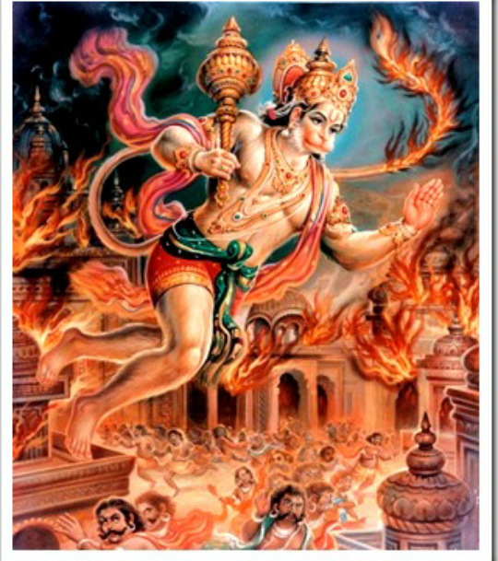
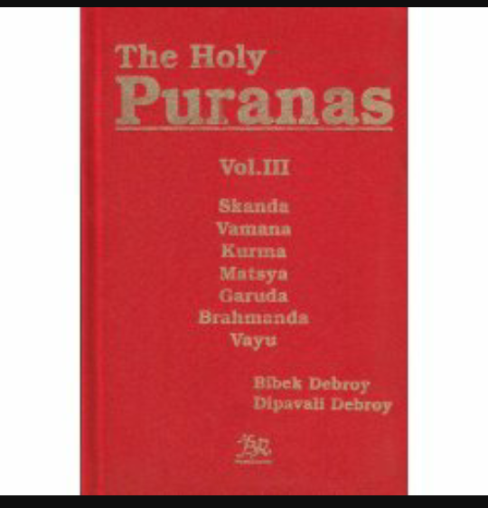
Epics

Slide 19
Thank You

