Slide 1
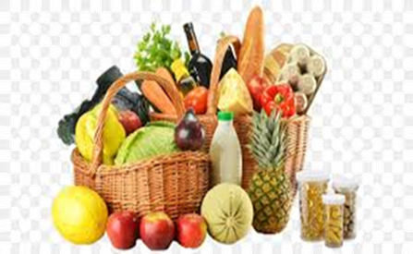
शिवाजी विद्यापीठ, कोल्हापूर बी..ए. भाग -1 सेमिस्टर -1 होम सायन्स : पेपर क्रमांक-1 अन्न व पोषणाची मुलतत्वे Fundamentals of Food and Nutrition Syllabus

Slide 2
Fundamentals of Food and Nutrition Syllabus
Nutrition has been recognized and given a special role in national development. Nutrition is the key to facilitate the study and enhance the quality of human life. This paper covers basic aspects of nutrients, food science, as well as open a vast understanding of the current spectrum of malnutrition,. This course equips the students for skill development, academic understanding, entrepreneurship, community role and employment in various fields of food industry, health clinics, NGOs, etc.

Slide 3
Objectives
1. To familiarize students with fundamentals of food, nutrients and their relationship to Health
2. To create awareness with respect to deriving maximum benefit from available food resources

Slide 4
Module 1 : Basic concepts in Food and Nutrition
1.1 Basic concepts used in study of food and nutrition: Food, Nutrients, Nutrition, Health, Malnutrition and Balanced Diet
1.2 Understanding relationship between food, nutrition and health
1.3 Functions of food – Physiological, psychological, social and cultural

Slide 5
Module 2: Food Groups
Selection and nutritional contribution of the following food groups:
2.1 Cereals
2.2 Pulses
2.3 Fruits and vegetables
2.4 Milk & milk products
2.5 Eggs
2.6 Meat, poultry and fish
2.7 Fats and Oils

Slide 6
Module 3: Methods of Cooking with advantages and disadvantages
3.1 Moist heat : Boiling, Steaming, Pressure cooking
3.2 Dry heat : Roasting, baking
3.3 Frying : Deep and Shallow frying
3.4 Microwave cooking

Slide 7
Module 4: Nutrients
Functions, dietary sources and clinical manifestations of deficiency of the following nutrients:
4.1 Carbohydrates, lipids and proteins
4.2 Fat soluble vitamins-A, D, E and K
4.3 Water soluble vitamins – Thiamine, Riboflavin, and vitamin C
4.4 Minerals – calcium and iron

Slide 8
Practical
1. Weights and measures of food stuff.
2. Food preparation, understanding the principles involved, nutritional quality and portion size
• Beverages: Hot tea/coffee/ Milk shake/ lassi / fruit based beverages (Any One)
• Cereals: Boiled rice / pulao/ chapatti / paratha / puri / pastas (Any One)
• Pulses: Whole / dehusked (Any One)
• Vegetables: curries / dry preparations
• Milk and milk products : Kheer / custard or Meat, Fish and poultry preparations / Egg preparations: Boiled / poached / fried / scrambled / omelettes / egg pudding

Slide 9
3. Plan and prepare nutrient rich recipe of the following with nutritive value calculation.
• Calorie / Protein (Any One)
• Vitamin A / Vitamin C (Any One )
• Vitamin B1 / Vitamin B2 (Any One )
• Iron / Calcium

