Slide 1
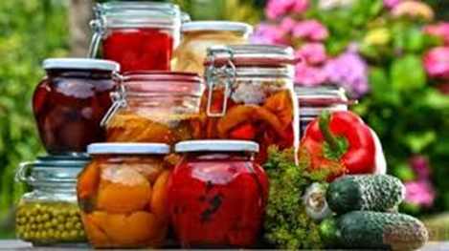
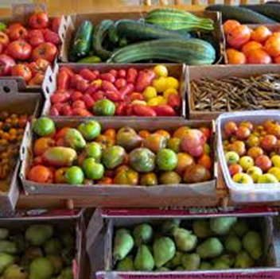
Mahila Mahavidyalaya, Karad Department of Home Science
Welcome to
B.A. II Semester 4
Home Science
Dr. Ila Jogi
Head, Department of Home Science

Slide 2
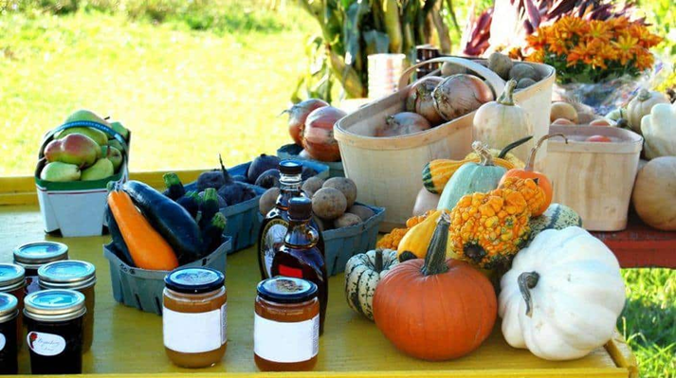
Paper III: Basics of Food Safety and Preservation
Module 1:Introduction to Food Preservation
1.1 Definition and Scope of Food
Preservation
1.2 Objectives of Food Preservation
1.3 Scope of Food Preservation
industry in India

Slide 3
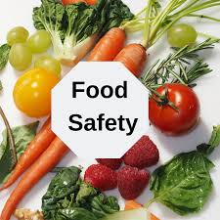
Module 2: Food Safety
2.1 Key terms. Factors affecting Food safety
2.2 Food Laws, Standards and Regulations
2.3 Food Additives and Contaminants
2.4 Hygiene and sanitation
2.5 HACCP

Slide 4
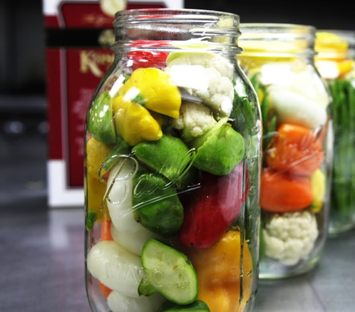
Module 3: Principles of Food Preservation
3.1 Principles of Food Preservation
3.2 Common Terms used in Food Preservation
3.3 Factors affecting growth of micro organisms

Slide 5
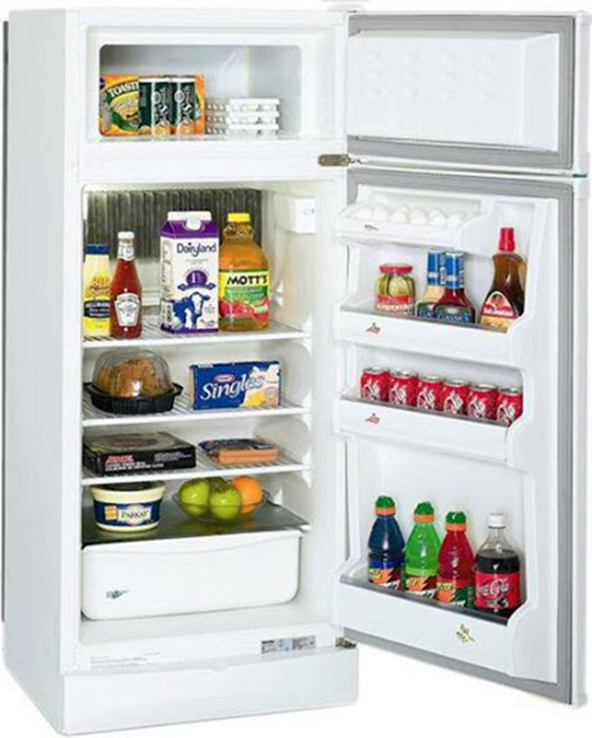
Module 4: Methods of Food Preservation
4.1 Preservation by High Temperature
4.2 Preservation by Low Temperature
4.3 Preservation by Drying
4.4 Preservation by Preservatives
4.5 Preservation by Irradiation
4.6 New Methods of Preservation

Slide 6
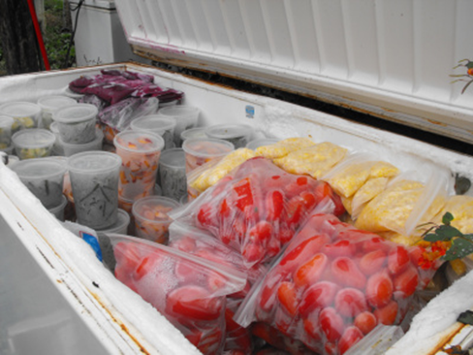
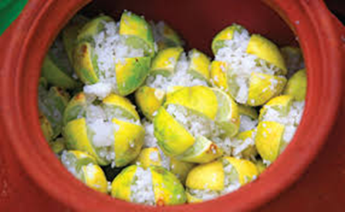
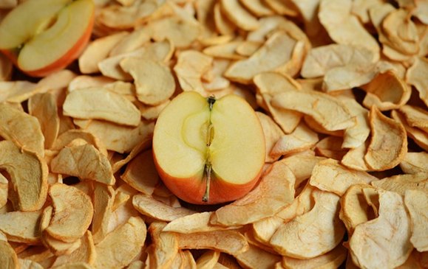
Practical
1. Introduction to Equipment used for
Food Preservation
2. Preparation of Jam
3. Preparation of Jelly
4. Preparation of Fruit Squash
5. Preparation of sauce/Ketchup
6. Preparation of Pickle
and Chutney
7. Blanching of vegetables
8. Preparation of Frozen peas
9. Visit to Food Preservation Unit/ Institute to observe technique and Food Safety measures

