Slide 1
B.A. III yr. Special English
Semester – V, Paper – VII (40 Marks) Introduction to Literary Criticism (CBCS)
Teacher Dr. P.S. Sontakke { M.A., M.Phil., Ph.D., UGC-MRP } Assistant Professor of English E-mail Id – paragsontakke75@gmail.com

Slide 4
What is Literary Criticism ?
Analysis/Classification,
Justification,
Evaluation
of a
Literary work of Art
(Poem/Drama/Novel/Prose)

Slide 5
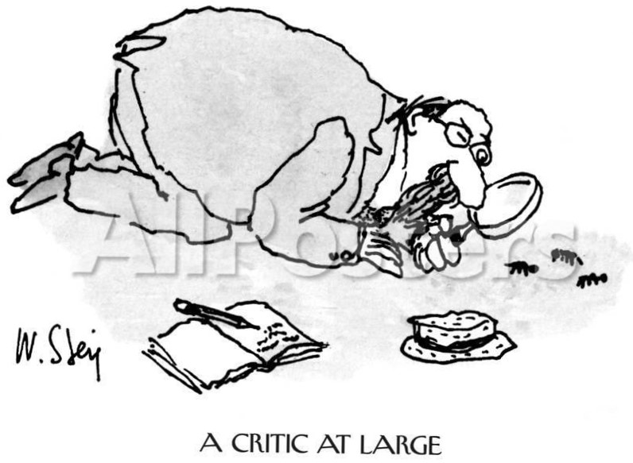

Slide 6
Who is a Critic ? A person who Analyses/Classifies, Justifies & Evaluates a literary or artistic work of art professionally (means by using literary theories/scientific methods) is called as a Critic.
Literary criticism/literary studies is study, evaluation & interpretation of literature.
Modern literary criticism is often influenced by literary theory, which is philosophical discussion of literature's goals & methods.
Though two activities are closely related, literary critics are not always & have not always been theorists. Whether literary criticism should be considered a separate field of inquiry from literary theory is a matter of controversy.
Literary criticism is often published in essay/in book form.

Slide 7
Academic literary critics teach in literature departments & publish in academic journals & more popular critics published their reviews in broadly circulating periodicals such like -
Times Literary Supplement,
New York Times Book Review,
New York Review of Books,
London Review of Books,
The Nation & The New Yorker.

Slide 8
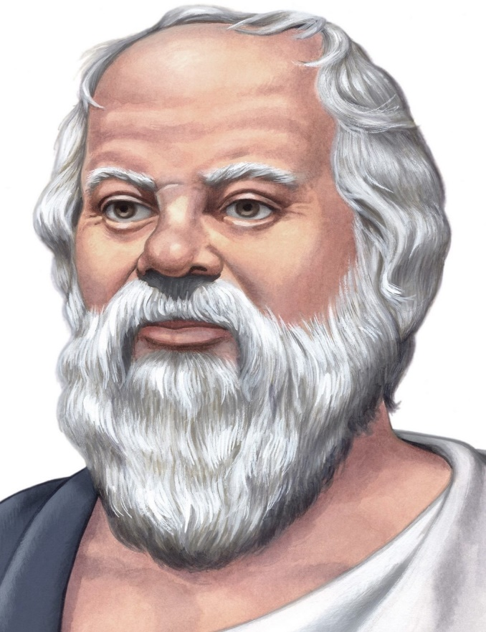
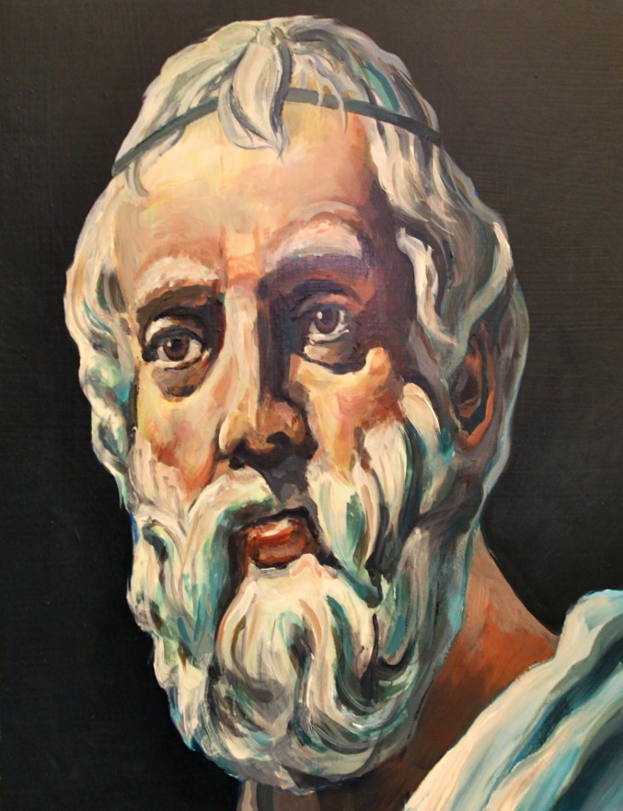
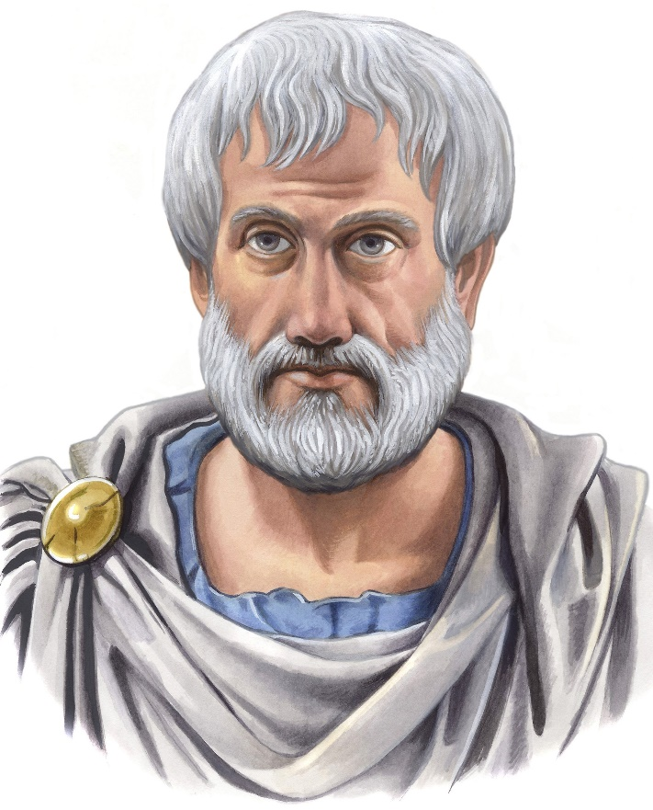
3 Great Greece Philosophers & Founders of Western Philosophy
Socrates Plato Aristotle
(470 – 399 BC) (399 – 387 B.C.E) (c. 384 B.C. – 322 B.C.)

Slide 9
Importance of Greece City of Athens -
Athens, one of the world’s oldest cities with a history of over 3,400 yrs. & its earlier human presence start somewhere bet. 11th & 7th millennium B.C.
Ancient Greek philosophy arose in the 6th century B.C.
Socrates, Plato & Aristotle - laid foundations to many believes of Western World. They cover enormous amount of topics like - political philosophy, ethics, metaphysics, ontology (study of nature of being, becoming, existence/reality), logic, biology, rhetoric & aesthetics (branch of philosophy deal with art, beauty & taste).
Socrates was born in Athens in 470 BC & is considered as one of the founders of Western philosophy. His largest contribution to philosophy is Socratic method.

Slide 10
Socratic method is defined as a form of inquiry & discussion between individuals, based on asking & answering questions to illuminate ideas.
The principle underlying Socratic Method is that humans learn through the use of reasoning & logic.
Plato, student of Socrates, is known as the founder of the Academy in Athens, the first institution of higher l earning in the Western world.
Plato’s contributed Theory of Forms. This theory was created to solve two problems, one of ethics & one of permanence & change.
Aristotle, student of Plato, lived from 384 BC-322 BC. At 18, he joined Plato’s Academy in Athens & remained there until age of 37.

Slide 11
There, he honed his talents of understanding the world. In his understanding of the world, he wrote his theory of the universals which is extremely intriguing.
In simpler terms, he believes universals exist only in things, never apart from things - differing from his teacher, Plato. Aristotle believes that a universal is identical in each of its instances. All round things are similar in that there is the same universal, characteristic, throughout.
AD is Anno Domini/Year of our Lord referring to year of Christ’s birth.
BC is Before Christ
CE is a recent term. It refers to Common Era & is used in place of A.D. the dates are the same i.e., 2009 AD is 2009 CE.
BCE is Before Common Era.

