Slide 1
Module – I
Introduction to Literary Criticism
1) Nature of Criticism (सामिक्षणाचे गुणधर्म) - Etymologically (उत्पत्तीशास्त्रानुसार) the word ‘Criticism’ is derived from Greek word meaning ‘Judgment’ (न्यायनिवाडा).
Criticism is the exercise of judgement & literary criticism is the exercise of judgement on works of literature.
Nature & function of criticism is simple & easy to understand.
Criticism is the play of mind on a work of literature & its function is to examine its excellencies (उत्कृष्ट) & defects (दोष) & finally evaluate its artistic worth (कलात्मकतेचे मूल्यमापन).

Slide 2
However, things are not quite so simple as that. As soon as we proceed to examine the nature & function of criticism in some detail, we are confronted (तोंड देणे) with a host of conflicting views (परस्पर विरोधी दृष्टीकोन), theories (सिद्धांत) & definitions (व्याख्या).
Diversity of views – Following statements on criticism give us an idea of the complexity of critical theories (सामिक्षणाचे सिद्धांत) came to us through ages.
According to S.M. Schreiber, ‘‘Business of literary critic is to distinguish between a good book & a bad one & help us to recognize full value of its literary quality.’’

Slide 3
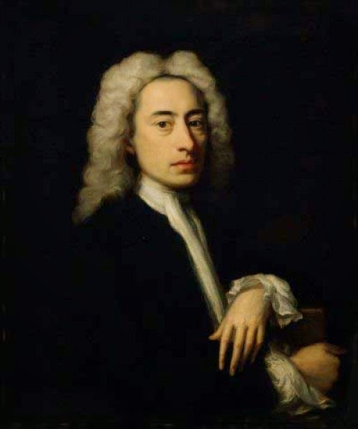
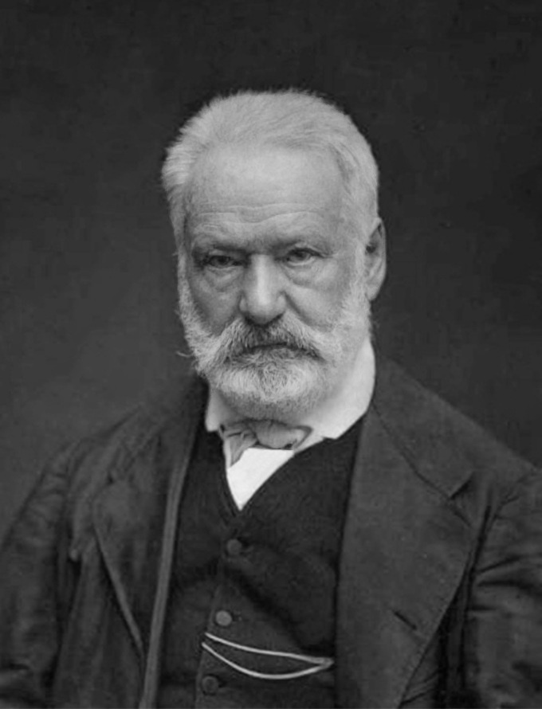
Atkins – Criticism is the play of the mind on the aesthetic qualities of literature for interpretation of literary values.
Addison – The true critic will dwell on excellencies rather than imperfections.
Victor Hugo – It is the work of good or bad that is the critics domain ?

Slide 4
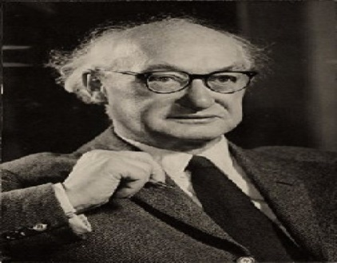
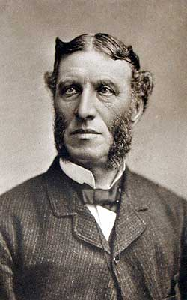
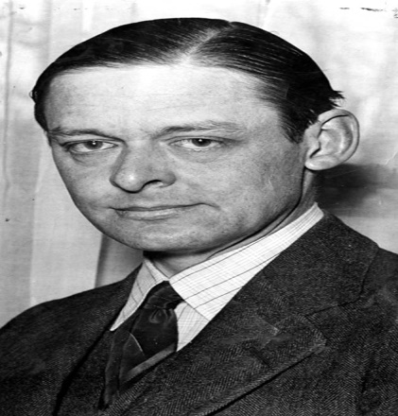
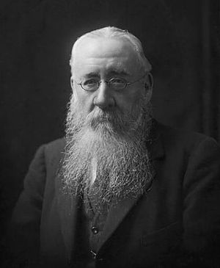
I.A. Richards – To set up as a critic is to set up a judge of value.
Matthew Arnold – Criticism is a disinterested (निस्वार्थी) endeavour (परिश्रम) to learn & propagate (प्रसार) the best that is known & thought in the world.
T.S. Eliot – End of criticism is ‘elucidation (स्पष्टीकरण) of works of art & the correction of taste.’
Saintsbury – Criticism busies itself with the goodness or badness, the success/ill-success of literature from purely literary point of view.

Slide 5
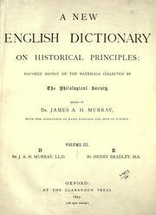
New English Dictionary – Criticism is the art of estimating the quality & character of a work of art & the function/work of a critic.
Views regarding functions of criticism & role of critics is changing through the ages. Every age has different functions of criticism.
Diversity of views & lack of unanimity (एकमत) among thinkers bring out complex nature of criticism & its functions.
There are many critics & theories. This is because attitude (दृष्टीकोन) towards criticism is determined by many factors.

Slide 6
First of all, it is determined by accidents of personal organization, by likes & dislikes, by prejudices (पूर्वग्रह) & predilections (भविष्यवाणी) of critic himself. View of criticism is directly related to critic’s own intellectual pre-occupation (बौद्धिक एकाग्रता) & his philosophy/outlook on life.
Critical theories become complex due to difference in outlook on life, pre-occupations & predilections from individual to individual. A critic with a moral & religious bias would think that the function of criticism is to examine the moral worth & significance of a work of literature.

Slide 7
On the contrary (उलट), a critic with a artistic mind be of view that function of criticism is chiefly aesthetic appreciation (सौंदर्य रसग्रहण).
Secondly, theory of criticism is closely connected with theory of poetry. Therefore, idea of criticism varies in accordance with idea of literature.
Neo-classical criticism is built upon neo-classical theory of literature & romantic emphasis on individualism (व्यक्ती स्वातंत्र्यवाद) accounts for the romantic impressionistic (प्रभावी) view of criticism.

Slide 8
Thirdly, critical theories are closely connected with spirit of age-intellectual & moral environments in which critic lives.
Thus, in modern age with development in social & behaviourial sciences (वर्तवणूक विज्ञान) like psychology, sociology, anthropology (मानववंश शास्त्र), etc, we have psychological & sociological approach to criticism.
Marxism (मार्क्सवाद) has given rise to ‘Marxist theory of literary criticism’ & Existentialism (अस्थित्ववाद) accounts for ‘Existential criticism’.

