Slide 1
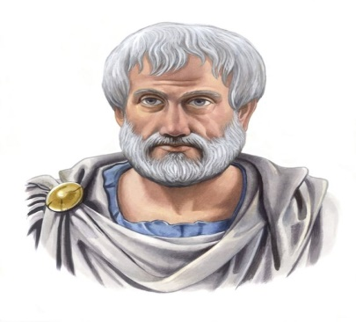
Module II
Classical Criticism
2) The Ideal Tragic Hero (From Aristotle’s Poetics)
Feelings of pity & fear are necessary for the spirit of tragedy. Aristotle’s views in “Poetics” define perfect & ideal tragic hero.
Greek tragedies are still being read & even dramatized in the world & it is because of their perfect tragic heroes.
Characteristics of an ideal tragic hero, given by Aristotle, are widely accepted in the world.
If a tragedy is written on the basis of Aristotelian concept, it will indeed evoke catharsis.

Slide 2
Aristotle’s Views on Ideal Tragic Hero : In Chapter XIII of his “Poetics”, the earliest surviving work of dramatic theory & first extant philosophical treatise to focus on literary theory.
This text refers to poetry/more literally "the poetic art," deriving from the term for "poet ; author ; maker’’.
In Aristotle’s opinion, a hero should neither be entirely bad nor completely good but a combination of both. He should be noble by birth. Hero should suffer. Women are not good for tragedy.
Mixture of Good & Bad in Hero : One of the important characteristics of an ideal tragic hero is that it should be a person, having both good & bad qualities.

Slide 3
Aristotle says that neither a good character can be an ideal tragic hero nor can a bad character fulfill the purpose of a true tragedy. Reason behind it is that a good character will not create fear, which is an important ingredient of tragedy.
God like person’s sufferings are not justified at all. It will only create sympathy. Hence, an ideal tragic hero in Aristotle’s views is the one who is possessor of both good & bad qualities. However, Aristotle has faced a lot of criticism on this point.
Tragic Hero Should be a Noble Person : Aristotle expresses his views further & says that tragic character should be noble by birth & he must fall from prosperity to adversity.

Slide 4
In this way, a totally bad person is also not good for a tragedy. If a villain suffers then his sufferings are entirely justified because he deserves it. He will neither evoke pity nor fear which is totally alien to the spirit of tragedy.
Noble characters are best for a tragedy. Suffering of a noble person is more effective than the sufferings of a person from lower class.
There is more interest & fear in seeing a noble man falling from a position of lofty eminence.
Sufferings : It is integral part of tragedy. No tragedy is called complete until hero suffers. Of course, suffering is base of a tragedy.

Slide 5
Tragic hero, who is combination of both good & bad qualities, should suffer because of an error/frailty, called hamartia. It can be an error of judgement/a bad decision of the character/any other thing which leads him to destruction.
Aristotle gives much importance to hamartia & adds that sufferings of tragic hero can also be the reason of unavoidable circumstances.
Women & Aristotle’s Views on Ideal Tragic Hero : Aristotle has something more to say in definition of a tragic hero. He does not consider a woman suitable for tragedy. Women, in his eyes are inferior & are not perfect tragic heroines.

