Slide 1
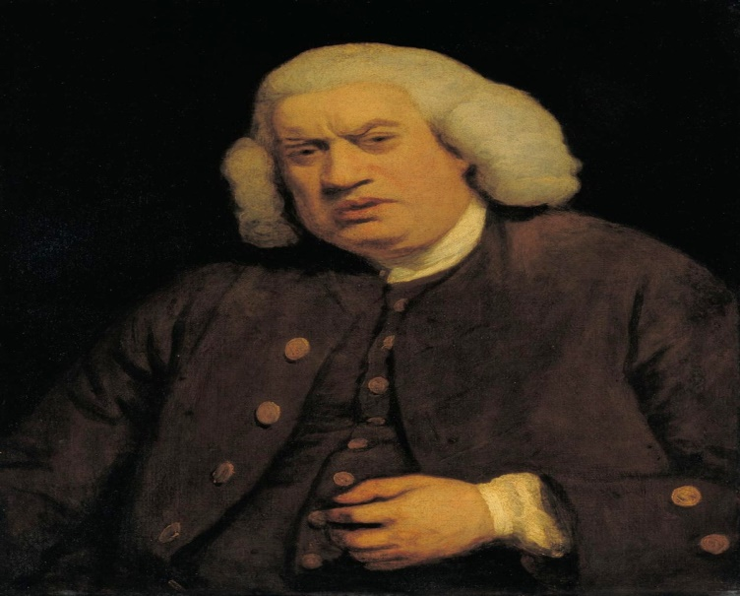
Dr. Samuel Johnson’s
Preface to Shakespeare (1765)
By
Dr. P.S. Sontakke
Samuel Johnson (1709-1784) was an extremely prolific writer of 18th century who worked in a variety of fields & forms.
His preface to The Plays of William Shakespeare (1765) is a classic document of English literary criticism.
According to Johnson, Shakespeare's characters are a representation of human nature as they deal with passions & principles which are common to humanity.

Slide 2
        They are also true to the age, sex, profession to which they belong & hence speech of one can’t be put in the mouth of another.
His characters are not exaggerated. Even when the agency is supernatural, the dialogue is level with life.
Shakespeare's plays are a storehouse of practical wisdom & from them can be formulated a philosophy of life.
Moreover, his plays represent the different passions & not love alone. In this, his plays mirror life.
Shakespeare’s use of comedy : Shakespeare is much criticized for mixing tragedy & comedy, but Johnson defends him.

Slide 3
Johnson says that in mixing tragedy & comedy, Shakespeare has been true to nature, because even in real life there is a mingling of good & evil, joy & sorrow, tears & smiles etc. this may be against the classical rules, but there is always an appeal open from criticism to nature.
Moreover, tragic-comedy being nearer to life combines within itself pleasure & instruction of both tragedy & comedy.
His use of tragi-comedy doesn’t weaken effect of a tragedy because it does not interrupt progress of passions. In fact, Shakespeare knew that pleasure consisted in variety. Continued melancholy/grief is often not pleasing. Shakespeare had power to move, whether to tears/laughter.

Slide 4
Shakespeare’s comic genius : Johnson says that comedy came natural to Shakespeare. He seems to produce his comic scenes without much labour & these scenes are durable & hence their popularity hasn’t suffered with passing of time.
Language of his comic scenes is language of real life which is not gross & over refined. He writes tragedies with great toil (परिश्रम) & study, but there is always something wanting in his tragic scenes.
His tragedy seems to be skill, his comedy instinct.
Shakespeare’s histories are neither tragedy nor comedy & hence he is not required to follow classical rules of unities.

Slide 5
The only unity (Time, Place, Action) he needs to maintain in his histories is the consistency & naturalness in his characters & this he does so faithfully. In his other works also, he maintained well the unity of action.
His plots have the variety & complexity of nature, but have a beginning, middle & an end & one event is logically connected with another & the plot makes gradual advancement towards the denouement.
Shakespeare shows no regard for the unities of Time & place & according to Johnson. The observance of these unities is considered necessary to provide credibility to drama.

Slide 6
But, any fiction can never be real & audience knows this. A spectator (प्रेक्षक) imagines much more than performed on stage.
Imitations produce pleasure/pain, not because they are mistaken for reality, but because they bring realities to mind.
Therefore, unity of Action alone is sufficient, & the other two unities arise from false assumptions. Hence, it is good that Shakespeare violates them.
Faults of Shakespeare : He writes without moral purpose & is more careful to please than to instruct. There is no poetic justice in his plays. This fault cannot be excused by the barbarity (क्रौर्य) of his age for justice is a virtue independent of time & place.

Slide 7
Next, his plots are loosely formed. He neglects opportunities of instruction that his plots offer. He neglects the later parts of his plays & his catastrophes (संकट/आपत्ती) seem forced & improbable.
There are many faults of chronology & many anachronisms (कालबाह्य) in his play. His jokes are often gross & licentious (व्याभिचारी). Narration in his dramas is tedious (कंटाळवाणा). His set speeches are cold & weak. They are verbose (पाल्हाळीक) & too large for thought.
Trivial (क्षुल्लक) ideas are clothed in sonorous epithets (प्रभावी उपकरणे). He is too fond of puns (पंजे) & quibbles (बडबड्या).

Slide 8
For a pun, he sacrifices reason, propriety & truth. He often fails at moments of great excellence. Some contemptible (तिरस्करणीय) conceit (घमेंडी) spoils the effect of his pathetic (करुणास्पद) & tragic scenes.
Merits of Shakespeare : He perfected blank verse, imparted to it diversity & flexibility & brought it nearer to language of prose.

