Slide 1
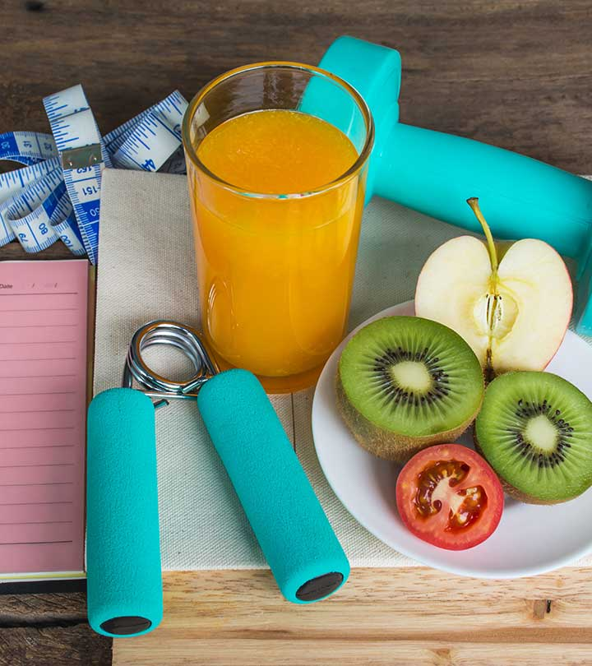
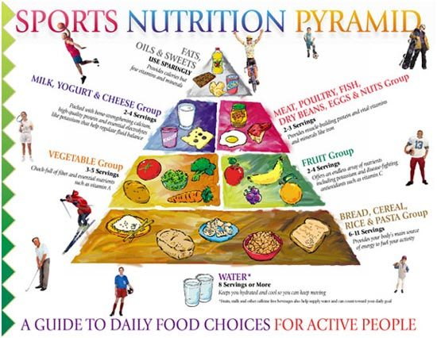
Diet and Health for Sportsman
Dr. Ila Jogi
Head, Department of Home Science
Mahila Mahavidyalaya, Karad

Slide 2
What do you mean by Health?
According to WHO,
“Health is a state of complete of physical, mental and social well being and not merely the absence any disease or infirmity”

Slide 4
Mental Health
Mental health is defined as a state of well-being in which every individual realizes his or her own potential, can cope with the normal stresses of life, can work productively and fruitfully, and is able to make a contribution to her or his community.

Slide 5
Signs of Good mental Well Being
Feel relatively confident in yourself and have positive self-esteem.
Feel and express a range of emotions.
Build and maintain good relationships with others.
Feel engaged with the world around you.
Live and work productively.
Cope with the stresses of daily life.

Slide 7
Ways To Acheive a Healthy Wealthy Life
Healthy Food
Regular Exercise
Good Thoughts
Sleep Management

Slide 21
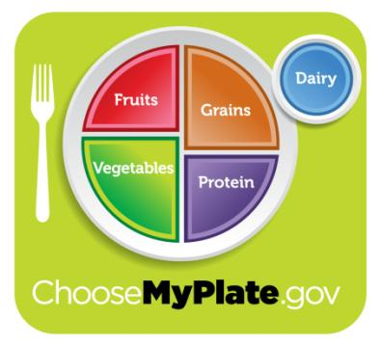
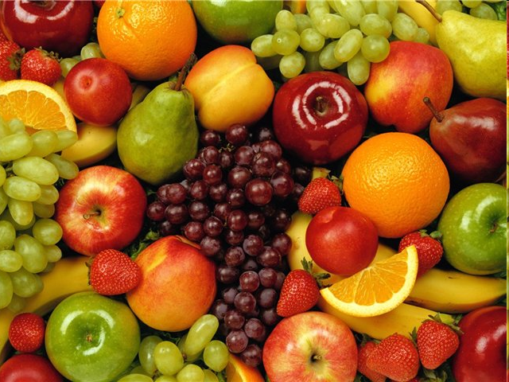
WHAT TO EAT????
HEALTHY FOOD

Slide 22
Functions of Food:
Energy Yielding
Body Building
Protective food stuffs

Slide 23
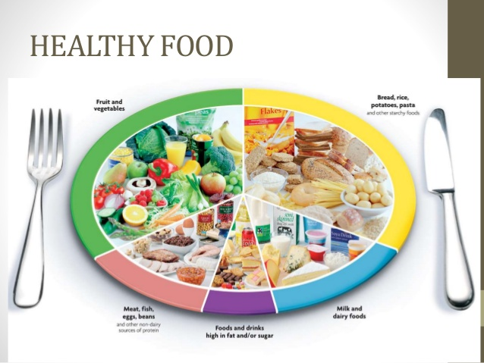

Slide 24
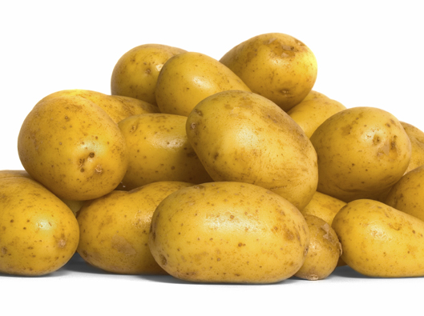
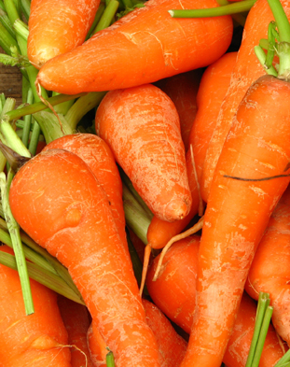
A balanced diet contains all the food types in the right amounts to stay healthy.
carbohydrates
For energy
For energy
Prevents constipation
sugar
starch
fibre

Slide 25
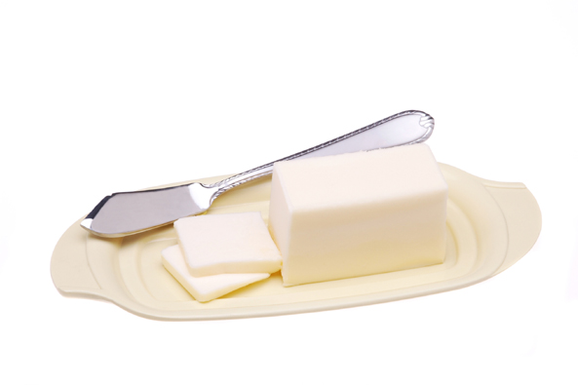
A balanced diet contains all the food types in the right amounts to stay healthy.
fats
For energy and insulation

Slide 26
CARBOHYDRATES
Carbohydrates:
All the sportspersons and active people should maintain a good inflow of this nutrient as it is an important source of fuel required by the body. Carbohydrate raises blood glucose level in the body.
*** What are the types of carbohydrates ? There are two main types of carbohydrates:
Complex carbohydrates
Simple carbohydrates

Slide 27
FATS
This type of food is not very good for us, but are still for our needed by our body. So it is important not to eat it very often but in proper proportion.
Fat has the best concentration of energy. Do not think that you cannot eat before an exercise routine. The fact is – a low fat meal can be absorbed easily and a high fat meal must be skipped before workout.

Slide 28
PROTEINS
Proteins are part of every cell, tissue, and organ in our bodies. These body proteins are constantly being broken down and replaced. The protein in the foods we eat is digested into amino acids that are later used to replace these proteins in our bodies.
Proteins are very important in the diet plan of a sportsperson as they are responsible for carrying oxygen in the body and are also the cell damage & cell formation agents. These must be obtained from dairy, non-vegetarian, fruits and vegetable type diets.

Slide 29
Vitamins and Minerals
Vitamins are organic substances (made by plants or animals), minerals are inorganic elements that come from the earth; soil and water and are absorbed by plants. Vitamins and minerals are nutrients that your body needs to grow and develop normally.

Slide 30
VITAMINS
vitamins
vitamin C
vitamin D

Slide 31
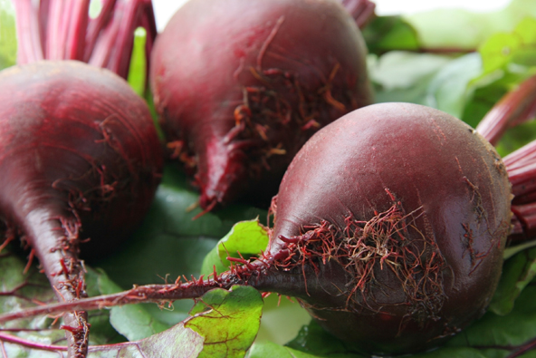
MINERALS
minerals
Iron
Calcium

Slide 32
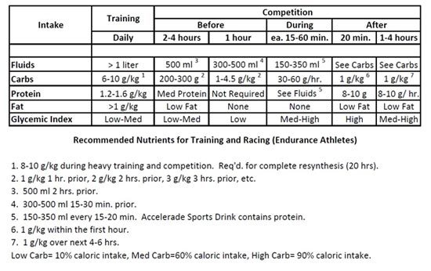
Nutrition Requirement of Sportsperson
The guidance and the timely facts about the required nutrients will even make a sportsperson fall in line with his or her routine. An appropriate nutritional diet for a sports person consists of a minimum of 2000 calories per day, in which the division from different nutrients are as follows
55–65% from Carbohydrates
15–20% from Proteins
20–30% from Fats

Slide 43
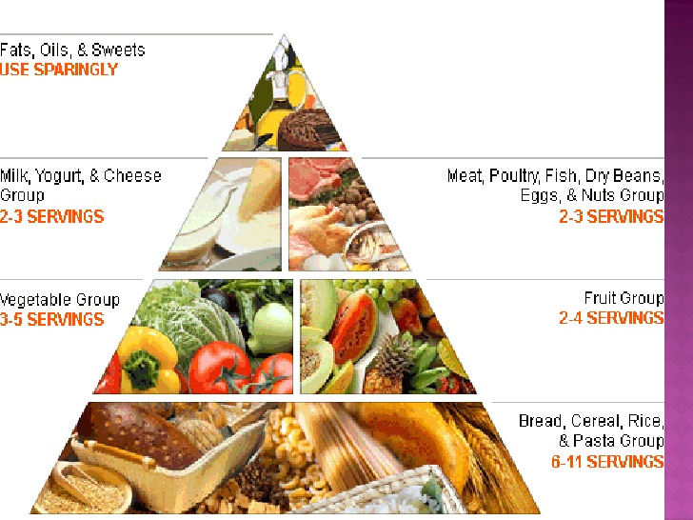

Slide 48
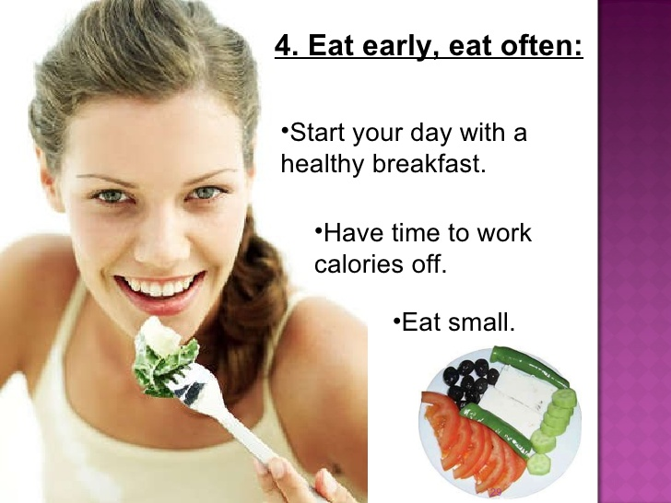

Slide 49
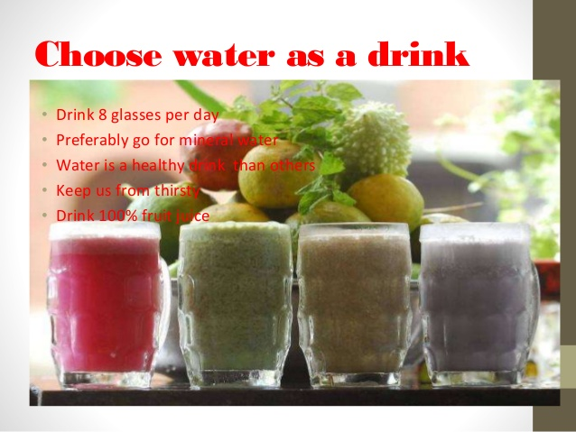

Slide 50
Eight tips for healthy eating
The Department of Health has produced the following practical tips to help you make healthier choices. They are:
Base your meals on starchy foods
Eat lots of fruit and veg
Eat more fish
Cut down on saturated fat and sugar
Eat less salt
Get active and be a healthy weight
Don’t get thirsty
8)Don’t skip breakfast
Source: NHS Choices 2012

Slide 51
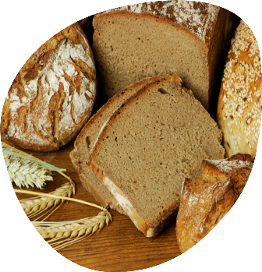
1. Base your meals on starchy foods
We should eat plenty of starchy foods. These should make up a third of our diet, as shown in The eatwell plate.
Starchy foods provide energy (calories), as well as dietary fibre, calcium, iron and B vitamins.
Why should we choose wholegrain varieties whenever possible?
They contain more fibre and make you feel fuller for longer.

Slide 52
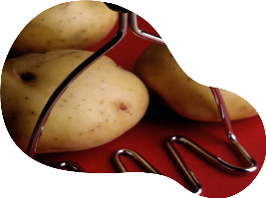
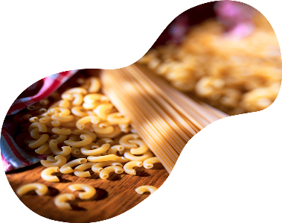
1. Base your meals on starchy foods
Most people need to eat more of these types of foods, so try to include an item from this group in each of your main meals.
Can you think of some ideas?
Breakfast – porridge or wholegrain cereals.
Lunch –sandwich made with wholemeal bread, jacket potato or wholegrain rice salad.
Dinner – pasta, potatoes or rice with your evening meal.

Slide 53
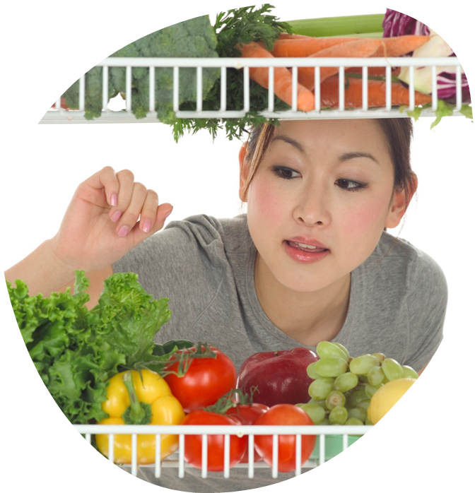
2. Eats lots of fruit and veg
Try to eat at least 5 portions of a variety of fruit and vegetables every day (5 A DAY).
Fruit and vegetables provide a range of nutrients, including vitamins and minerals, such as folate, vitamin C, potassium and dietary fibre.

Slide 54
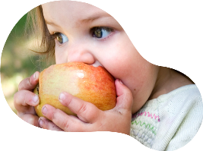
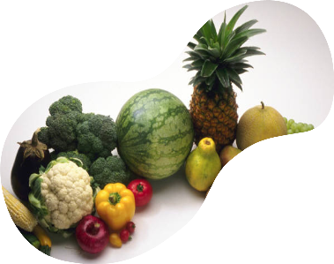
2. Eats lots of fruit and veg
Fresh, frozen, canned, dried
and juiced fruit and vegetables
all count.
Potatoes do not count towards
5 A DAY as they are a starchy food.
What is a portion?
One adult portion of fruit or vegetables is 80g.
Young children may need less depending on their age and size. As a rough guide, one portion is the amount they can fit in the palm of their hand.

Slide 55
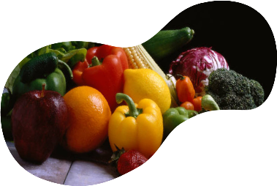
Did you know?
Only one glass of juice counts towards our 5 A DAY, no matter how much we drink.
This is because much of the fibre is lost through juicing.
A smoothie containing all the edible pulped fruit or vegetable may count as more than one 5 A DAY portion.

Slide 56
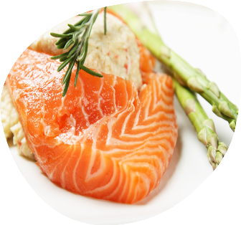
3. Eat more fish
Fish is a good source of protein and provides many vitamins and minerals.
White fish is low in fat. Oily fish are rich in long chain omega 3 fatty acids which are important for heart health.
Try to eat at least two portions (1 portion =140g) of fish a week, including a portion of oily fish.
Can you name some oily fish?
Salmon, mackerel, trout, fresh tuna* and sardines are all oily fish.
* Only fresh tuna counts as an oily fish. When it is canned the amount of long-chain omega 3 fatty acids is reduced to levels similar to those in other fish.

Slide 57
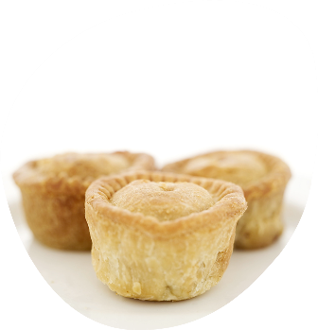
4. Cut down on saturated fat and sugar
We all need some fat in our diet, but it is important to get the right type and amount.
There are two main types of fat: saturated and unsaturated.
Eating too much saturated fat can increase blood cholesterol levels and the chance of developing heart disease.
Saturated fat is found in many foods, such as hard cheese, cakes, biscuits, pies, pastry, cream and butter.

Slide 58
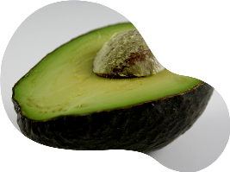
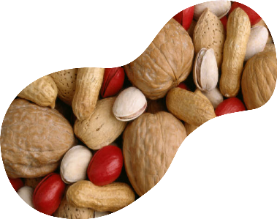
4. Cut down on saturated fat and sugar
Try to cut down on foods high in saturated fat and replace with foods that are high in unsaturated fats, such as vegetable oils, oily fish, avocados, nuts and seeds.
Did you know?
Most of us eat about 20% more than the recommended maximum amount. No more than 11% of dietary energy should come from saturated fat.

Slide 59
4. Cut down on saturated fat and sugar
Too many sugar-containing food and drinks consumed between meals is associated with an increased tendency towards tooth decay, especially in those with poor dental hygiene.
Food and drinks high in sugar include sweets, cakes,
biscuits and some carbonated drinks.

Slide 60
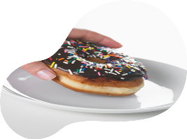
4. Cut down on saturated fat and sugar
Use food labels to check how much saturated fat and sugar foods contain.
More than 5g of saturated fat per 100g of food means that it is high in saturates.
More than 15g of sugar per
100g of food means that the food is high in sugar.

Slide 61
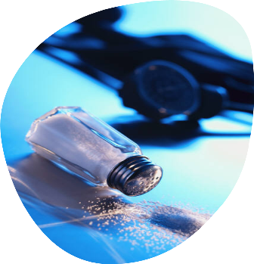
5. Eat less salt
Maintaining a normal blood pressure is important for health.
Eating too much salt may raise blood pressure and lead to stroke and heart disease.
Approximately three-quarters of the salt in our diet comes from processed foods such as bread, breakfast cereals, soups, sauces and ready meals.
Some is also added during cooking, or at the table.

Slide 62
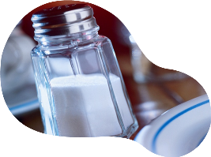
5. Eat less salt
Did you know?
Adults should eat no more than 6g of salt each day, children under 11 years should eat less.
You can use food labels to help you cut down.
More than 1.5g of salt per 100g means the food is high in salt.
Salt is also called sodium chloride. Sometimes, food labels only give the figure for sodium. To work out how much salt you are eating from the sodium figure:
Salt = sodium x 2.5

Slide 63
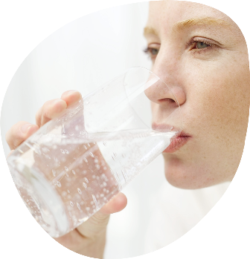
7. Don’t get thirsty
Around two-thirds of the body are made up of water. We lose water throughout the day when we breathe, sweat and use the toilet.
When our bodies do not have enough water, we are said to be dehydrated. We need to drink around 6-8 glasses of fluid every day to stop us getting dehydrated. More when the weather is hot or when we are active.
Apart from water, most drinks count – but not alcohol. Good choices are fruit juice, milk, tea, coffee and low-calorie soft drinks.

Slide 64
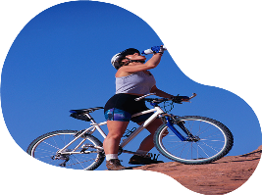
7. Don’t get thirsty
Did you know?
Common signs of dehydration are:
thirst;
dark-coloured urine;
not passing much urine when you go to the toilet;
headaches;
lack of energy;
feeling lightheaded.

Slide 65
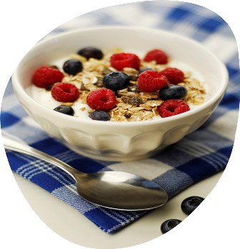
8. Don’t skip breakfast
Eating breakfast provides us with energy as well as some important nutrients that we need for good health.
Breakfast can help to increase concentration and alertness during the morning.
For example, a healthy breakfast of wholegrain breakfast cereal or a slice of toast with low fat spread and a glass of fruit juice, will give our bodies the energy and nutrients we need to start the day.

Slide 66
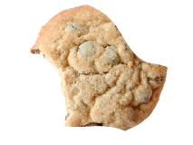
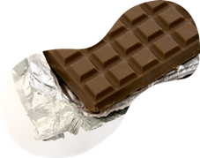
8. Don’t skip breakfast
Did you know?
Some people skip breakfast because they think it will help them lose weight.
Skipping breakfast means we are more likely to fill up on snacks that are high in fat and/or sugar before lunch.
Research shows that eating breakfast can help people control their weight.

Slide 67
Healthy Eating Myths
It doesn’t matter what I eat as long as I do lots of exercise.
Back to Introduction

Slide 68
Healthy Eating Myths
It doesn’t matter what I eat as long as I do lots of exercise.
Wrong! Exercise is good for you, but it still matters what you eat. Eating the right foods means we can learn better and exercise better too!
Back to Introduction

Slide 69
Healthy Eating Myths
Chocolate is bad for you!
Back to Introduction

Slide 70
Healthy Eating Myths
Chocolate is bad for you!
It’s true that chocolate isn’t the healthiest snack – but it isn’t innately bad either! So, some chocolate can be part of a balanced diet. Plain (dark) chocolate is better for you thank milk; it is higher in iron.
Back to Introduction

Slide 71
TO SUMMARIZE
Eight tips for healthy eating
Remember:
Base your meals on starchy foods
Eat lots of fruit and veg
Eat more fish
Cut down on saturated fat and sugar
Eat less salt
Get active and be a healthy weight
Don’t get thirsty
8)Don’t skip breakfast
Source: NHS Choices 2012

Slide 72
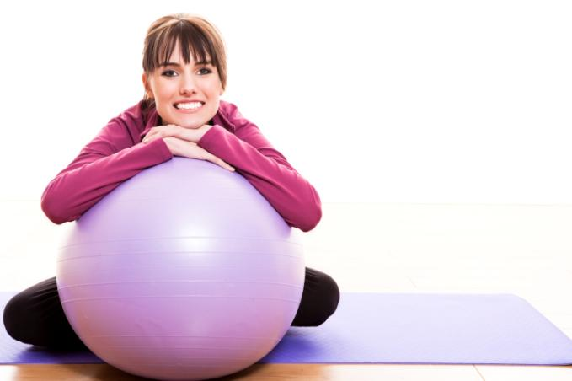
DAILY EXERCISE

Slide 73
REGULAR EXERCISE
It also improves your respiratory system which in turn improves your whole body working. There are lots of benefit of regular exercise. It Refresh not only your body but also your mind.
You need to do two types of physical activity each week to improve your health–aerobic and muscle-strengthening. For Important Health BenefitsAdults need at least:

Slide 74
WHAT TO DO?????
150 minutes of brisk walking every week and muscle-strengthening activities on 2 or more days a week that work all major muscle groups (legs, hips, back, abdomen, chest, shoulders, and arms).
75 minutes of vigorous-intensity aerobic activity like jogging or running every week and muscle-strengthening activities on 2 or more days a week that work all major muscle groups like legs, hips, back, stomach.

Slide 75
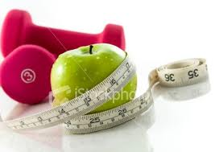
Try going for a 10-minute brisk walk, 3 times a day, 5 days a week. This will give you a total of 150 minutes of moderate-intensity activity.

Slide 77
6. Get active and be a healthy weight
To achieve a healthy weight, we need to balance the energy from food and drinks with the energy we use up through activity.
Being active can help maintain a healthy weight by using more energy.
Being overweight or obese can lead to health conditions such as type 2 diabetes, some cancers, heart disease and stroke.
Being underweight could also affect our health.

Slide 78
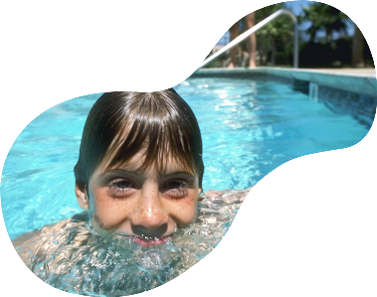
6. Get active and be a healthy weight
Did you know?
Young people should do at least 60 minutes of physical activity of moderate to vigorous intensity every day.
Adults should aim to be active daily and achieve at least 150 minutes of physical activity of moderate intensity over a week.
What does being active mean?

Slide 79
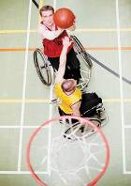
6. Get active and be a healthy weight
Being active means …
Active living, e.g. brisk walking, gardening, using the stairs.
Active recreation, e.g. playing, dancing, cycling, skateboarding.
Organised sport, e.g. basketball, netball, running, gymnastics.

Slide 80
SO..LETS LOOK AT ADVANTAGES OF SPORTS

Slide 81
BMI...

Slide 82
WHAT IS BMI ????

Slide 85
GOOD THOUGHTS
One's thoughts plays the most powerful weapon to rule over your own body. So, keep your thoughts positive and body healthy.
Healthy mind can be achieved only through our efforts and proper health care.

Slide 86
Becoming A Positive Thinker
Positive Thinking Focusing on what is good about yourself, other people, and the world around you.
Optimism The tendency to expect the best possible outcome.
Attitude A belief or opinion that predisposes you to act in a certain way.
Success Secret
Positive thoughts lead to positive feelings and actions.

Slide 87
The Power of Positive Thoughts

Slide 88
Negative Thinking And Pessimism
Negative Thinking Focusing on the flaws and problems in yourself, other people, and the world around you.
Pessimism The tendency to expect the worst possible outcome.
Success Secret
Negative thinking blocks you from taking risks, making changes and expressing your real self.
Activity 24: Are You A Positive Thinker?

Slide 89
Adopting Positive Habits
Look For The Good
Focusing on the Good.
Choose Your Words
Make a habit of speaking positively to people.
Surround Yourself With Positive People
Seek the company of positive people who share ideas.
Accept, Don’t Judge
Strive to accept people as they are.
Limit Complaints
Instead of complaining, take constructive action.

Slide 90
When Faced With Worry, Strategize…
Focus on solutions, not worst-case scenarios.
Cope, don’t avoid. Take action!
Share your worries. Talk with a friend.
If you really can’t do anything about the situation, try to let the worry go.
Drown out the worry with positive affirmations.
Channel your nervous energy into physical activity.

Slide 91
Your Thinking Style And Your Health
Positive Thinking can make us mentally and physically healthy.
Negative Thinking can delay healing and cause us to neglect our health.
Depression An illness characterized by profound feelings of sadness, hopelessness, and helplessness.
Success Secret
Thinking well can make you well.

Slide 92
SLEEP MANAGEMENT
We should get up early in the morning, go out for a walk, breathe in fresh air in order to keep our lungs clean, and take brisk walk, move arms while walking.
We should take proper 8 to 9 hours of sleep during a day. Balance sleep and rest are also useful in keeping your body healthy.

Slide 93
To Get a Good Night’s Sleep – Practice Good Sleep Hygiene!
Maintain a regular sleep / wake schedule whenever possible … even on weekends and vacations
Avoid napping during the day, especially after 3pm. Limit naps to < 1 hour.
Establish a regular, relaxing bed time routine

Slide 94
Guidelines For Better Sleep
Exercise regularly – but not within 2 hours of sleep
Avoid eating large meals just before going to sleep
Avoid caffeinated beverages, particularly after lunch
Avoid the use of alcohol and nicotine as these substances can disrupt sleep

Slide 95
Environmental Factors Impacting Sleep
Light – exposure to light inhibits ability to fall asleep and bright light in the morning can shorten sleep
Noise – traffic, TV, music, phones, and computers can disturb sleep
Bed sharing
Room temperature (too hot or too cold can inhibit sleep)

