Slide 1

Beneficial Bacteria

Slide 2
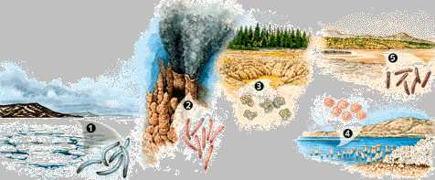
Fuel Production
Archaebacteria produce methane gas, which makes up 20% of the world’s natural gas used for fuel.

Slide 3
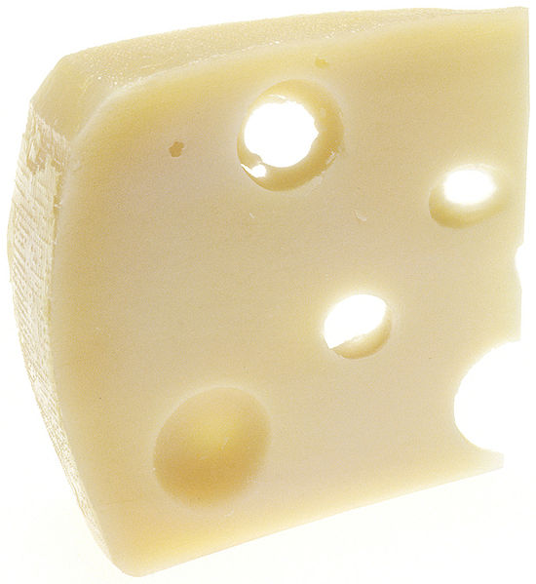
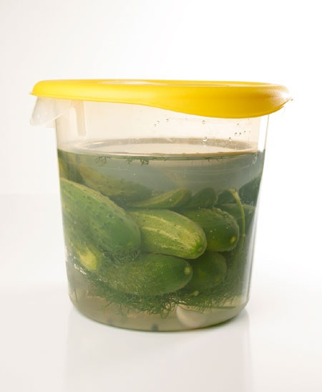
Food Production
Lactobacillus and other bacteria turn milk into buttermilk, sour cream, yogurt, and cheeses.
Other bacteria turn apple cider into vinegar, and cucumbers into pickles.

Slide 4
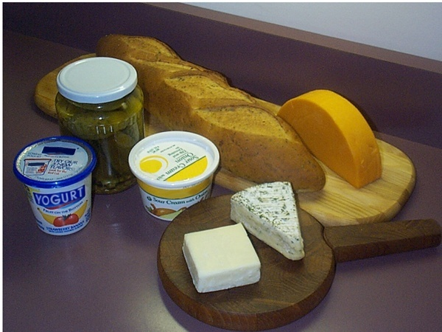
Definition
Beneficial microorganisms
Helpful bacteria and fungi that are either added or naturally occur in foods.
Create unique flavors
and textures or improve
the body’s ability to
digest foods or fight
disease.
Notes:
Beneficial microorganisms
Helpful bacteria and fungi that are either added to or naturally occur in foods. These microorganisms are used to create unique flavors and textures in food.

Slide 5
Microorganisms involved in different food….
Cucumbers → Pickles
Cabbage → Sauerkraut
Milk → Yogurt, cultured buttermilk, cheese
Meats → Summer sausage, pepperoni
Notes:
Beneficial microorganisms
Helpful bacteria and fungi that are either added to or naturally occur in foods. These microorganisms are used to create unique flavors and textures in food.

Slide 6
Micro-organisms in Milk
The types of m.o found in milk vary considerably
Bacteria, yeasts, moulds and bacteriophages are commonly encountered.
Viruses and protozoa are seldom observed in milk, except as occasional contaminants.

Slide 7
Bacteria
The most important
bacteria used in food
production are the
Lactobacillaceae family.
This family produces
lactic acid from
carbohydrates, resulting
in changes in certain foods.
Example: milk to yogurt.
Notes:
Bacteria
The most important bacteria used in food production are the Lactobacillaceae, family which have the ability to produce lactic acid from carbohydrates. For example in producing yogurt from milk.

Slide 8
Bacteria
Most common and most numerous of m.o found in milk and milk products .
They belong to four main groups:
Gram +ive cocci
Gram +ive non-spore forming rods
Gram +ive spore-forming rods
Gram -ive non-spore forming rods.
+
₊₊₊₊

Slide 9
Lactic Acid Bacteria
Normally present in milk and they are also used as starter culture for the production of cultured dairy products. They ferment lactose and yield lactic acid.

Slide 10
LAB reclassified (older names in parenthesis).
Lactococci
L.delbrueckii sub sps.lactis (Str.Lactis)
L. Lactis sub sps. Cremoris (Str. Cremoris)
Lactobacili
L. Casei
L. delbrueckii sub.sps.lactis (L. Lactis).
L. delbrueckii sub Sps. bulgaricus (L.bulgaricus)
Leuconostoc

Slide 11
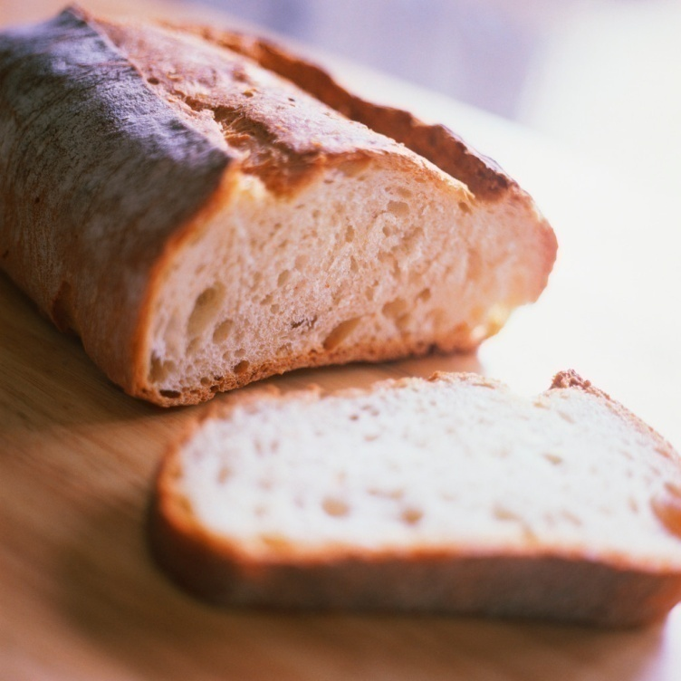
Yeast
The most beneficial yeasts for food production are from the genus Saccharomyces.
Yeasts produce desirable
chemical reactions.
Example: leavening of
bread and production of
alcohol.
Notes:
Yeast
The most beneficial yeasts in terms of food production are from the genus Saccharomyces. Yeasts play an important role in food microbiology as they produce enzymes that favor desirable chemical reactions such as the leavening of bread and the production of sugars.

Slide 12
Molds
Molds from the genus Penicillium are associated with the ripening and flavor of cheeses.
Notes:
Molds
Molds from the genus Penicillium are associated with the ripening and flavor of cheeses.

Slide 13
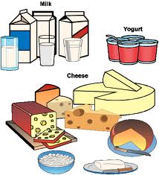
1. Buttermilk, Sour cream, Kefir and Koumis
Different products are produced by using different strains of lactic acid bacteria as starter cultures and different fractions of whole milk as the starting substrate.
Sour cream uses Streptococcus cremoris or S. lactis for producing lactic acid and Leuconostoc cremoris for characteristic flavour.
Cream is starting substrate. Butter is normally made by churning cream that has been soured by lactic acid bacteria.
Streptococcus cremoris or S. lactis is used to produce lactic acid rapidly and Leuconostoc citrovorum produces necessary flavors.
Kefir and Koumis, popular in Europe are fermentation products of S. lactis, S. cremoris, other Lactobacillus spp and yeasts.

Slide 14
2. Yoghurt.
How do we know there are beneficial microorganisms in yogurt?
Are they listed in the ingredients?
What does “live active cultures” mean on the container?
  Refers to the living organisms: L. Bulgaricus & S. Thermophilus
  Convert pasteurized milk to yogurt during fermentation
  Help support healthy digestion

Slide 15
3. Cheese.
Cheese consists of milk curds that have been separated from the liquid portion of the milk (whey). The curdling of milk is done by enzyme rennin (casein coagulase or chymosin) and lactic acid bacterial starter cultures.
Cheeses are classified as soft (high, 50-80% water content), semi hard (about 45% water) and hard (a low water content, less than 40%).
They are also classified as unriped if produced by single-step fermentation or ripened if additional growth is required during maturation of the cheese to achieve the desired taste, texture and aroma.
Cottage and cream are soft, unripened cheese; Brie, Camembert and Limburger are soft, 1-5 months ripened cheeses;
Blue, Brick, Gorgonzola, Monterey, Muenster and Roquefort are semi soft, 1-12 months ripened cheeses, whereas Cheddar and Colby are hard, 3-12 months ripened cheeses.

Slide 16
Natural production of cheese involves lactic acid fermentation, with various mixtures of Streptococcus and Lactobacillus spp. used as starter cultures.
The flavour results from use of different microbial starter cultures, varying incubation times and conditions and the inclusion or omission of secondary microbial species late in the process.
Ripening involves additional enzymatic transformations after the formation of cheese curd.

Slide 17
Swiss cheese formation involves a late propionic acid fermentation with ripening done by Propionibacteria shermanii.
Various fungi are also used in the ripening of different cheeses.
The unripened cheese is inoculated with fungal spores.
Blue cheeses are produced by Penicillium spp. Roquefort cheese is produced by using P. roqueforti and Camembert and Brie by using P. camemberti and P. candidum.

Slide 18
Soda
Microorganisms are used to make this can of soda?
citric acid comes from Microbial source-Most common organisms used for production of citric acid are Aspergillus niger, Bacillus subtilis.
Citrus fruit: lemons & limes
Preservative; used to add an acidic or sour taste

Slide 19
Soda (cont)
Demand for citric acid went beyond what could be extracted from citrus fruit
Industry needed an alternative
Mold: 99% of the world’s citric acid is produced with the help of this mold

Slide 20
Fermented Foods
Alcoholic Beverages
  Alcohol is produced from fermentation by the yeast Saccharomyces cerevisiae
Bread
Dairy Products
Other Fermented Foods

Slide 21
Production of Breads
involves growth of Saccharomyces cerevisiae (baker’s yeast) under aerobic conditions
  maximizes CO₂ production, which leavens bread
other microbes used to make special breads (e.g., sourdough bread )
can be spoiled by Bacillus species that produce ropiness

Slide 22
Production of alcoholic beverages
Fermentation of fruit juice results in wine. Most wine is made from grapes.
Beer and ale is produced by the fermentation of malted grains.
Distilled beverages are produced by concentrating alcohol by distillation.

Slide 23
Fermented Foods
Beer
  “Beer is dear”
  Produced by the fermentation of malted grain
    Malted grain: Grain that has been allowed to germinate, then dried in a kiln & perhaps roasted
    Germinating the grain causes the production of a number of enzymes, most notably α- and β-amylase
    Malted grains that may be used are barley, rye, or wheat
    Unmalted grains, such as rice or corn, may also be used

Slide 24
Beer
The starch in malt is converted to sugar by natural enzymes.
Sugars are then fermented by yeasts.
The aqueous extract (wort) is separated by filtration, hops added and boiled for several hours.
Wort is then transferred to fermentation vessel (1-3 weeks).
Yeast used is Saccharomyces carlsbergensis.
    Bottom-fermenting yeasts produce lagers
    Top-fermenting yeasts produce ales
    The beer may be disinfected either by cold filtration through a 0.45 μm filter or by pasteurization

Slide 25
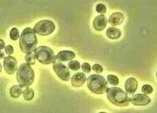
Fermented Foods
Wine
  “Wine is Fine”
  Produced from the fermentation of fruit juice, usually from grapes
  The grapes are crushed to form a “must”
    For white wines, white grapes are usually used, and the skins are removed from the must (“pressing”) before fermentation
    For red wines, red or black grapes are used, and the skin is allowed to remain during fermentation
    For rosé wines, red grapes are used and the juice is allowed to remain in contact with the skins just long enough for a rose or pink color to develop

Slide 26
Wine production
Grapes are harvested and crushed by machines and the juice called must, is squeezed out.
Yeasts used can be of two types – wild yeasts and Saccharomyces ellipsoideus.
Fermentation is carried out in vats of various sizes made of various materials.
Wine is separated from the sediment and then stored at lower temperature for aging.
Dr. NAKADE RCK

Slide 27
Fermented Foods
Wine
  The must undergoes primary fermentation
    Natural yeasts on the skins of the grapes may be used, but in commercial production cultured yeast is often used to give more predictable results
    Malolactic fermentation by bacteria in the must converts malic acid into lactic acid
    After primary fermentation, the must is pressed (red wines) and transferred to different containers for secondary fermentation.
    Secondary fermentation and aging -Takes 3 – 6 months
    Done in either stainless steel vessels or in oaken barrels
    The vessel is kept airtight to prevent oxidation.
    Proteins are broken down, & particles settle
    Blending and bottling

Slide 28
Fermented Foods
Yogurt
  Milk is fermented by a mixture of Streptococcus salivarius ssp thermophilus and Lactobacillus bulgaricus (official name Lactobacillus delbrueckii ssp. bulgaricus). Often these two are co-cultured with other lactic acid bacteria for taste or health effects (probiotics).
  Acid produced from the fermentation causes the protein in the milk (casein) to coagulate into a semisolid curd
  For flavored yogurt, fruit are added after the yogurt is made.

Slide 29
Cheese production
Cheese is one of the oldest human foods and is thought to have developed approximately 8000 years ago.
About 2000 varieties are produced throughout the world.
All cheese results from a lactic acid fermentation of milk, which results in coagulation of milk proteins and formation of a curd.
All the major cheeses produced by dairy fermentation are done by Streptococcus lactis.

Slide 30
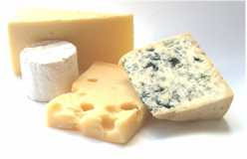
Fermented Foods
Cheese
  Milk is treated with lactic acid bacteria and an enzyme called rennin that partially hydrolyses the protein and causes it to coagulate into “curds.” The liquid portion of the milk at this time is called “whey.”
  The whey is separated from the curds, and the curds are heated, pressed and then usually aged (ripened).
  Different microbes in the early and late stages of processing give rise to cheeses with different characteristics.

Slide 31
Fermented Milks
Dairy products can be fermented to yield a wide variety of cultured milk products.
Fermented milks have therapeutic effects.
Acidophilus milk is produced by Lactobacillus acidophilus. L. acidophilus may exhibit anticancer activity.
Bifidobacterium-amended fermented milk products may also promote antitumorigenic activity.

Slide 32
Microorganisms as Foods and Food Amendments
variety of bacteria, yeasts, and other fungi are used as animal and human food sources
probiotics
  microbial dietary adjuvants
  microbes added to diet in order to provide health benefits beyond basic nutritive value

Slide 33
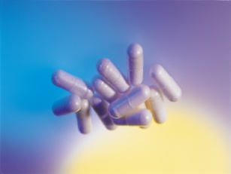
What are Probiotics Supplements?
Probiotics are supplements made of beneficial, friendly lactic acid bacteria and formulated to reflect the composition of healthy gut flora
They should be taken 2-3 times per day to restore healthy intestinal flora. Afterwards, on a daily basis in order to maintain healthy intestinal flora and help guard against diseases caused by pathogenic or putrefactive bacteria

Slide 34
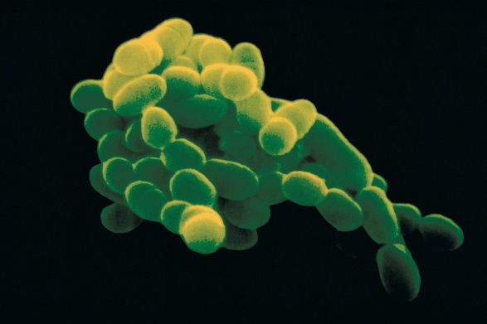
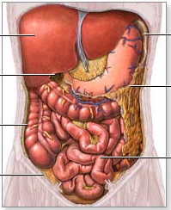
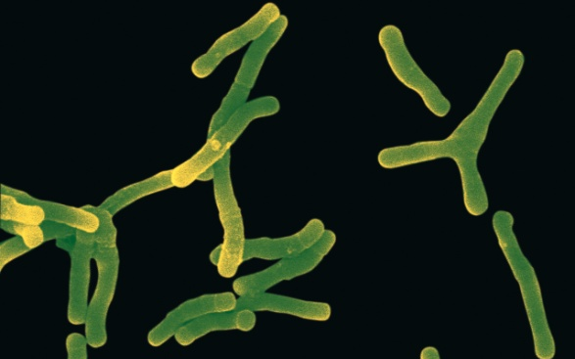
Main Families of Lactic Bacteria
Fig 1: Lactobacilli (Small Intestine)
Large Intestine
Small Intestine
Fig 2: Bifidobacteria (Large Intestine)

Slide 35


Lactic Bacteria: Action Mechanism
Lactic Acid Bacteria Act like a shield and mask receptor sites for pathogenic bacteria
Lactic Acid Bacteria Act like a shield and mask receptor sites for enterotoxinogen pathogens
Lactic Acid Bacteria Adhere to intestinal cells and protect them against pathogenic bacteria

Slide 36
Requirements of Probiotics
Probiotics must be alive
Probiotics must be safe
Probiotics must deliver a measured physiological impact
Survival of gastrointestinal tract transit
Probiotics needn’t be restricted to food applications

Slide 37
Expected Benefits Associated with consumption of Probiotics
•Increased tolerance to infections
•Control of diarrhea
•Reduction of blood pressure
•Cholesterol reduction
•Allergy control
•Cancer reduction

Slide 38
Probiotics and poultry
A probiotic made up of 29 bacteria (PRE-EMPT) is being used in chickens.
This establishes a functional microbial community in the cecum and limits Salmonella colonisation of the gut through competitive exclusion.

Slide 39
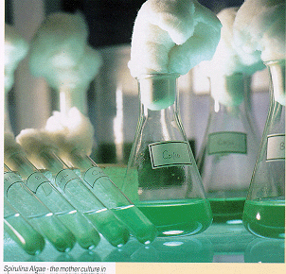
Single cell proteins
Refers to the dried cells of microorganisms such as algae, bacteria and fungi.
Used as protein sources in animal feeds including human food supplements.
  E.g Pruteen - Made from the bacterium Methilophilus methilotrophus.
  Spirulina – cyanobacteria of the genus Arthrospira. Whole cells as well as beta carotenes from spirulina are available.

Slide 40
Yeast as a food supplement
Yeast for nutritional purposes is cultivated in large aerated fermentors in a medium containing molasses as an ingredient.
At the end of the growth period, yeast cells are recovered by centrifugation and washed.
Nutritional yeast is heat-killed and usually dried.
Yeast cells are rich in B vitamins and in protein.

Slide 41
Mushrooms as a food source
Several kinds of fungi are sources of human food of which the most important are the mushrooms.
The mushroom commercially grown in most parts of the world is Agaricus bisporus and is cultivated in mushroom farms.
Fungus is grown under environmentally controlled conditions in a mixture of soil and organic matter.

Slide 42
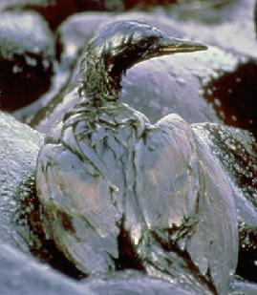
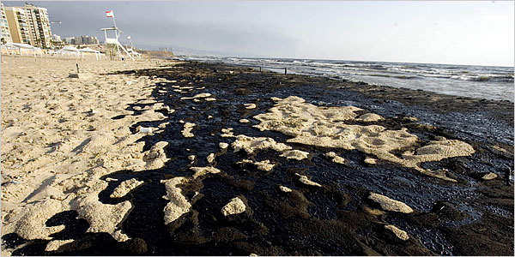
Environmental Clean-up
Some bacteria eat oil and turn it into environmentally friendly chemicals. These bacteria are dumped into waters contaminated by oil spills.

Slide 43
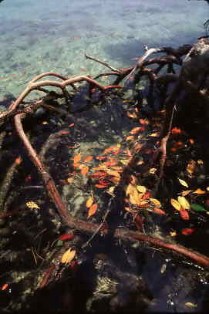
Environmental Recycling
Bacteria are decomposers: they break down dead organisms into smaller chemicals which then go back into the soil.

Slide 44
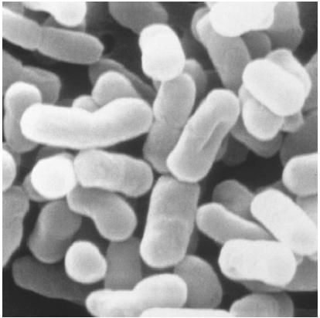
Digestion
Many bacteria, such as human E. coli, live a warm and cozy life in your intestines. They help digest your food and make vitamins, such as Vitamin K (which is necessary for blood clotting).

Slide 45
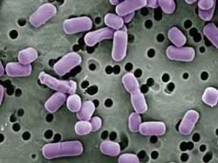
Digestive Health
Beneficial bacteria, such as Lactobacillus, keep the “bad” bacteria in check, by competing with them for nutrients.

Slide 46
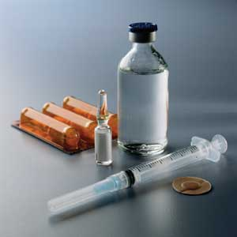
Medicines
The pharmaceutical industry uses some forms of bacteria to make vitamins and antibiotics.
Other bacteria can be used to produce insulin, which can be collected and given to people with diabetes.

Slide 47
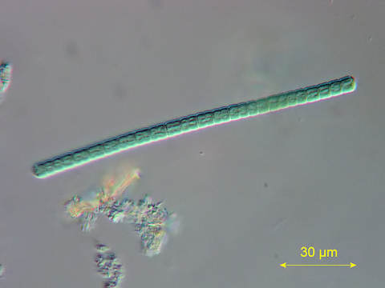
Food Chain
Bacteria are a food source for many small organisms!

