Slide 1
Campus Novel Introduction:
Also known as ‘Academic Fiction’
includes structure and setting related to a college or university.
academicians are the characters in it
their activities are action of such novels.
Trend began in first half of twentieth century.
David Lodge : one of the most popular contemporary writers of this genre in Britain.
The Groves of Academy (1952) by Mary McCarthy as the first classic campus novel.
gained popularity, because of its subject matter and setting.

Slide 2
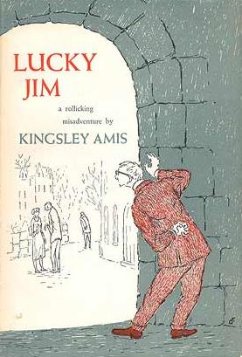

Slide 3
A campus -- geographical place / land on which a college, university or any related educational building is situated.
a literary genre whose main action is set in or around the campus of a college or university.
depict the world of students, teachers, administrators, and owners of the academic institutions.
written from the students’ point of view and some of the novels focus the perspective of teachers or faculty.
Ideal Academic life is a myth.
Seeks attraction due to imaginary idealistic notions.
paradise of learning where the inmates dedicate themselves
to lofty pursuits.

Slide 4
Teachers -- as sculptors who with the provided raw materials called ‘students’ create sculptures.
Idealism is juxtaposed with reality -- a rich source for parody, satire and irony –
Reason -- some of the people inside it, struggle between reality and intellectual pretensions.
exploit the tension between idealism and corruption
novels engage is the interplay between fiction and fact.
gap between ‘is’ and ‘ought to’.

