Slide 1
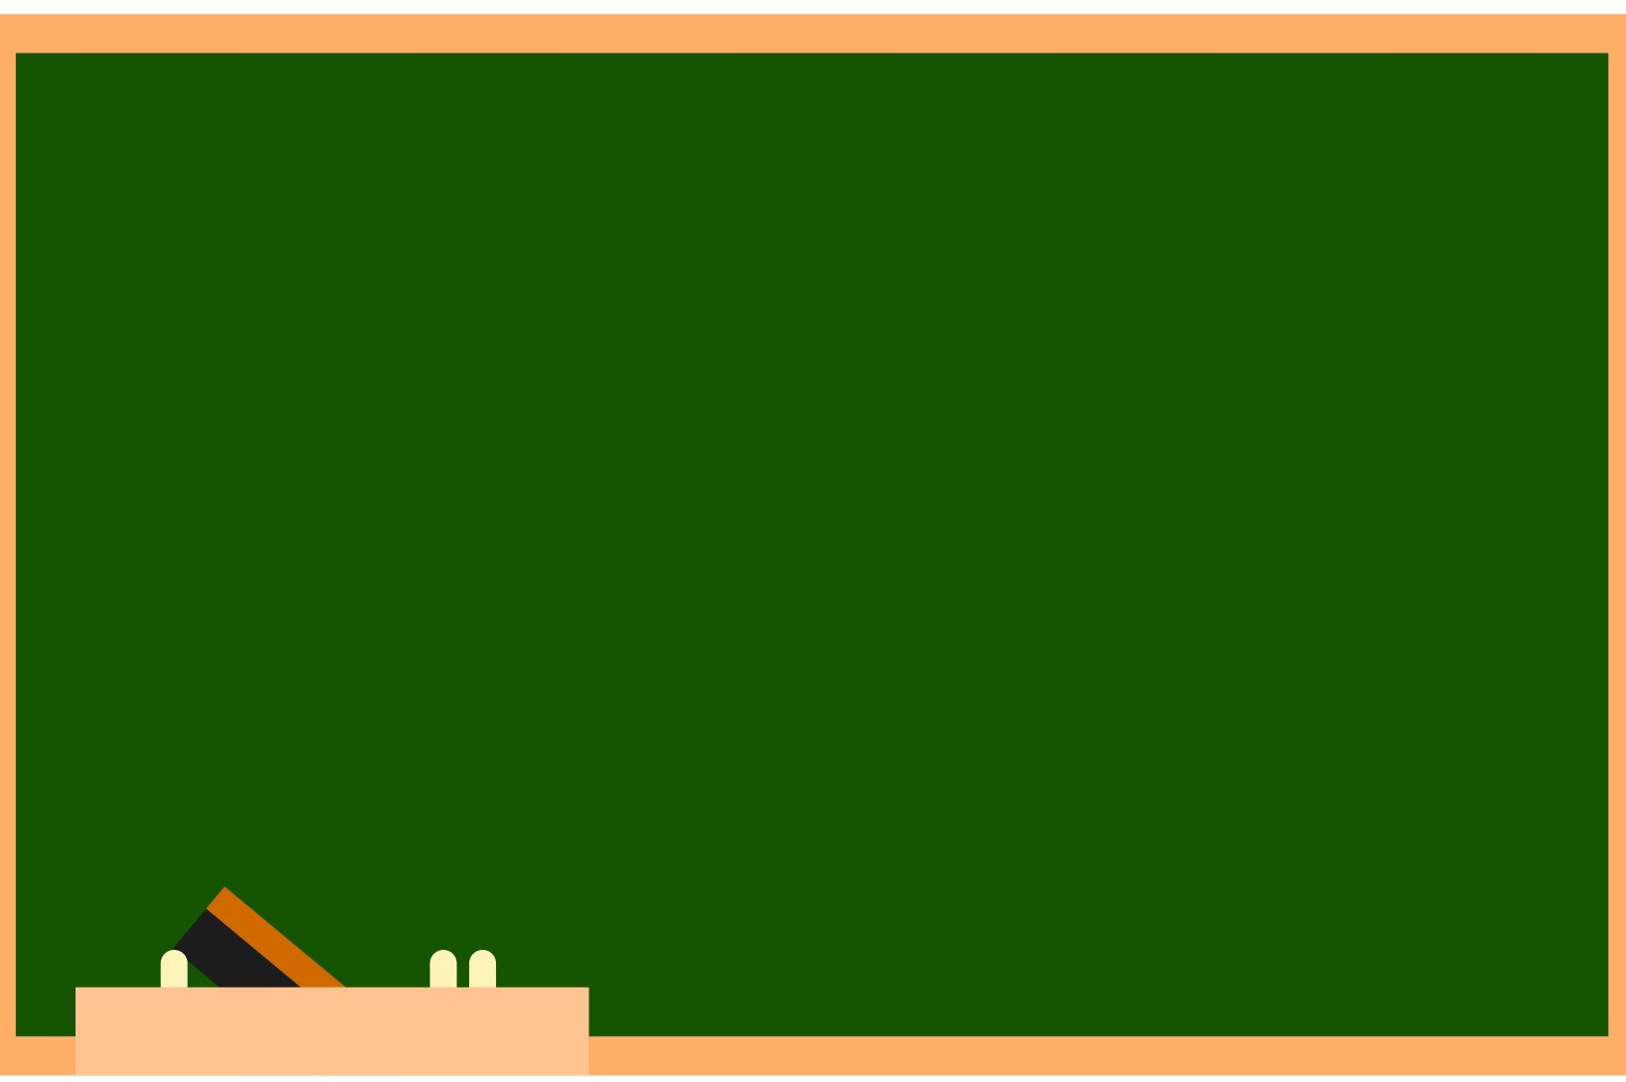
Paper XI :
Language and Linguistics

Slide 2
Module I :
Language and Communication

Slide 3
Language is a purely human and non-instinctive method of communicating ideas, emotions and desires by means of a system of voluntarily produced symbols.
Sapir : Language

Slide 4
A language is a system of arbitrary vocal symbols by means of which a social group cooperates.
Bloch & Trager : Outline of Linguistic Analysis

Slide 5
Language is a human… verbal systematic symbolism … a means of transmitting information … a form of social behaviour … (with a) high degree of convention.
J. Whatmough : Language

Slide 6
A language ( is a) symbol system … based on pure or arbitrary convention … infinitely extendable and modifiable according to the changing needs and conditions of the speakers.
R. H. Robins : General Linguistics

Slide 7
Human Languages are unlimited ( an unlimited sets of discrete signals) … have great structural complexity … structured on at least two levels … ( the learning task is considerable) … are open – ended … allow for the transmission of information.
R. W. Langacker : Language and Its Structure

Slide 8
Thank you…

