Slide 1
Disaster Management in India Past, Present and Future
Dr H.H.Karande
Head ,
Department of Geography,(P.G. & U.G.)
Mahila Mahavidyalaya, Karad

Slide 2
Disasters in India
Moving away from the Great Bengal famine of 1769-1770 in which a third of the population perished.
The Chalisa famine of 1783, the Doji Bara or Skull famine of 1790 to 1792, the North West Provinces famine of 1838, the North West India Famine of 1861, the Bengal and Orissa famine of 1866, the Rajputana famine of 1869, the famine of 1899 to 1901, the Bengal famine of 1943…
The drought years of 1965, 1972, 1979, 1987, 2002

Slide 3
India’s Vulnerability to Disasters
57% land is vulnerable to earthquakes. Of these, 12% is vulnerable to severe earthquakes.
68% land is vulnerable to drought.
12% land is vulnerable to floods.
8% land is vulnerable to cyclones.
Apart from natural disasters, some cities in India are also vulnerable to chemical and industrial disasters and man-made disasters.

Slide 6
Seismic Activity in India 180 AD - 2004

Slide 8
Distribution of epicenters of earthquakes greater than magnitude 5.0 for the period 1976-2000, South East Asia and Indian Ocean

Slide 9
Areas of Concern
Activating an Early Warning System network and its close monitoring
Mechanisms for integrating the scientific, technological and administrative agencies for effective disaster management
Terrestrial communication links which collapse in the event of a rapid onset disaster
Vulnerability of critical infrastructures (power supply, communication, water supply, transport, etc.) to disaster events

Slide 10
Areas of Concern
Funding : Primacy of relief as disaster response.
Preparedness and Mitigation very often ignored.
Lack of integrated efforts to collect and compile data, information and local knowledge on disaster history and traditional response patterns.
Need for standardised efforts in compiling and interpreting geo-spatial data, satellite imagery and early warning signals.
Weak areas continue to be forecasting, modelling, risk prediction, simulation and scenario analysis, etc.

Slide 11
Areas of Concern
Absence of a national level, state level, and district level directory of experts and inventory of resources.
Absence of a National Disaster Management Plan, and State level and district level disaster management plans.
Sustainability of efforts
Effective Inter Agency Co-ordination and Standard Operating Procedures for stakeholder groups, especially critical first responder agencies.
Emergency medicine, critical care medicine, triage, first aid

Slide 12
Nodal Agencies for Disaster Management
Floods : Ministry of Water Resources, CWC
Cyclones : Indian Meteorological Department
Earthquakes : Indian Meteorological Department
Epidemics : Ministry of Health and Family Welfare
Avian Flu: Ministry of Health, Ministry of Environment, Ministry of Agriculture and Animal Husbandry
Chemical Disasters : Ministry of Environment and Forests
Industrial Disasters : Ministry of Labour
Rail Accidents : Ministry of Railways
Air Accidents : Ministry of Civil Aviation
Fire : Ministry of Home Affairs
Nuclear Incidents : Department of Atomic Energy
Mine Disasters : Department of Mines

Slide 13
Dynamics of Disasters
There is a high probability of a low probability event happening somewhere sometime soon…
The unpredictability of disaster events and the high risk and vulnerability profiles make it imperative to strengthen disaster preparedness, mitigation and enforcement of guidelines, building codes and restrictions on construction of buildings in flood-prone areas and storm surge prone coastal areas.

Slide 14
New Directions for Disaster Management in India
The National Disaster Management Authority (NDMA) has been set up as the apex body for Disaster Management in India, with the Prime Minister as its Chairman.
Disaster Management Authorities will be set up at the State and District Levels to be headed by the Chief Ministers and Collectors/Zilla Parishad Chairmen respectively.

Slide 15
New Directions for Disaster Management in India
A National Disaster Mitigation Fund will be administerd by NDMA. States and districts will administer mitigation funds.
A National Disaster Response Fund will be administerd by NDMA through the National Executive Committee. States and Districts will administer state Disaster Response Fund and Disaster Response Fund respectively.
8 Battalions of National Disaster Response Force (NDRF) are being trained and deployed with CSSR and MFR equipments and tools in eight strategic locations.
A National Disaster Management Policy and National Disaster Response Plan will also be drawn up.

Slide 16
Lessons Learnt
Be Prepared : Preparedness and Mitigation is bound to yield more effective returns than distributing relief after a disaster.
Create a Culture of Preparedness and Prevention.
Evolve a code of conduct for all stake-holders

Slide 17
Future Directions
Encourage and consolidate knowledge networks
Mobilise and train disaster volunteers for more effective preparedness, mitigation and response (NSS, NCC, Scouts and Guides, NYK, Civil Defence, Homeguards)
Increased capacity building leads to faster vulnerability reduction.
Learn from best practices in disaster preparedness, mitigation and disaster response

Slide 18
Future Directions
Mobilising stakeholder participation of Self Help Groups, Women’s Groups, Youth Groups, Panchayati Raj Institutions
Anticipatory Governance: Simulation exercises, Mock drills and Scenario Analysis
Indigenous knowledge systems and coping practices
Living with Risk: Community Based Disaster Risk Management
Inclusive, participatory, gender sensitive, child friendly, eco-friendly and disabled friendly disaster management
Technology driven but people owned
Knowledge Management: Documentation and dissemination of good practices
Public Private Partnership

Slide 19
Invest in Preparedness
Investments in Preparedness and Prevention (Mitigation) will yield sustainable results, rather than spending money on relief after a disaster.
Most disasters are predictable, especially in their seasonality and the disaster-prone areas which are vulnerable.
Communities must be involved in disaster preparedness.

Slide 20
Best Practices
On 12 November, 1970 a major cyclone hit the coastal belt of Bangladesh at 223 km/hr. with a storm surge of six to nine meters height, killing an estimated 500,000 people.
Due to the Cyclone Preparedness Program, the April 1991 cyclone with wind speed of 225 km/hr. killed only 138,000 people even though the coastal population had doubled by that time.
In May 1994, in a similar cyclone with a wind speed of 250 km/hr. only 127 people lost their lives.
In May 1997, in a cyclone with wind speed of 200 km/hr. only 111 people lost their lives.

Slide 21
New possibilities
National Urban Renewal Mission for 70 cities: recent experience of “unprecedented” extreme weather conditions in a few major metros and megacities
100,000 Rural Knowledge Centres
( IT Kiosks): Need for Spatial e-Governance for informed decision making in disaster-prone areas: before, during and after disasters

Slide 22
BMTPC
NBSSLUP
SOI
Dept. of Space
NRSA
GoI
Ministries
NDMA
Census
of India
NIC
PSUs
IMD
NATMO
CGWB
CWC
NSDI
Spatial Information
Electronic Clearing House
GSI
ISRO
FSI
CPCB
URBAN
BODIES
BSI
Private Sector
NRDMS
Academic
& Research
Institutions
NNRMS
NGOs
PRIs
Knowledge Networking

Slide 23
DISASTERS IN INDIA Scope of Hazards and Disaster Management

Slide 24
India and Natural Disasters
India is one of the most disaster prone countries in the world.
Over 65% land area vulnerable to earthquakes;
70% of land under cultivation prone to drought;
5% of land (40 million hectares) to floods;
8% of land (8,000 km coastline) to cyclones.
A Major Disaster occurs every 2-3 years;
50 million people affected annually
1 million houses damaged annually along with human,social and other losses
During 1985-2003, the annual average damage due to natural disasters has been estimated at 70 million USD
Source: Ministry of Agriculture, GOI: BMTPC, Ministry of Urban Development, GOI

Slide 25
The Myths
It Can’t Happen to Us.
The Nature’s forces are so Deadly the Victims will Die anyway.
There is Nothing We Can Do.

Slide 26
Definition of Disaster
A Disaster is an event that occurs in most cases suddenly and unexpectedly, causing severe disturbances to people, objects and environment, resulting in loss of life ,property and health of the population. Such a situation causes disruption in normal pattern of life, generating misfortune, helplessness and suffering affecting the socio-economic structure of a region/country to such an extent that there is a need for assistance or immediate outside intervention.

Slide 27
Ingredients of a Disaster
A phenomenon or event which constitutes a trauma for a population/environment.
A vulnerable point/area that will bear the brunt of the traumatizing event.
The failure of local & surrounding resources to cope with the problems created by the phenomenon.
Types of Disasters
Natural - Manmade

Slide 28
Disasters affecting India
EARTHQUAKE
VOLCANIC ERUPTION
TSUNAMI
CYCLONE
FLOOD
LANDSLIDE
BUSHFIRE
DROUGHT
MAJOR ACCIDENT (FIRE, EXPLOSION, HAZMAT)
CIVIL UNREST

Slide 29
GENERAL EFFECTS OF DISASTER
LOSS OF LIFE
INJURY
DAMAGE TO AND DESTRUCTION OF PROPERTY.
DAMAGE TO AND DESTRUCTION OF PRODUCTION.
DISRUPTION OF LIFESTYLE
LOSS OF LIVELIHOOD.
DISRUPTION TO ESSENTIAL SERVICES
DAMAGE TO NATIONAL INFRASTRUCTURE
DISRUPTION TO GOVERNMENTAL SYSTEMS
NATIONAL ECONOMIC LOSS
SOCIOLOGICAL AND PSYCHOLOGICAL AFTER EFFECT.

Slide 30
DISASTER MANAGEMENT
“AN APPLIED SCIENCE WHICH SEEKS, BY THE SYSTEMATIC OBSERVATION AND ANALYSIS OF DISASTERS, TO IMPROVE MEASURES RELATING TO PREVENTION, MITIGATION, PREPAREDNESS, EMERGENCY RESPONSE AND RECOVERY.”

Slide 31
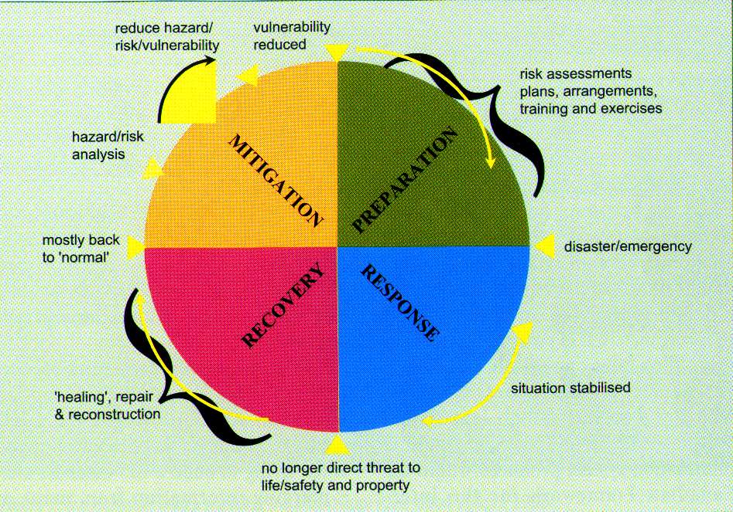
Disaster Management Cycle

Slide 32
Disaster Management Cycle
Response
Recovery
Prevention & Mitigation
Preparedness

Slide 33
RESPONSE
Response measures are usually those which are taken immediately prior to and following disaster impact.
Typical measures include :
Implementation of plans
Activation of the counter-disaster system
Search and Rescue
Provision of emergency food, shelter, medical assistance etc.
Survey and assessment
Evacuation measures

Slide 34
RECOVERY
Recovery is the process by which communities and the nation are assisted in returning to their proper level of functioning following a disaster.
Three main categories of activity are normally regarded as coming within the recovery segment:
Restoration
Reconstruction
Rehabilitation

Slide 35
PREVENTION & MITIGATION
Prevention : Action within this segment is designed to impede the occurrence of a disaster event and/or prevent such an occurrence having harmful effects on communities or key installations.
Mitigation : Action within this segment usually takes the form of specific programs intended to reduce the effects of disaster on a nation or community. For instance, some countries regard the development and application of building codes (which can reduce damage and loss in the event of earthquakes and cyclones) as being in the category of mitigation.

Slide 36
PREPAREDNESS
Preparedness is usually regarded as comprising measures which enable governments, organizations, communities and individuals to respond rapidly and effectively to disaster situations.

Slide 37
PREPAREDNESS (Contd)
Examples of Preparedness measures are :
The formulation & maintenance of valid, up-to-date counter-disaster plans
Special provisions for emergency action
The provisions of warning systems
Emergency communications
Public education and awareness
Training programs, including exercises and tests.

Slide 38
Principles of Disaster Management
Risk & Hazard Assessment
Planning
Organization
Resource Utilization
Need for Specialists
Training

Slide 39
RISK AND HAZARD ASSESSMENT
Disaster risk will be a combination of the likelihood of the event and the vulnerability of a place to that event.
The hazard assessment will aim to deliver accurate disaster information about individual locations.

Slide 40
HAZARD ASSESSMENT
Vulnerability to a particular hazard will include :
Critical products, services, records and operations.
Hazardous materials
Potential effects of damage on stakeholders.
Likely financial costs.
Resources personnel and time available to make preparations.
Level of insurance cover.
The combination of hazard and vulnerability assessments will result in formulating total risk assessment.

Slide 41
Principles of Disaster Management
Planning :
to have a clear and logical approach to dealing with disasters.
to provide common reference for all departments and authorities with roles.
to assist with information for sitting-up a multi- functional organizational structure.
to form a basis for coordinated action.
to provide clear allocation of responsibilities.
to form a basis for reviewing and evaluating current and future disaster management requirements.
to give a focus for disaster related training.

Slide 42
Principles of Disaster Management
Organisation :
the nature of National Disaster Management Authority (NDMA)
Utilization of total governmental structures/ resources i.e. National, State & Local level.
Co-ordination of non governmental resources
Community involvement
Clear lines of Authority and unity of command
Special system requirements.

Slide 43
Principles of Disaster Management
Organisation (Contd.) :
Special system requirements.
Emergency Operation Center/Control Center
Direction & Coordinating Authority
Communications
Warning Systems
Survey & Assessments
Information Management
Emergency Logistics

Slide 44
Principles of Disaster Management
Resource Utilization :
Identification of resources
Assessment of resources with relation to their capability & availability
Allocation of appropriate tasks
Level of skill in handling allotted tasks and experience
Activation time for deployment/availability
Co-ordination with line authorities of resource organizations
Coalition of accurate information for effective deployment of resources.

Slide 45
AGENCIES
Governmental (Including Military both at National & State Level).
Non Governmental Organizations.
Community groups both social & religious.
International Volunteer organisation.

Slide 46
Principles of Disaster Management
Need for Specialists :
Search & Rescue
Survey & Damage Assessment
First Aid & Triage
Mobile Medical & Health Team
Evacuation
Animal Husbandry/Veterinary

Slide 47
Principles of Disaster Management
Need for Specialists (Contd):
Emergency Welfare
Emergency Shelter
Emergency Logistics
Staff for EOC (Emergency Operating Center)
Information Management including public information needs.
Specialists from field of disaster studies and research (Geologists, Meteorologists, etc.)

Slide 48
Principles of Disaster Management
Training :
Identification of Training needs.
Scope of Training programmes.
Training policy.
Implementation of training.

Slide 49
Principles of Disaster Management
Training (Contd.):
Design of training should be compatible to support tasks required to be performed after a Disaster at three levels.
Foundational Training
Team Training
Combined Organizational Training.

Slide 50
National Disaster Management Framework
Ministry of Home Affairs - GoI
To make Disaster Management an integral part of National Development Agenda
To promote Awareness and Education in Disaster Management
To promote Human Resource Development in Disaster Management (master plan for training and capacity building)
To develop Institutional Frameworks at the National and State levels for mainstreaming disaster management
To establish multi-hazard preparedness, mitigation and prevention plans at all levels
To enhance capacities at all levels for multi-hazard preparedness and response
GOI-UNDP Disaster Risk Management Programme (DRM)
will be the platform to launch these activities.

Slide 51
Any Questions

Slide 52
THE END

