Slide 1
Lord of the Flies
William Golding

Slide 2
William Golding (1911-1993) British Writer First Novel – Lord of the Flies (1954) Noble Prize for Literature

Slide 3
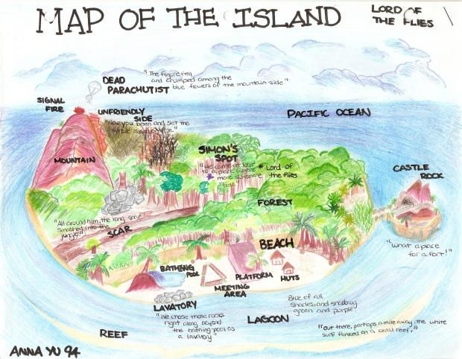
Plot: Group of young boys crash on a deserted island Face fierce struggle to survive Struggle for survival with no food, no shelter, no grownups, and no rules Humans turn Savages Innocence is lost

Slide 4
Study of basic human nature and psyche portrays the horrors of evil which reside nowhere but inside human beings. the evil, inherently present inside human the insatiable thirst to conquer and to tame the external frees itself.. leads to the destruction of both nature and the order and harmony

Slide 5
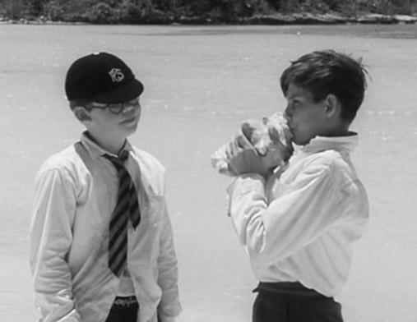
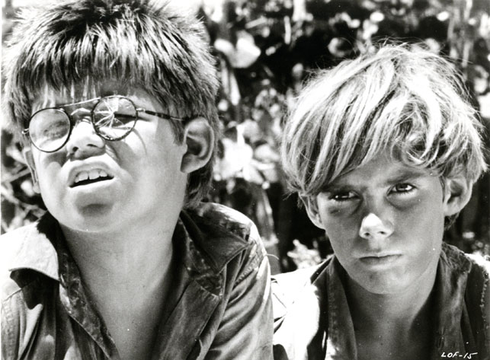
Part I: Paradise Ralph Piggy Conch Boys Jack and Choir Boys Ralph – Leader Rules Signal Fire – Piggy’s Glasses Fire – Disappearance of a boy

Slide 6
Part II: Littluns and their Fear Jack’s obsession with hunting Ralph’s concern for rescue & shelters Jack ----Savage Miss the ship Argument between Jack & Ralph Samnerick --- Pilot /Beast Hunting of a boar – Chanting Hunt for the beast – Simon, Ralph, Jack

Slide 7
Part III: Jack’s camp: Castle Rock Ralph – Piggy –Simon Hunting of the Sow Lord of the Flies – Beelzebub – Simon Boys’ Dance – Simon’s Death Piggy’s glasses are stolen Piggy’s Death Ralph All are rescued

Slide 8
Symbols: Ralph – Nature & Order Jack – Dark Psyche Piggy – logic & Wisdom Simon – Christ Sam Eric – Sense of togetherness Conch – Civilised society Lord of the Flies -Beelzebub

Slide 9
Thank you

