Slide 1
Educational Uses of Smart Phones
By-
Ms. ---
Class: B.A. II
Mahila Mahavidyalaya, Karad

Slide 2
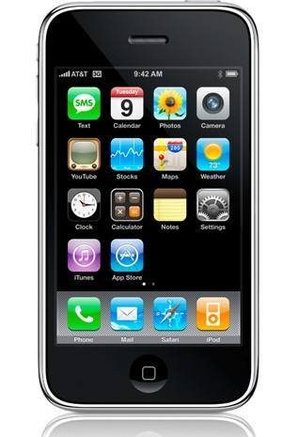
Smart Phone is a mobile phone that performs many of the functions of a computer.

Slide 3
Special Features
Touchscreen Interface
Internet Access
Operating system capable of running downloaded apps

Slide 4
Smart Phone Users
People from all walks of life:
Students Politicians
Industrialists Police
Scientists ---
Farmers ----
Teachers ----
Management Officials ---
Non-Skilled Workers ---
Skilled workers ---

Slide 5
Educational Use
Collection of Information
Calculations
Preparation of Projects
Preparation of Study Material
Preparation of PPT for Classroom Presentation
Excel Sheet for Commerce students
Watching Movies/ plays based on literary works

Slide 6
Benefits
Quick and Easy Access to New Ideas and Information
Effective Audio Visual Learning
Easy Calculations
Fast Communication
Sharing of Knowledge
Access to Education Friendly Apps

Slide 7
Thank You

