Slide 1
Introduction to Color Theory
Dr. Ila Jogi
Head, Department of Home Science

Slide 2
Introduction to Color Theory
With colors you can set a mood, attract attention, or make a statement. You can use color to energize, or to cool down. By selecting the right color scheme, you can create an ambiance of elegance, warmth or tranquility, or you can convey an image of playful youthfulness. Color can be your most powerful design element if you learn to use it effectively.
Colors affect us in numerous ways, both mentally and physically. A strong red color has been shown to raise the blood pressure, while a blue color has a calming effect.
Being able to use colors consciously and harmoniously can help you create spectacular results.

Slide 3
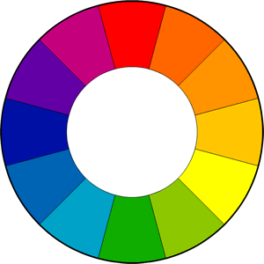
The Color Wheel

Slide 4
The color wheel or color circle is the basic tool for combining colors. The first circular color diagram was designed by Sir Isaac Newton in 1666.
The color wheel is designed so that virtually any colors you pick from it will look good together. Over the years, many variations of the basic design have been made, but the most common version is a wheel of 12 colors based on the RYB (or artistic) color model.
Traditionally, there are a number of color combinations that are considered especially pleasing. These are called color harmonies or color chords and they consist of two or more colors with a fixed relation in the color wheel.
ColorImpact is designed to dynamically create a color wheel to match your base color.

Slide 5
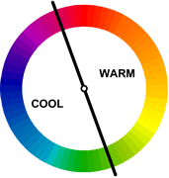
Warm and cool colors
The color circle can be divided into warm and cool colors.
Warm colors are vivid and energetic, and tend to advance in space.
Cool colors give an impression of calm, and create a soothing impression.
White, black and gray are considered to be neutral.

Slide 6
Tints, Shades, and Tones
These terms are often used incorrectly, although they describe fairly simple color concepts. If a color is made lighter by adding white, the result is called a tint. If black is added, the darker version is called a shade. And if gray is added, the result is a differenttone.

Slide 7



Tints - adding white to a pure hue:
Shades - adding black to a pure hue:
Tones - adding gray to a pure hue:

Slide 8
Colour Scheme
Color Harmonies
- basic techniques for creating color schemes
Below are shown the basic color chords based on the color wheel.

Slide 9
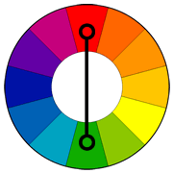
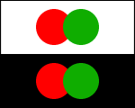
Complementary color scheme
Colors that are opposite each other on the color wheel are considered to be complementary colors (example: red and green).
The high contrast of complementary colors creates a vibrant look especially when used at full saturation. This color scheme must be managed well so it is not jarring.
Complementary color schemes are tricky to use in large doses, but work well when you want something to stand out.
Complementary colors are really bad for text.

Slide 10
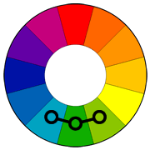

Analogous color scheme
Analogous color schemes use colors that are next to each other on the color wheel. They usually match well and create serene and comfortable designs.
Analogous color schemes are often found in nature and are harmonious and pleasing to the eye.
Make sure you have enough contrast when choosing an analogous color scheme.
Choose one color to dominate, a second to support. The third color is used (along with black, white or gray) as an accent.

Slide 11
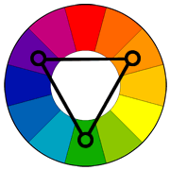
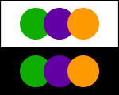
Triadic color scheme
A triadic color scheme uses colors that are evenly spaced around the color wheel.
Triadic color schemes tend to be quite vibrant, even if you use pale or unsaturated versions of your hues.
To use a triadic harmony successfully, the colors should be carefully balanced - let one color dominate and use the two others for accent.

Slide 12
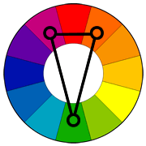
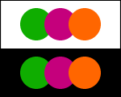
Split-Complementary color scheme
The split-complementary color scheme is a variation of the complementary color scheme. In addition to the base color, it uses the two colors adjacent to its complement.
This color scheme has the same strong visual contrast as the complementary color scheme, but has less tension.
The split-complimentary color scheme is often a good choice for beginners, because it is difficult to mess up.

Slide 13
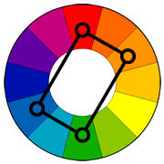
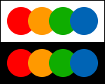
Rectangle (tetradic) color scheme
The rectangle or tetradic color scheme uses four colors arranged into two complementary pairs.
This rich color scheme offers plenty of possibilities for variation.
Tetradic color schemes works best if you let one color be dominant.
You should also pay attention to the balance between warm and cool colors in your design.

Slide 14
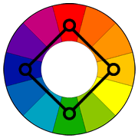
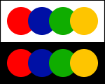
Square color scheme
The square color scheme is similar to the rectangle, but with all four colors spaced evenly around the color circle.
Square color schemes works best if you let one color be dominant.
You should also pay attention to the balance between warm and cool colors in your design.

Slide 15
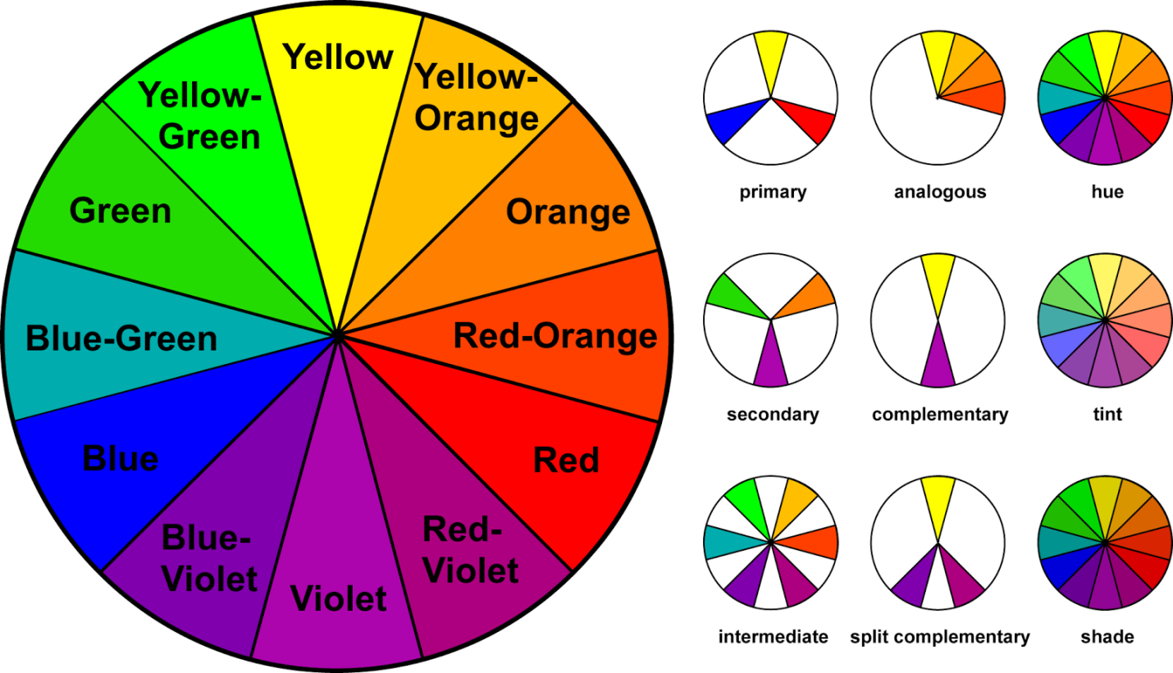
Colour Wheel

Slide 16
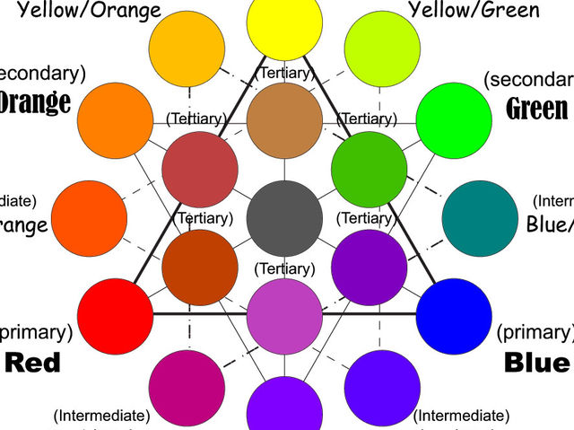

Slide 17
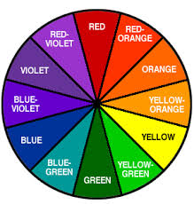

Slide 18
Thank you…

