Slide 1
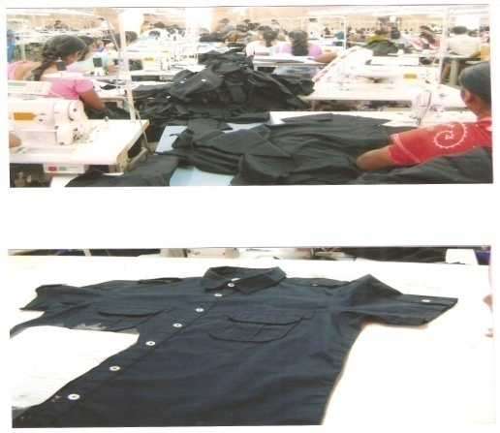
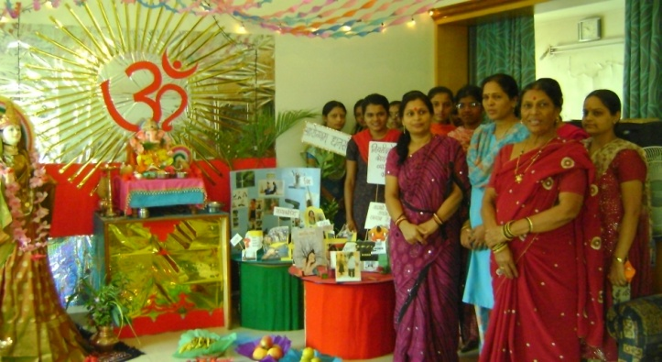
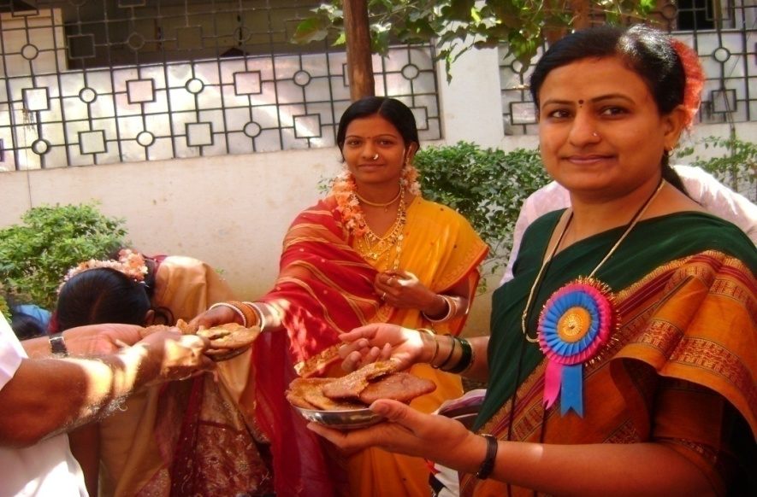
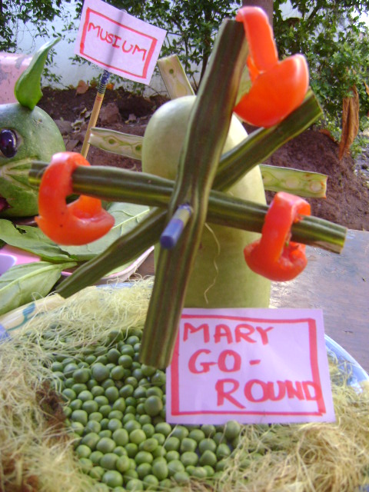
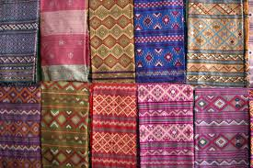
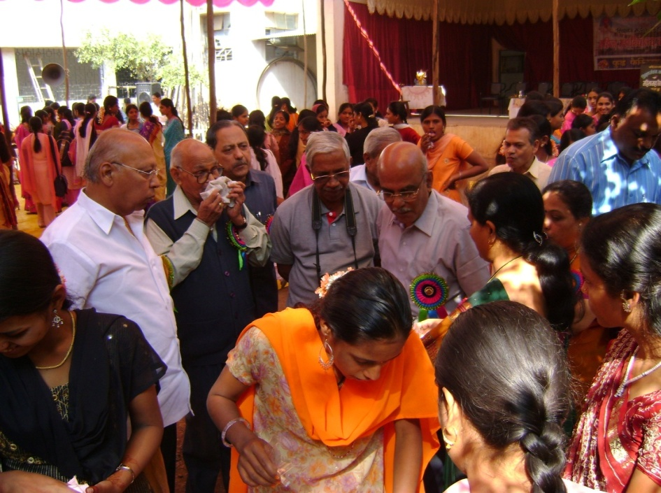
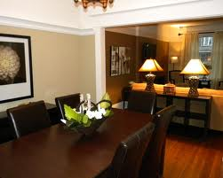

Slide 2
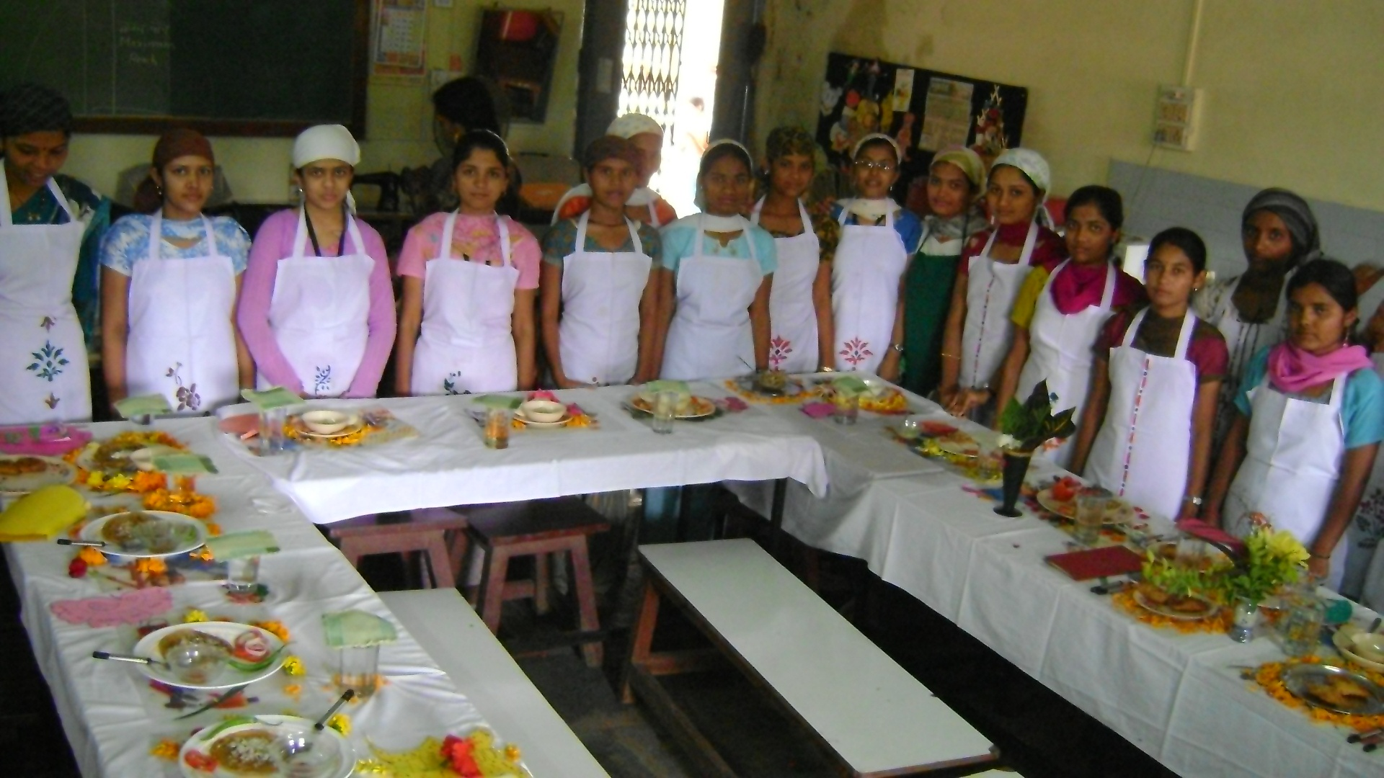
Home SCIENCe
Home Science means art of managing ones
resources efficiently and the science of achieving a
healthier, happier home and if need be, a career.

Slide 3
Home Science is the science of the home which is concerned with the maintenance and enrichment of human relationship through development and judicious use of all available human and material sources. Home Science aims to develop women personally and professionally. Home Science is not just about educating women to be experts of home decoration. The subject is largely scientific in nature and requires analytical mind and scientific temper.
Home Science

Slide 4
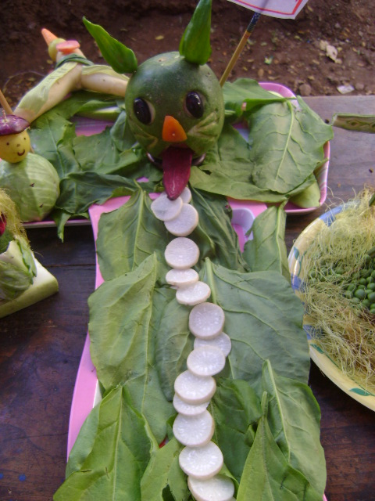
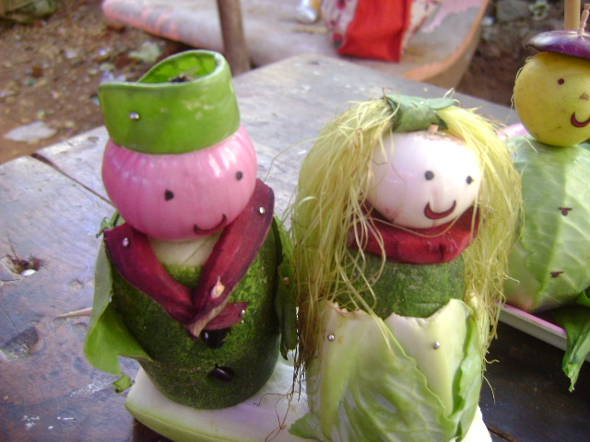

Slide 5
It is a holistic field that aims to develop women personally and professionally.
The goal of Home Science is to enable students to be successful homemaker, entrepreneurs and educationist.

Slide 6
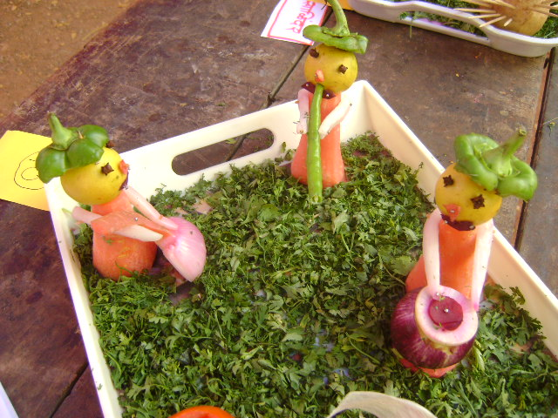
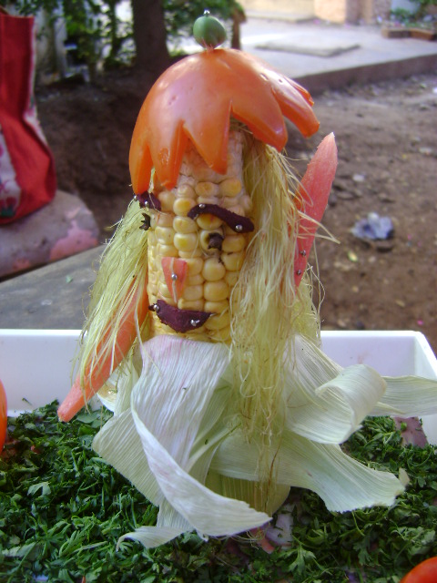
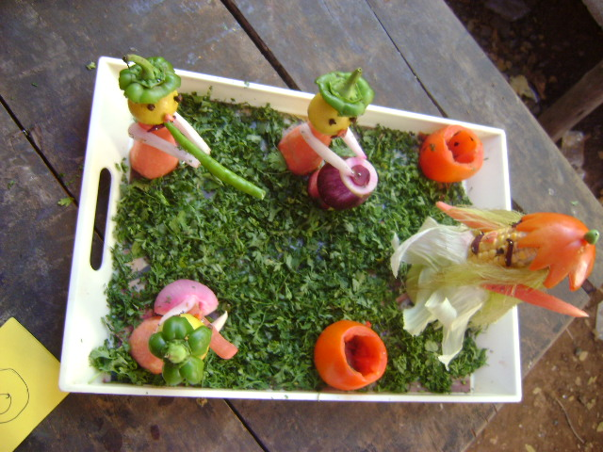
Salad Decoration Competition

Slide 7
Home Science is the field of knowledge and services primarily concerned with strengthening family life and enhancing potentials of the individual for meaningful living through : TEACHING : Educating the individual for family living. Improving the services and goods used by families. RESEARCH: Conducting the research to discover the changing needs of individual and families and the means of satisfying these needs. EXTENSION : Furthering community, national and worldwide conditions favourable to family living.
HOME SCIENCE

Slide 8
Home Science synthesizes knowledge drawn from its own research, from the physical, biological ,social sciences and the arts and applies this knowledge to improving the lives of families and individuals.

Slide 9
Objectives
Be efficient homemakers, dutiful mothers and purposeful citizens.
Develop a sense of responsibility in their homes.
Lead happy and contented lives within their means.
4. Adjust between demands of home and career.
5. Cultivate good responsibilities at home, school and society.
6. Appreciate dignity of labour.
7. Form good health habits.

Slide 10
8. Develop self reliance and confidence.
9. Get equipped with all the skills necessary to manage a home.
10. Promote aesthetic appreciation in daily life.
11. Develop spirit of civic consciousness.
12. Learn ways and means to supplement family income.
13. Plan for leisure time and recreation.

Slide 11
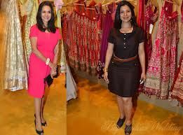
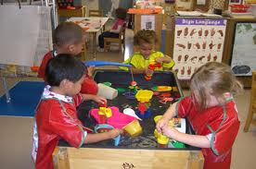
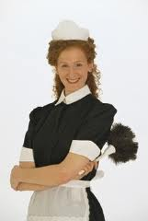
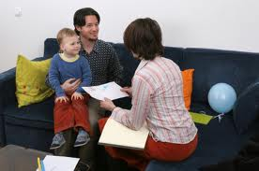
Disciplines of Home Science
Food and Nutrition
Textiles and Clothing
Family Resource Management
Child/Human Development
Home Science Extension Education

Slide 12
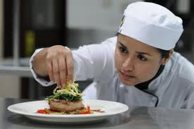
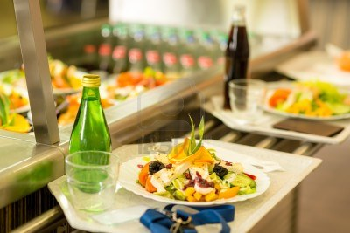
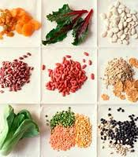
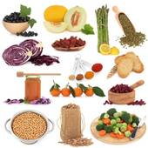
Food and Nutrition Catering
Wage Employment
1. Manager
2. Cook
3. Waiter
Self Employment
As a owner of
1. Canteen
2. Cafeteria
3. Restaurant
4. Dhaba
5. Tea shop
6.Contract of catering order
7.Management of catering centre
8. Organisation of hobby classes

Slide 13
Food Preservation
Wage Employment
Production manager
Production Supervisor
Assistant in Quality Control Dept.
In charge of Community Canning Centre
Instructor of Community Canning Centre
Self Employment
As a Owner of
Food Processing unit
Advisor of Food Processing Unit
Organisation of Hobby centres – jam, Jelly making, cake, pastry making etc.

Slide 14
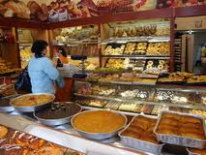
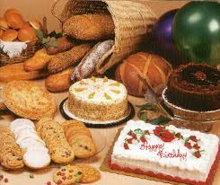
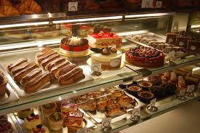
Baking and Confectionary
Wage Employment
Worker in Bakery
Supervisor in Bakery
Manager in Bakery
Self Employment
As a Owner of
Bakery
Organiser of Hobby Classes : Biscuits, cake making

Slide 15
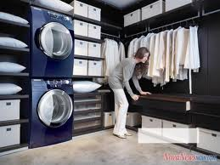
Family Resource Management
Wage Employment
Housekeeper
Caretaker
Supervisor in Laundry
Home Caretaker
Manager in Laundry
Self Employment
As a Owner of
Guest House
Take on Contract management of offices, commercial complexes, shops, etc.
Laundry
Organiser of Hobby Classes

Slide 16
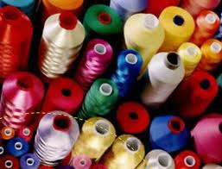
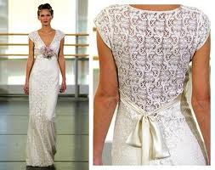
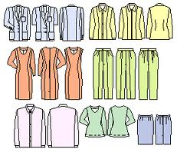
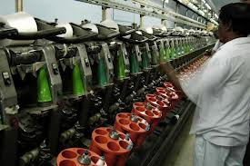
Textile and Garment Designing
Wage Employment
Managers in Mills
Managers in Mills
Dress Designer
FINISHERS
Cutter
Pattern Maker
Tailor
Self Employment
As a Owner of
Designing of Dress
Boutique
Take a contract of school uniform
Manufacturing of garment designing
Dress making shop
Pattern maker
Organiser of Hobby Classes

Slide 17
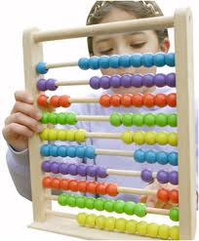
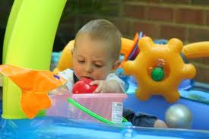
Child/Human Development
Wage Employment
Anganwadi Worker
Anganwadi Supervisor
Balwadi Supervisor
Nursery Teacher
Nursery Instructor
Principal of school
Counselor in Special School
Self Employment
As a Owner of
Creche
Balwadi
Nursery School
School for Special Children
Old Age Care Home / Day Care Centre
Organiser of Hobby Classes

Slide 18
Communication and Extension Education
Wage Employment
Social Worker
Counsellor
Project officer
Researcher in Community
Self Employment
As a Owner of
Non Govt. Organisation
Develop Enterprise and Generate income
Counselling Centre for Vulnerable group
Create trust, society for needy population

Slide 19
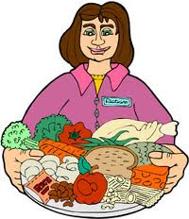
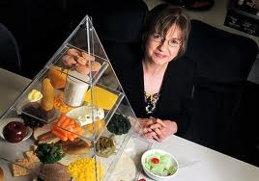
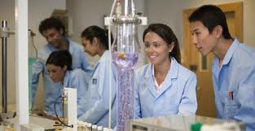
Dietician Lecturer Reader Researcher in National Institutes, Research Centres

Slide 20
Thank you…

