Slide 1
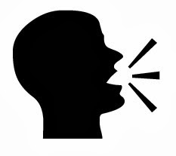
Manner of Articulation

Slide 2
Production of sound depends on : a kind of closure & narrowing.

Slide 3
Plosives

Slide 4
Fricatives

Slide 5
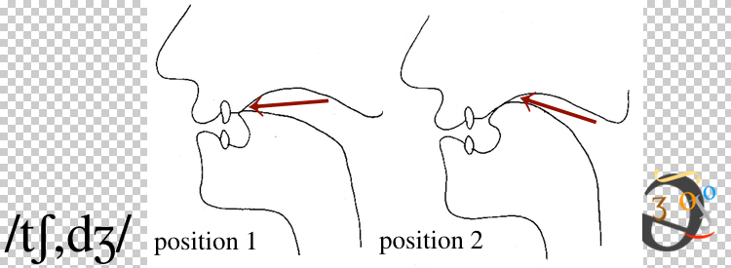
Affricates

Slide 6
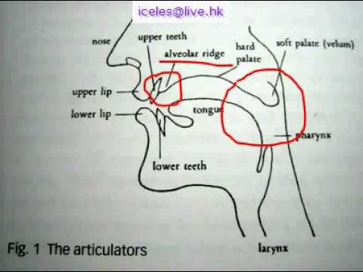
Trill / Roll

Slide 7
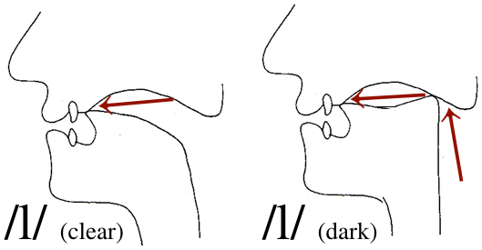
Lateral

Slide 8
Nasal

Slide 9
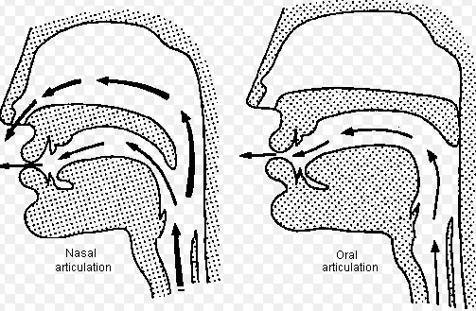
Nasal and Oral Articulation

Slide 10
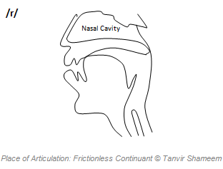
Frictionless Continuant

Slide 11
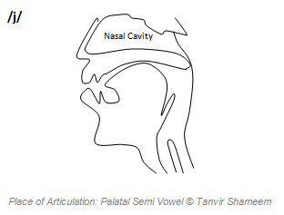
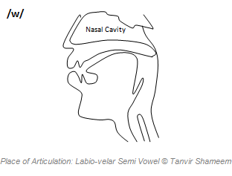
Semi Vowels

