Slide 1
Module V E- Communication
Dr. Ujjwala Tathe
Associate Professor,
Department of English
Mahila Mahavidyalaya, Karad

Slide 2
AGENDA
Why Do we write emails? Business email
Creating Business Email id Email Window
Recipients : To Cc Bcc Subject
Main Body Essential Tips
Attachments Forward
Responding Emails Folders
Don’ts

Slide 3
Why Do We Write Email?
To Share Detailed Information And Data.
To Ensure A Record Of Our Communication.
To Provide Directional, Important, And Timely Information.
To Deliver Short Status Updates.

Slide 4
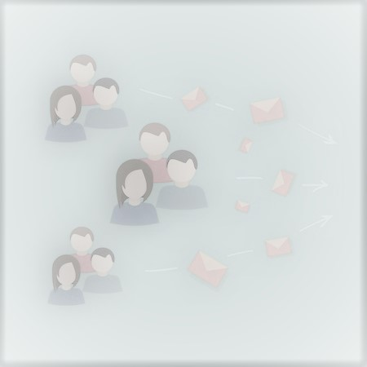
Business Email
Business Email is an email that is written about a certain business in a work place.
It is a professional way of communication through electronic media.
Important Part of Day to Day Business Communication.

Slide 5
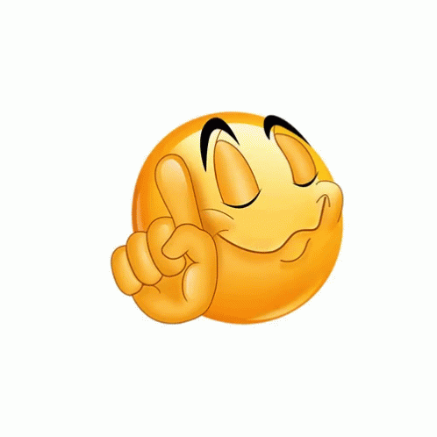
Prepare Your Own Email Id
Pronounceable and Memorable
Formal
Give Professional Impression meghabaliga@mahabank.com
Builds Trust and Credibility megha-baliga @ gmail.com
Avoid:
Fancy Names ~~ buntygr8 @ yahoo.com
Nicknames ~~ Monto123 @ gmail.com
Too many numerical, symbols and punctuations ~~ Difficult to Remember
Reference to Race, Religion, Sexual Orientation and Age

Slide 6
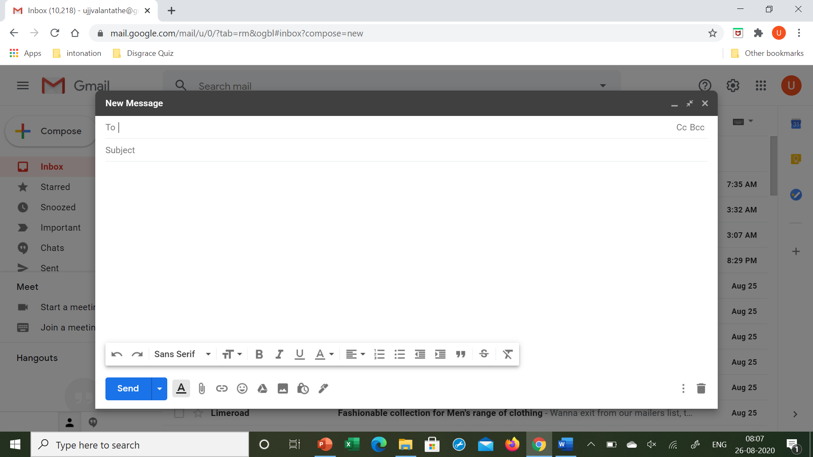
Email Window

Slide 7
Undo / Redo
Font
Font Size
Bold
Italics
Underline
Text Colour
Alignment
Numbered list
Bulleted List
Indent Less
Indent More
Quote
Strikethrough
Remove Formatting
6
Send e. Emojis
Formatting Option f. Google Drive
Attachment g. Photo
Link h. Turn Confidential
i. Insert Sign
1
5
10
13
1a
2
9
12
14
15
7
8
11
c
d
e
f
i
b
g
h
3
4

Slide 8
TO:
The Person You Want The Reply From ( Your Client / Customer)
Spell The Name Correctly
Spell The Email Correctly
Check the status of your email.

Slide 9
Cc : Carbon Copy OR Courtesy Copy
The Person Who Needs To Be Informed / Reported
Do Not Use CC Frequently.
You Can Ask Your Head Whether She/ He Would Like To Be Informed.
As Per Your Position If You Have Right To Take Certain Decisions, Don’t Make It A Practice.

Slide 10
Bcc : Blind Carbon Copy OR Blind Courtesy Copy
The Person You Add As BCC Is Not Shown To Other Recipients.
The Person You Want To Keep Informed But You Don’t Want Other Recipients To Know About It.
If It Is A Large Distribution List, Then Use BCC
If The Sender Does Not Want To Share Email Ids With Other Recipients
In The Office .. Avoid Using Bcc As It Leads To Destruct In The Organisation
Don’t Use Bcc With Wrong Intentions.

Slide 11
Subject
Introduction To The Email
Crisp, Specific, As Short As Possible
Related To The Content
E.G. Appointment Letter
Use It Wisely And Effectively
Saves Both Recipient’s And Your Time
Should Not Be Too Lengthy.
Must Not Be A Sentence.

Slide 12
The Main Body Of Email
Salutation/ Greetings
Content
Closing
Complimentary Close
Signature

Slide 13
Salutation/ Greetings
Right And Polite Salutation / Greetings Exudes Pleasant And Positive Tone
Sets The Tone And May Shape The Recipient’s Perception Of You
Writing Email To The Recipient For The First Time Use
Dear Ms. [ First Name] OR [ First Name] [Surname]
Dear Mr. [ First Name] OR [ First Name] [Surname]
Dear Ms / Mr. [ Surname]
Hello – Acceptable But Less Formal
If Confused, Follow The Other Person’s Usage
Use Of Comma
To Whom It May Concern ~ Cold And Way To Formal

Slide 14
Content
Brief - Precise - Specific
Tone : Positive And Polite
Font : Standard Official Fonts : Times New Roman / Ariel / Verdana
Size : 12 ( Readable)
Colour : Black Or Bl
Beginning - Middle - End
Beginning - Introduction To Your Main Content
Introduces The Reason For Writing
Single Sentence
e.g. I Am Writing To Ask About The Last Date Of Submission Of CSR Proposal.
With Reference To Our Telephonic Call, Could You Please Arrange The Videoconference In The Last Week Of August.

Slide 15
Middle:
Comprises: The Detail Reason Of Your Writing.
Give Supportive Information ( What The Recipient Needs To Know)
Should Comprise 4 – 5 Sentences

Slide 16
End OR Last Paragraph
Includes Call Of Action + Time Limit
Closing Remark / Pleasantries :
I Look Forward To Your Reply.
I Look Forward To Seeing You.
Look Forward To Hear From You.
Look Forward To Meeting You Tomorrow Morning.

Slide 17
Complimentary Close
Kind / Best / Kind regards, OR Regards,
Kind / Best wishes,
Sincere Regards,
Many Thanks, / Thank you,
Sincerely,

Slide 18
Signature
Proper Closing Helps You To Connect With The Recipient.
Formal Signature
First Name + Surname
Relevant Signature Include:
Your Name
Contact Details
Company Website

Slide 19
Dos Don’ts
Simple, Complete and Clear Sentences  Complex Sentences
Well Organised  Incomplete and Unorganised
Sentences
Short  Lengthy
Stick to One topic  Discuss too many issues
Use Bullets  No Paragraphs
Polite Language  Direct Directions , Rude / Curt
Highlight Moderately  Capital Letters
 Small Letters

Slide 20
Essential Tips
If Your Emails Are Lengthy , Put That In Doc, Excel.
And Put It As Attachment
If You Are On Vacation Or Not In A Position To Receive Emails, Put “ Out Of Office Alert”.
Proofread:
Any Email You Have Sent Can Not Be Reverted.
Proofread For Spelling And Grammatical Mistakes.
Any Message That Is Littered With Mistakes Will Not Be Taken Seriously.
Email That Conveys Clear Message Creates A Good Impression.

Slide 21
Attachment/S
Must Be Limited In Size And Number
Give Professional Name # Don’t Use Any Casual Title
Take Permission Of The Recipient.
Send Limited Number Of Documents Or Pdfs
Write A Note Before You Send Attachment
e.g. I Am Attaching My CV
Please Find Attached My CV
Check If You Have Attached The File/S
If You Have Many Files Or Heavy Attachments To Send ,
# Make .ZIP OR .RAR File OR Send URL
# Send Separate Emails

Slide 22
Forward
Be Careful
Seek Permission Of The Sender Before Forwarding To The 3rd Party
Do Write A Note
Delete The Previous Sender’s Messages . Don’t Send Chain Letters.
If Necessary , Edit The Subject

Slide 23
Responding To Emails
Show Appreciation And You Are Appreciated.
Tag Time ~ 24 Hours
If It Is Not Possible To Respond Immediately, At Least Send The Email Of Acknowledgement. Along With Time.
E.G. Received Mail. I Will Get Back To You.
Thank You For Your Mail. I Will Respond In Detail By Tomorrow.
Use “ Reply To All” Carefully.
Prioritise Your Emails.
Don’t Respond Emails Immediately. # Read It Carefully. # Understand The Message. # Think Over It. Formulate Your Response. # Then Respond.
If You Want To Set The Reminder For “Later To Read Emails” , You Can ‘Snooze’  Them By Giving Suitable Day And Time.

Slide 24
Responding To Emails
Tone Of Email : Formal
Friendly
Keep The Same Subject Heading For The Same Thread. But When The Messages Begin To Drift, Start A New Thread.
If You Have Doubt About Something In Email, Don’t Try To Interpret It. Call The Sender And Resolve The Issue
Useful Opening Expressions:
Thank You For Writing / For Your Interest. / Contacting Me. / Reaching Out To Me.
I Apologise For The Delay. OR Sorry For Late Reply.
Templates: Frequently Used Messages Are Saved As Templates.

Slide 25
Folders
Create Folders Where You Can Archive Important Emails For Reference
Give Title

Slide 26
Don’t …
Silly Mistakes
Use of Informal Greetings
Too Many Punctuation Marks ( … !!! ,,, )
Abbreviations ( Ur, Gr8, Info, )
Emoticons
Fancy Background And Multiple Coloured Fonts
Capital Letters And Small Letters
Humour
Abusive Language
Direct Instructions
Jargons
Share Professional Messages With Personal Contacts.
Save Professional Messages On Your Personal Id

Slide 27
Don’t
Use Old Mails To Reply.
Begin Each Sentence On A New Line.
Write A Long Text As One Paragraph.
Send The Mail Until You Make Sure All The Correct Recipients Are Listed And Copied.
Insult Anyone Over Email.
Make Hurry In Writing Email Ids. You Might Send Unfinished Mails Accidently.
Write Dear Madam /Sir. Shows ~~ Careless Approach.
Use Good Morning OR Good Afternoon

Slide 28
Thank You..

