Slide 1



Computer Mediated Communication

Slide 2
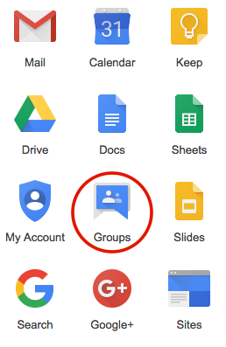

Google Discussion Group

Slide 3
What Is It?
A discussion group is a group of individuals, typically who share a similar interest, who gather either formally or informally to discuss ideas, solve problems, or make comments.
What Is Its Function?
Allows people with common interests to easily share information and participate in discussions by using a dedicated email address.
Business Group:
Anyone in the organization can send an email to a single address that
then sends the message to every member of the team.

Slide 4
Benefits
Improves Communication
Allows timely communication
Individuals scattered across the world working towards a common goal can have a discussion on the topic of their interest.

Slide 5
How To Create An E-mail Discussion Group

Slide 7
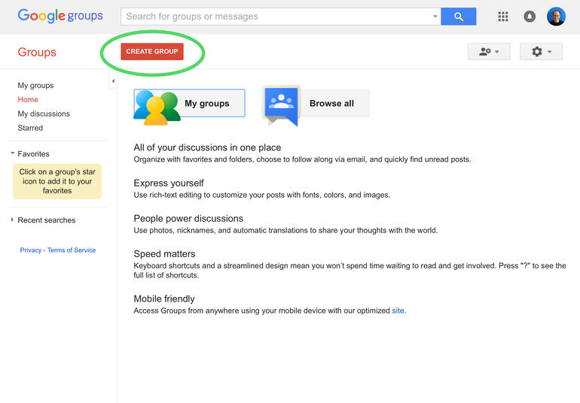
How to Form an E-Mail Discussion Group???
Step 1

Slide 14
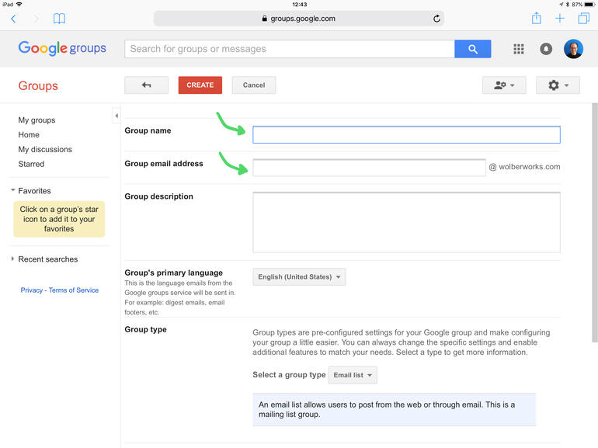

Slide 15
Name your group
Fill in the "Group name" and "Group email address" fields. Keep the name and address as short as possible. For example, "staff" is much easier--and faster--to type than "all-employees."
You can also review the sharing settings further down this page. You may want to adjust these settings to restrict who may view or post messages, and/or join the group.
When ready, select the "Create" button near the top of the page.

Slide 16
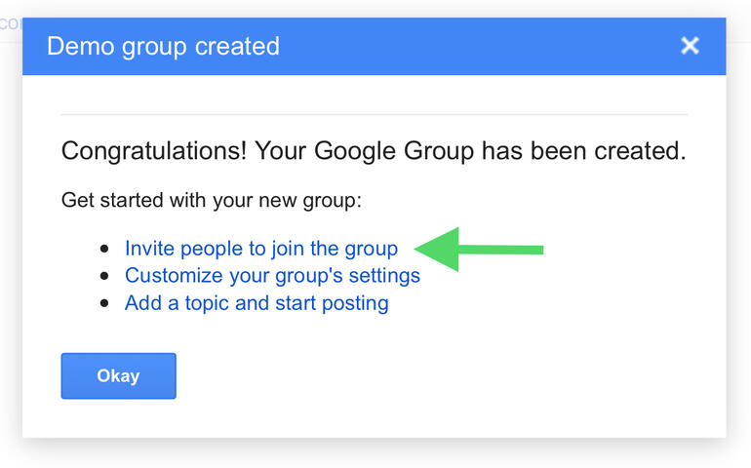
Step 3

Slide 17
Invite members / Direct add members
Next, you'll see a message that indicates that "Your Google Group has been created.“
Select the "Invite people to join the group" link. This will take you to a page where you may--not surprisingly--invite people to join.

Slide 18


Email Pal / Email penpals

Slide 19
Purpose:
Used To Practice Reading And Writing In A Foreign Language
To Learn More About Other Countries And Life-styles
Share one’s Culture, Tradition, Nature, Habits, Feelings, Information, etc.
To Make Friendship
Pen Pal Clubs Of Special Interest Groups Can Nowadays Be Found On The Internet

Slide 20


Blog / Weblog
Personal
Professional

Slide 21
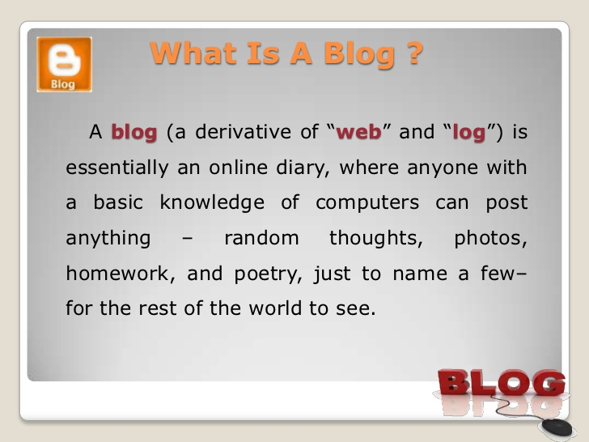

Slide 22
Blogs are usually maintained by an individual with regular entries of commentary, descriptions of events, or other material such as graphics or video. ... Microblogging is another type of blogging, featuring very short posts.

Slide 23
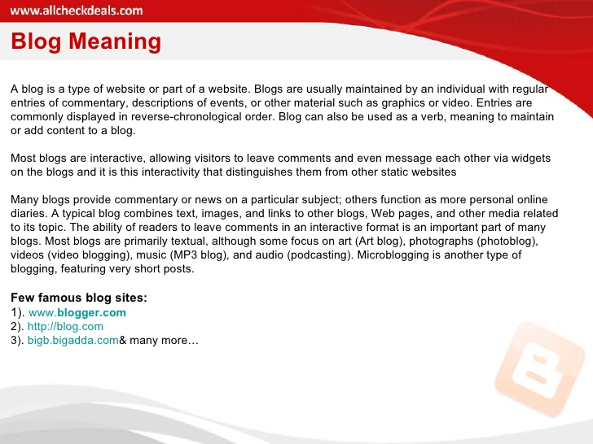

Slide 24
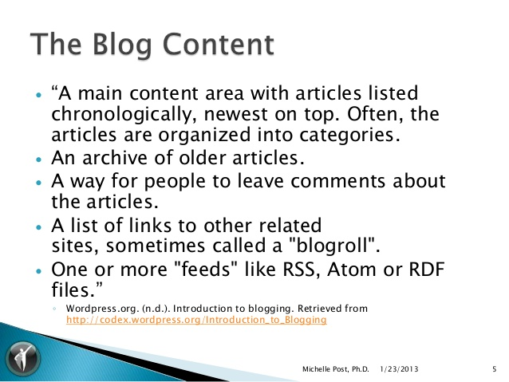

Slide 25
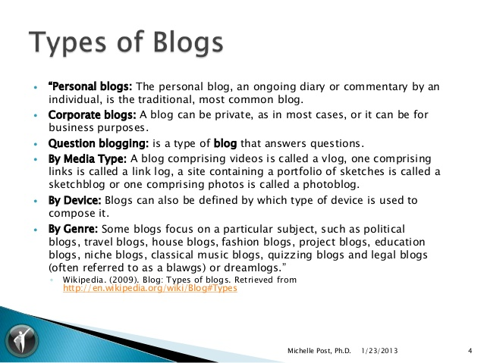

Slide 26
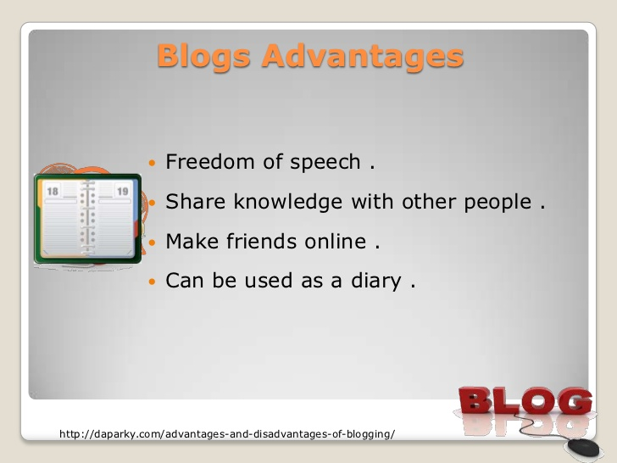

Slide 27
Thank you

