Slide 1
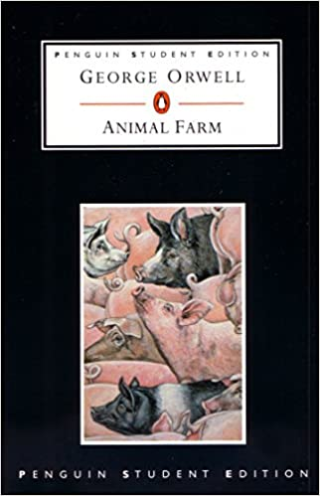
Animal Farm
George Orwell
17 August 1945
Allegorical Novella
Dr. Ujjwala Tathe

Slide 2
George Orwell
Real Name : Eric Arthur Blair
Born In Motihari, Bihar, India on 25 June 1903
English novelist, essayist, Journalist, Critic
Literary Contribution :
Animal Farm (1945) Political Allegory on Joseph Stalin’s Betrayal of Russian Revolution of 1917
Nineteen Eighty- Four ( 1949) – Warning against totalitarianism
Critic of Stalin & Stalinism

Slide 3
Background
Russian Revolution 1917 / Bolshevik Revolution / October Revolution
(November 6 & 7 , 1917)
Bolshevik party Leader – Vladimir Lenin
Launched bloodless seizure of Duma provisional government
Called for Soviet government ruled directly by councils of soldiers, peasants and industrial workers
The Bolsheviks and their allies occupied govt. buildings and other strategic locations in Petrograd (capital)
Formed a New Government
1918 : The Romanovs were executed by the Bolsheviks

Slide 4
Impact:
End of Centuries old empirical rule.
End of Civil War
Social and Political Changes
Formation of Soviet Union / USSR ( Union of Soviet Socialist Republic)
Lenin – Architect of USSR
First Head / Dictator of the world’s first communist state
Head of Russia till his death – 1924
Headship : 1917 - 24

Slide 5
Rise of Joseph Stalin (1924 – 1952)
After Lenin’s death Stalin removed the associate of Lenin Trotsky from all positions of power.
Trotsky was assassinated by Stalinist Agent in 1940.
Stalin’s Rule:
Rapid Industrialization
Agrarian Reforms Image – Autocratic Ruler
Series of Purges Led to Death and Imprisonment of millions of soviet citizens
Stalin was Known for -- Rude manners, Excessive Power, Ambition, Politics
Slogan : “ Thank You Dear Comrade Stalin for a Happy Childhood.”

Slide 6
Marxism | Communism
A political ideology based on Karl Marx’s ideas is known as Marxism. | A political system based on Marxist ideology is known as Communism.
Marxism can be considered as the theory. | Practical Implementation of Marxism could be considered as Communism.
The framework on which a state is developed is known as Marxism | A stateless society where all the people are considered equal and treated equally is known as Communism.
Marxism is a way to view the world, a system of analysis. | A form of Government, condition of a society, a political movement can be considered as Communism.
The transformation of society into Socialism, and ultimately to Communism is the philosophy of Marxism. | Communism also believes in the same transformation, but the differentiating factor between the two is the path that needs to be taken for the transformation to take place. Communism believes in the transformation through revolutions.
One may not say that the birth of Marxism was dependent on Communism. | The very existence/birth of Communism depended on Marxism.

Slide 7
Totalitarianism / Authoritarian | Communism
Total Control: State Is Powerful | Society Is All Powerful
State Controls Everything | Believes In Stateless, Classless Society
No Value For An Individual’s Thoughts Or Opinions | Community Takes All Major Decisions (Central Planning)
No Freedom For An Individual; People Are Bound By The State | Society Has A Free Hand.
Right Wing | Left Wing ( Govt owns everything & People own the govt.)
Believes In State Ownership | Believes In Common Ownership Of Everything
The State Handles All Resources | Society / Community Is The Sole Owner Of Resources (Abolition – Private Property)
Controls Beliefs, Values Of The Society, Interferes In Private Life | No Control , No Interference
 | Government Is Controlled By One Political Party And Political Dissent Is Not Tolerable.
 | Calls For Govt. To Take Control Of Everything – Economic Control

Slide 8
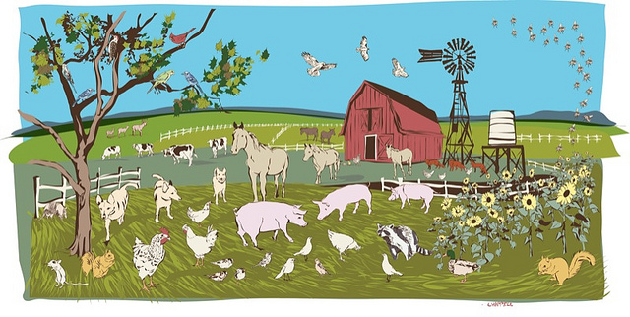
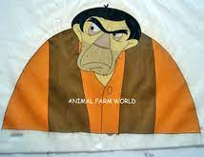
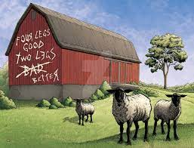
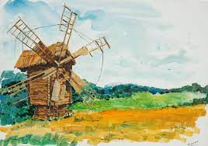
Animal Farm
Satirical Tale against Stalin
Farm : Manor Farm
Owner : Mr. Jones

Slide 9
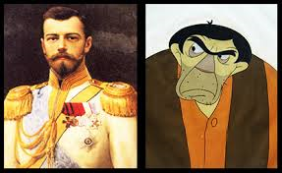
Mr. Jones
Irresponsible to his animals (lets them starve)
Sometimes cruel (uses whip to beat animals)
Sometimes kind (mixes milk in animal mash)
Czar Nicholas II
A poor leader at best, compared to Western monarchs and leaders
Cruel, sometimes brutal with opponents
Kind, sometimes hired students as spies so they could earn $

Slide 10
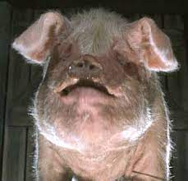
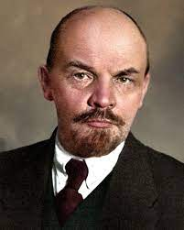
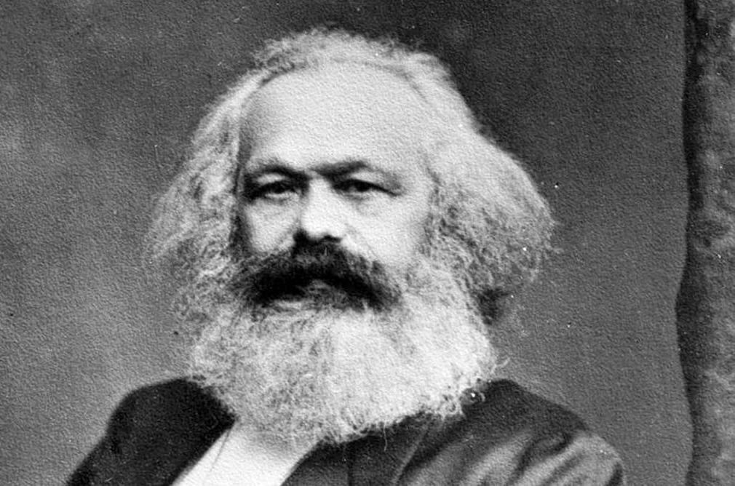
Old Major
Taught Animalism
Workers do the work, rich keep the $, animals revolt
Dies before Revolution
Karl Marx / Vladimir Lenin
Invented Communism
“Workers of the world unite", take over gov't
Dies before Russian Revolution

Slide 11
Animalism
No Owners, No Rich, But No Poor
Workers Get A Better Life, All Animals Equal
Everyone Owns The Farm
Communism
No Owners, No Rich, But No Poor
All People Equal
Gov't Owns Everything, People Own Gov't

Slide 12
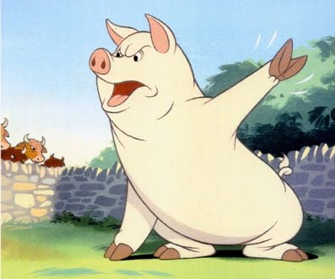
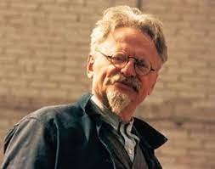
Snowball
Young, smart, good speaker, idealistic
Really wants to make life better for all
One of leaders of revolution
Chased away into exile by Napoleon's dogs
Leon Trotsky
Other leader of "October Revolution"
Pure communist, followed Marx
Wanted to improve life for all in Russia
Chased away by Lenin's KGB (Lenin's secret police)

Slide 13
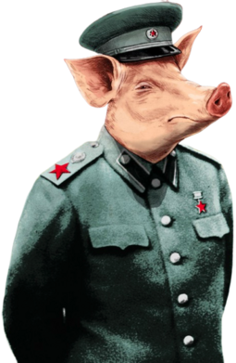
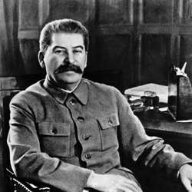
Napoleon
Not a good speaker, not as clever as Snowball
Cruel, brutal, selfish, devious, corrupt
His ambition is for power, killed opponents
Used dogs, Moses, and Squealer to control animals
Joseph Stalin
Not a good speaker, not educated like Trotsky
Same as Napoleon, didn't follow Marx's ideas
Cared for power, killed all that opposed him
Used KGB, allowed church, and propagandized

Slide 14
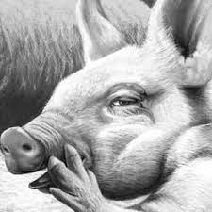
Squealer
Big mouth, talks a lot
Convinces animals to believe and follow Napoleon
Changes and manipulates the commandments
Propaganda Dept. of Lenin’s Government / Communist Govt.
Worked for Stalin to support his image
Used any lie to convince the people to follow Stalin
Benefited from the fact that education was controlled

Slide 15
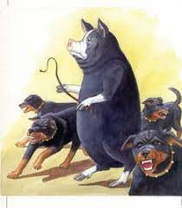
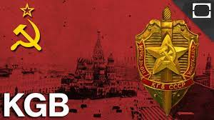
The Dogs
A private army that used fear to force animals to work
Killed or intimidated any opponent of Napoleon
Another part of Napoleon's strategy to control animals
KGB
Not really police, but forced support for Stalin
Used force, often killed entire families for disobedience
Totally loyal, part of Lenin's power, even over army

Slide 16
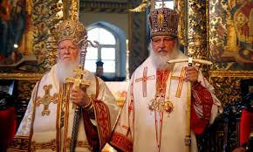
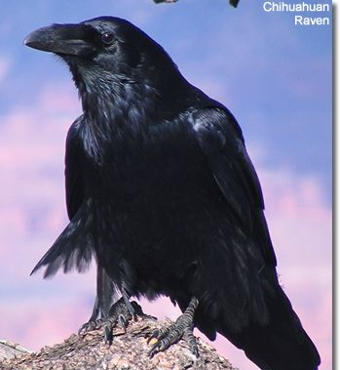
Moses the Raven
Tells animals about Sugar Candy mountain - Heaven
Animals can go there if they work hard
Snowball and Major were against him
They thought Heaven was a lie to make animals work
Napoleon let him stay because he taught animals to work and not complain
Religion
Marx said "Opiate of the people" and a lie
Used to make people not complain and do their work
Religion was tolerated because people would work
Stalin knew religion would stop
violent revolutions

Slide 17
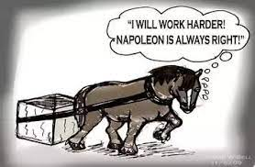
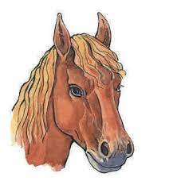
Boxer
Strong, hard working horse, believes in Animal Farm
"Napoleon is always right", "I must work harder"
Gives his all, is betrayed by Napoleon, who sells him
Clover
Dedicated But Tricked Communist Supporters
People believed Stalin because he was "Communist"
Many stayed loyal after it was obvious Stalin a tyrant
Betrayed by Stalin who ignored and/or killed them

Slide 18
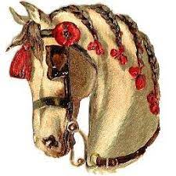
Mollie
was vain
loved her beauty and self
didn't think about the animal farm
went with anyone who gave her what she wanted
Vain, Selfish people
some people didn't care about revolution
only thought about themselves
went to other countries that offered more for them

Slide 19
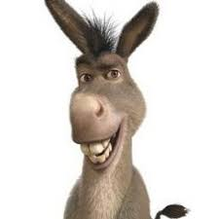
Benjamin
Old, wise donkey who is suspicious of revolution
Thinks "nothing ever changes", is right
His suspicions are true, about Boxer and sign changes
Sceptical people in Russia and Outside Russia
Weren't sure revolution would change anything
Realized that a crazy leader can call himself communist
Knew that communism wouldn't work with power
Hungry leaders

Slide 20
Overall Animal Revolution
It was supposed to make life better for all
Life was worse in the end
The leaders became the same as, or worse than, the other farmers
(humans) they rebelled against
Overall Russian Revolution
Supposed to fix problems from Czar
Life was even worse long after revolution
Stalin made Czar look like a nice guy

Slide 21
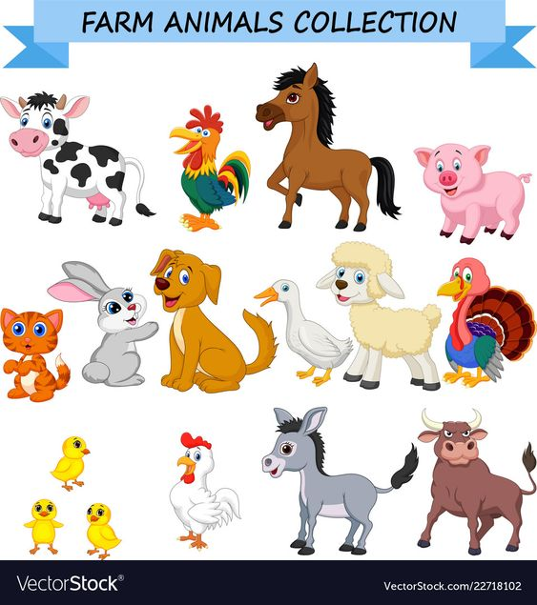
Animal Farm
George Orwell

Slide 22
Chapter I
Manor Form / Willingdon Farm
Old Major’s Dream – The Prize Middle White Boar – 12 Year Old – Wise And Benevolent Appearance
Meeting Of The Animals Of Manor Farm At Big Barn
Arrival Of Animals :
3 Dogs : Bluebell, Jessie, Pincher
Pigs Hens Pigeons Sheep Cows
Boxer : Tall, Enormous Beast, Has A White Strip Down His Nose – Steadiness Of Character, Tremendous Power Of Work
Clover: Middle Aged Motherly Mare
Muriel – White Goat
Benjamin – Donkey – The Oldest Animal On The Farm – Seldon Talks – Gives Cynical Remarks
Mollie – The Foolish, Pretty White Mare – Draws Mr. Jones Trap – Wears Red Ribbons
Cat Moses – The Tame Raven

Slide 23
Old Major’s Speech
Nature of Animal’s Life on the Farm
No Animal in England is Free
Man is the only Real Enemy they have
“Remove Man from the Scene and the root cause of hunger and overwork is abolished for ever”.
Man is the Only Creature that consumes without Producing.
When the animals get old , he either sales or kills them
Only Solution : Rebellion
All Men are enemies and all Animals are Comrades.
Whatever goes upon two legs is an enemy. Whatever goes upon four legs or has wings is a friend.
Animals must not imitate the man’s life style and attitude
All Animals are equal.
Song: Beasts of England

Slide 24
Chapter II
Early March
Old Major’s death
Secret Activities – next 3 Months
Impact of Major’s Speech – Completely New Outlook to Animals on life
Animals Prepared for the Revolution as a Duty
Role of Pigs : Considered as Cleverest of Animals
Teaching and Organising everyone
Snowball and Napoleon – Young Boars – Bred for sale
I I
Vivacious Berkshire Boar, not a talker, Gets his own way
Quicker in Speech
More Inventive

Slide 25
Chapter 7
Shortage of food – Starvation
Rebuilding of Windmill – more thicker and strong
Rumours by Human beings – famine, disease, fights, cannibalism, infanticide
Sheep – Convey lies through Whymper – No food shortage
Orders are issued through Squealer
Hen’s Protest – Punishment
Threat of Snowball – Rumours – corns, milk, eggs,seedbeds,fruits, broken windows, blocked drains, lost key of store-shed, etc.
Investigation of Napoleon – Snowball
Change in Napoleon’s appearance
Murder of Animals
Beast of Animals is forbidden
Animal Farm, Animal Farm, Never through me shall thou come to harm - Minimus

Slide 26
Chapter 8
Change In 6th Commandment – No Animal Shall Kill Any Other Animal Without Cause.
Squealer's Lies – Increase In Foodstuff
Cockrel – Napoleon’s Escort
Napoleon – Our Leader, Father Of All Animals, Terror Of Mankind, Protector..Loves Animals
Animals Lies – Hens, Cows,
7 Commandments –
Execution Of Hens
Timber Is Sold To Fredrick Not To Mr. Pilkington – Fake Notes
False Picture Of Outside World
Windmill Is Named – Napoleon Mill
Fredrick Attacks Windmill – Blasted – Battle – Decision To Rebuild The Windmill
Still Victory Is Celebrated – To Forget The Banknotes Fraud
Napoleon – Death Rumours –
Grazing Ground – Barley
5th Commandment – No Animal Shall Drink Alcohol To Excess.

Slide 27
Chapter 9
Boxer Is Hurt – Still Works Hard
Less Ration To Animals – Shortage Of Food
Squealer – Readjustment Not Reduction – Lies About More Food
Animals Total Belief In Squealer
More Pigs At The Farm
Building Of School
Green Ribbons For All Pigs
All Barley Is Reserved For Pigs – Liquor Production
Spontaneous Demonstration – Songs, Speeches, Processions, Marching, Military Formations, Green Banner – ‘ Long Live Comrade Napoleon’
Animal Farm Is Declared – Republic – President – Unanimous Selection Of Napoleon
Moses – Sugercandy Mountain – Pigs Declare Them Lies
Boxer Works Harder –Boxer Falls Ill – Taken To Glue Trader – Slaughtered – Death – Squealer’s Lies –
More Liquor

Slide 28
Chapter 10
Death of many old inmates – murial, bluebell, jessie, pincher
Clover n Benjamin – old
Snowball, boxer - forgotten
Napoleon – matured boar
Squealer – very fat
New animals – ignorant about the past history
Farm – prosperous , enlarged , Pilkington’s 2 farms are bought, windmill is rebuild, one more windmill, - milling corn, more pigs and dogs – hungry animals,
Still animals hopeful, proud
Sheep – are taken away – four legs good, two legs bettet
Pigs walk on hind legs
Pigs with whip
“All Animals are equal but some animals are more equal than others” – no commandments
Wireless telephones, clothes – pigs
Napoleon – in military clothes, pipe in mouth – his sow in dress
Deputation of farmers
Party – cards , drinks
Pilkington, Fredrick – appreciation of animal farm
No mistrust, misunderstanding

Slide 29
Pilkington – lower animals – lower classes
Napoleon – enterprise with human beings
No Animals will be addressed as comrades
No Boars’s Skull
Change in flag – No white hoof and horn --- plan green flag
Change in the Name – Animal Farm – Manor Farm
Quarrel
Animals – No change in Man and Pigs

Slide 30
Thank you

