Slide 1
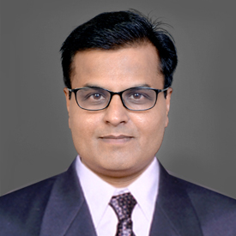
B.A. PART – III, SEMESTER – V (Paper - E)
ABILITY ENHANCEMENT COMPULSORY(CBCS) COURSE
ENGLISH FOR COMMUNICATION
Teacher
Dr. P.S. Sontakke
{ M.A., M.Phil., Ph.D., UGC-MRP }
Assistant Professor of English
E-mail Id – paragsontakke75@gmail.com

Slide 2
Module I (B) Interview
By V.V. John
Present extract is taken from Light Luggage.
It shows how smart candidates sometimes turn the tables upon the interviewers.
Generally, candidates don’t get jobs because young people presume to be more knowledgeable than the knowledgeable elders on the selection.
The selection boards can not be blamed because they are expected to assess the comparative suitability of young man, among many young men by talking to him for 15 minutes.

Slide 3
According to V.V. John, even the Gods would not be able to do this without jumping to conclusions.
Many times, candidates impress the interviewers but unfortunately that is considered as dandy behaviour & the candidate get rejected.

