Slide 1
B.A. PART – III, SEMESTER – V (Paper - E) ABILITY ENHANCEMENT COMPULSORY(CBCS) COURSE ENGLISH FOR COMMUNICATION Teacher Dr. P.S. Sontakke { M.A., M.Phil., Ph.D., UGC-MRP } Assistant Professor of English E-mail Id – paragsontakke75@gmail.com

Slide 2
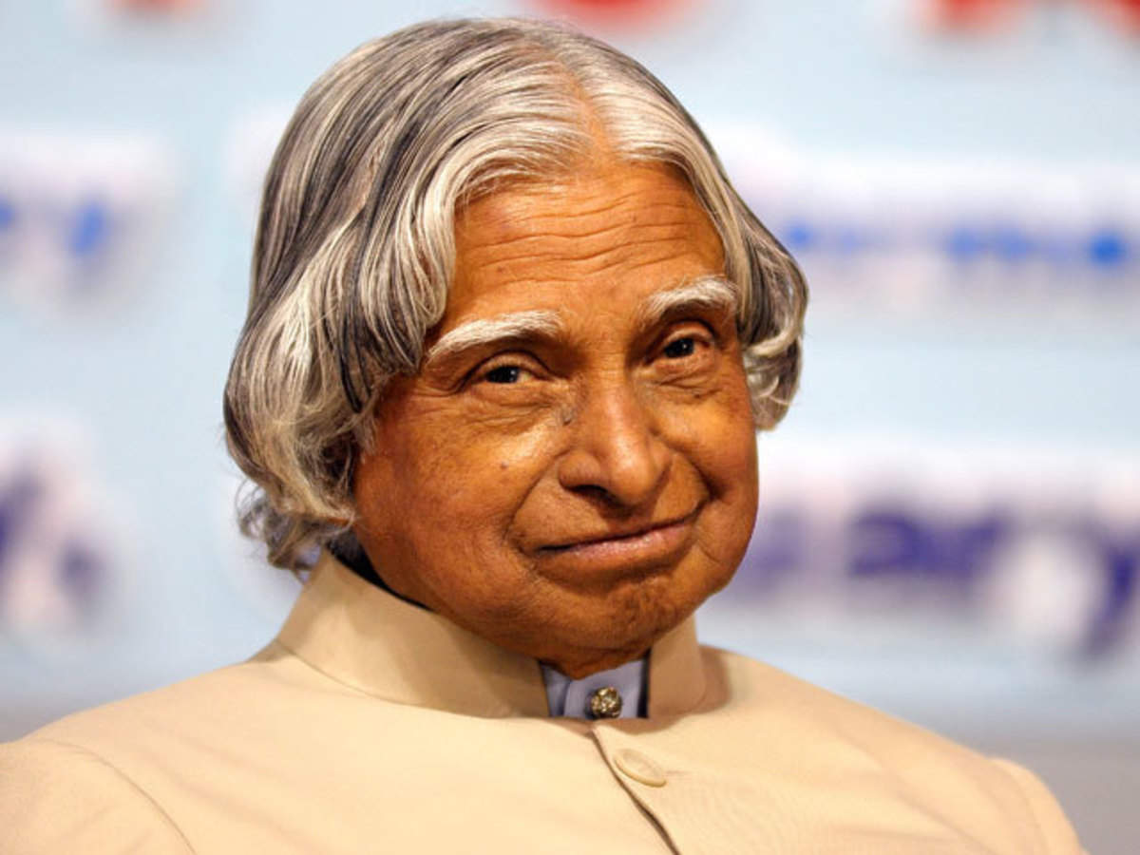
Module IV (B) Song of Youth
By A.P.J. Abdul Kalam (1931-2015)
As a young citizen of India, armed with technology, knowledge and love for my nation, I realize, small aim is crime. I will work and sweat for a great vision, the vision of transforming India into a developed nation, powered by economic strength with value system I am one of the citizens of the billion; Only the vision will ignite the billion souls. It has entered into me ; The ignited soul compared to any resource is the most powerful resource on the earth, above the earth and under the earth. I will keep the lamp of knowledge burning to achieve the vision - Developed India If we work and sweat for the great vision with ignited minds, the transformation leading to the birth of vibrant developed India will happen. I pray the Almighty: "May the divine peace with beauty enter into our people; Happiness and good health blossom in our bodies, minds and souls". APJ Abdul Kalam

Slide 3
The song of the youth, is a great & notable poem by Missile man of India, Dr. A. P. J. Abdul Kalam.
In this poem, Kalam explains to us what should be the youth's ideals & goals. He puts forward that, Youth has the greatest ability & will power to achieve.
In a country like India, where there are many youth, Kalam tells us that with constant efforts, It won't take longer to make India a developed country.
Kalam's vision for youth & the young minds is pretty clear, that He likes to motivate them & encourage them, for they are souls when ignited, can wear their wings of fire & bring the glory.

Slide 4
This poem tells us & gives us a hope that, we will be able to make our dreams true. The poem motivates the Indian youth.
Kalam had tremendous faith in the power of youth in constructing the future of a country.
He believed that young minds have superfluous possibilities & potentials that if equipped with knowledge & creativity can work wonders for a country.
He puts forward that, youth has the greatest ability & will power to achieve. In a country like India, where there are many youth, Kalam tells us that with constant efforts, it won't take longer to make India a developed country.

Slide 5
Kalam's vision for youth & the young minds is pretty clear, that he likes to motivate them & encourage them, for they are souls when ignited, can wear their wings of fire & bring the glory.
This poem tells us & gives us a hope that, we will be able to make our dreams true.

