Slide 1
B.A. PART – III, SEMESTER – V (Paper - E) ABILITY ENHANCEMENT COMPULSORY(CBCS) COURSE ENGLISH FOR COMMUNICATION Teacher Dr. P.S. Sontakke { M.A., M.Phil., Ph.D., UGC-MRP } Assistant Professor of English E-mail Id – paragsontakke75@gmail.com

Slide 2
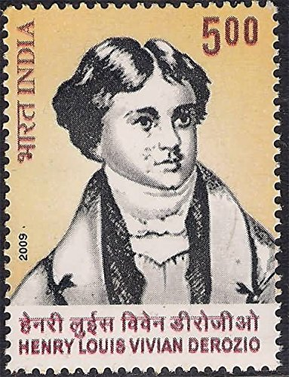
Module IV (C) The Orphan Girl
By Henry Derozio (1809-31)
Henry Louis Vivian Derozio was an Anglo-Indian poet & assistant headmaster of Hindu College, Kolkata.
He was a radical thinker of his time & one of the first Indian educators of Western learning & science of Bengal.
‘The Orphan Girl’ (1827) is a poem from the treasure of Indian Writing in English. The poet shows his sympathy toward an orphan girl (अनाथ). It is a heart-touching poem. It is a story about a girl’s lonely struggle after losing both her parents.

Slide 3
The poet describes a child’s hapless face, her loneliness & struggle.
This poem has a story-like structure. It begins with a prologue where Derozio introduces the unfortunate character of the girl.
In the following stanza, he describes how the innocent girl looks. She had black hair, a red cheek, a soft voice & a fair visage. This description of the girl portrays how innocent & noble the girl was.
Her father died in a war & her mother died of the pain of her husband’s death. It made the infant parentless. The last stanza of the poem starts telling about what happened to the girl afterward.
She was all alone. There was none to shelter her. Society did not even sympathize with the condition of the girl.

Slide 4
People criticized her if she strayed from the accepted norms.
After describing her condition, Derozio says that it is inhumane to hurt such a poor girl if she made a mistake. He wishes that some generous person may shelter her from sorrow & shame.
X - X - X

