Slide 1
REPRODUCTIVE HEALTH
Presented by
Dr. Ila Jogi
Head, Department of Home Science
Mahila Mhavidyalaya, Karad

Slide 2
Adolescence :
Adolescence is a period of rapid growth: up to 45% of skeletal growth takes place and 15 to 25% of adult
height is achieved during adolescence (Rees and Christine, 1989).
During the growth spurt of adolescence,
up to 37% of total bone mass may be accumulated (Key and Key, 1994).
Nutrition influences growth
and development throughout infancy, childhood and adolescence; it is, however, during the period of
adolescence that nutrient needs are the greatest (Lifshitz, Tarim and Smith, 1993).

Slide 3
Changes during Adolescence
Changes in height, weight and body composition
during adolescence
The time and tempo of changes in height, weight and body
composition can vary greatly between and among adolescents.
Changes in height
• 15-20% of adult height is gained during adolescence.
• Growth spurt starts later in boys than girls and has a higher peak
velocity than in girls. Linear growth can be slowed or delayed in
adolescence if diet is severely restricted in energy or energy
expenditure is increased as in highly competitive athletes.
Changes in weight
• 25-50% of final adult ideal weight is gained during adolescence.
• The timing and amount of weight gain can be greatly affected by
energy intake and energy expenditure.

Slide 4
Changes in body composition and skeletal mass
• In the pre-pubertal period the proportion of fat and muscle in
boys and girls is similar, and lean body mass is equal in both
sexes.
• Growing boys gain proportionately more muscle mass than fat,
and more lean body mass as compared to girls.
• As adults the normal percentage of body fat is about 23% for
women and 15% for men.
• Approximately 45% of skeletal mass is added during adolescence.
By the end of the second decade of life, 90% of total bone mass
is gained.
• Females with delayed puberty fail to gain bone mass at a normal
rate and show lower mineral density as adults. Nutrition is one
of the environmental factors that determines onset of puberty.
• The pubertal growth can be monitored by using height-for-age,
weight-for-age and body mass index (BMI)-for-age (weight/
height2).

Slide 5
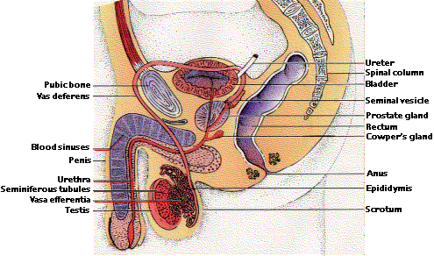
Male Reproductive System

Slide 6
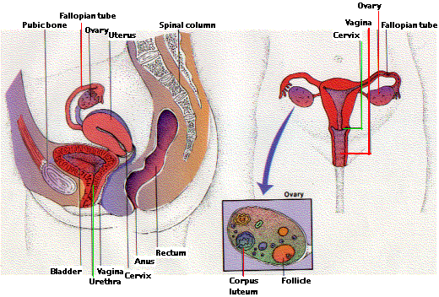
Female Reproductive System

Slide 7
Menstrual cycle
Females of reproductive age (anywhere from 11-16 years) experience cycles of hormonal activity that repeat at about one-month intervals. (Menstru means "monthly"; hence the term menstrual cycle.)
Menstruation refers to the periodic shedding of the uterine lining or refers to the discharge of blood and mucus from the uterus. It occurs in the women from puberty till menopause, at regular intervals of about a month. The average menstrual cycle takes about 28 days .The time at which menstruation first begins in girls is said as menarche. It corresponds to the period of puberty. The release of the egg cell to the outér end of uterine tube is called ovulation. Ovulation occurs midway of every menstrual cycle. The actual age at which cycles occur varies according to individuals’ race, climate, social conditions health etc. In India most girls begin to menstruate between the ages of 9 and 14yrs. The duration of the cycle is 5 days.

Slide 8
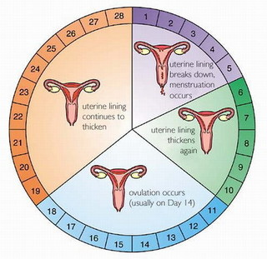

Slide 9
Changes during puberty:
Puberty is a time when there are a lot of changes in the girl not only physically but also in the way she feels.
Some of the physical changes that may occur are, changes in height or growth in weight, breasts, the body produce more sweat giving out a body odour, hair growth under the arms, on legs and in the pubic area and vaginal discharge begins. The onset of menstrual cycle is the biggest change in a girl during puberty. Psychological changes such as an increased shyness ,feeling of reserve and awakening of sexual feelings are experienced.
Many girls are worried that cycles are irregular at the beginning. But this is normal. It takes a while for the body to settle, which could be a few years after which the cycles will be regular.
Periodic headaches and general upsets of health , stomach pain are common.
Many girls have cramps like feeling in the abdominal area, backache, they can relieve by keeping a hot water bag, taking bath in warm water and doing some gentle exercises.
Many of the girls get anxious because of pimples. This is only natural because of the hormonal changes occurring in the body. But some basic care can be taken to minimize the same.

Slide 10
Care during menses
Regular cleansing of face with a cleanser. Care should be taken that face is not washed too many times because the skin tends to react and this produces more oil. Pimples should not be squeezed. Any good medicated soap or lotion has antibacterial properties that proves more useful than other products to reduce pimples.
According to certain religion having a bath during menstrual cycles is not acceptable. But nowadays with girls being an active participant in academic as well as other extra curricular and sports activities, following these sentiments would be unhealthy. Having a body wash twice a day during periods is advisable.
In the olden days women would use cloth pad which was not enough protection. It could be embarrassing as it could be smelly, sometimes could leak and stain and of course unhealthy, as dampness of the cloth could result in microbial growth.
Today we have other alternatives one of which is using sanitary pads. It is more hygienic and comfortable to use. But care has to be taken with pads too. They should be changed regularly. One should always clean the hands with soap after using them. It should be disposed in a safe manner by wrapping it in a paper and putting them in the waste bins.
Last but not the least many young girls at this age are very keen to stay slim and skip their lunch or breakfast. It is very essential to have a proper balanced diet during these growing years.

Slide 11
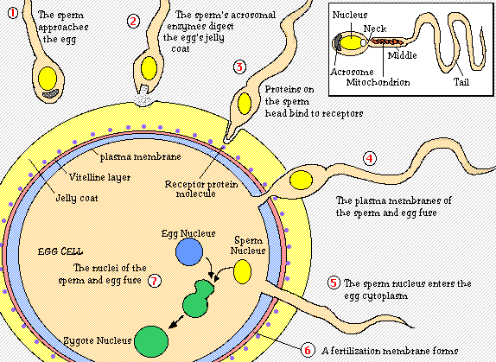
Conception

Slide 12
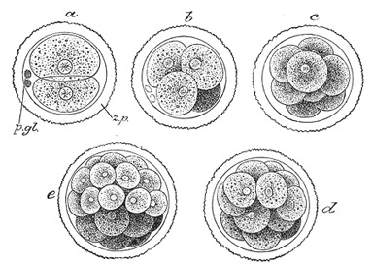
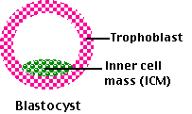

Slide 13
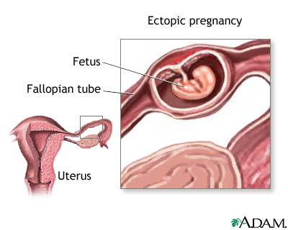

Slide 14
Children normally have a growth spurt during their adolescent years (12 to 18 years old).
A healthy diet for most adolescents is one that provides enough nutrients for growth.
A healthy diet also has the right amount of nutrients to keep an adolescent healthy and keep him from having health problems.
A poor diet may lead to health problems such as anemia (decreased oxygen going to body tissues), eating disorders, or obesity (being overweight).
A poor diet may cause other health problems later in life such as obesity, heart disease, or diabetes.
Regular physical activity can lower your child's risk of having some of these health problems

Slide 15
A healthy diet for adolescents should include different kinds of foods from all the food groups.
Meals should have enough protein (such as meat, beans and nuts) to help your child grow.
Meals should also have carbohydrates (kahr-bo-HI-drayt) (bread, pasta and cereal), fruits, and vegetables.
Meals should also include dairy products such as milk and cheese.
The kinds of foods your child eats should be high in vitamins and minerals.
Your child's diet should also be low in fat and sugar.
Eating foods that are low in fat and sugar can help your child stay at a healthy weight, and decrease his risk of health problems.

Slide 16
What foods should be avoided eating and drinking?
Don’t eat a lot of fast food and convenience foods.
These foods are high in fat and sugar. Some examples of fast foods and convenience foods are hamburgers, french fries, pizza, potato chips, candy and soda. These high fat, high sugar foods may replace healthy foods if your child eats or drinks them too often. For example, adolescents may drink a lot of soda and not drink any milk.
Your child may not get enough calcium if he does not drink milk or eat other dairy foods.
High fat, high sugar foods may also cause your child to eat too many calories. Eating too many calories may cause your child to become overweight.
Plan and pack healthy foods if your child eats meals and snacks away from home.

Slide 17
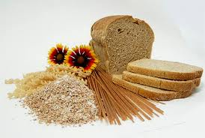
What should adolescent eat and drink for a healthy diet?
Breads, cereal, rice, and pasta:
Eat six to eleven servings each day.
One slice of bread, small roll, or 6-inch tortilla.
One-half of a cup of cooked cereal, rice, or pasta.
One-half of a hamburger bun, English muffin, or bagel.
Three to four small crackers.
One ounce or about one-half of a cup of ready-to-eat cereal.
Vegetables:
Eat three to five servings each day.
One-half of a cup of cooked or chopped, raw vegetables.
Three-fourths of a cup of vegetable juice.
One cup of leafy green raw vegetables such as lettuce or spinach.

Slide 18
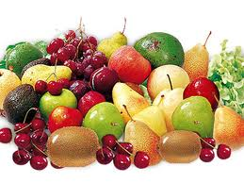
Fruit:
Eat two to four servings each day.
One whole fruit such as a medium banana, apple, or orange.
One melon wedge, one-fourth of a melon, or one-half of a grapefruit.
Three-fourths of a cup of fruit juice.
One-half of a cup of berries, or one-fourth of a cup of dried fruit.
One-half of a cup of chopped or canned fruit.
Milk, yogurt, and cheese:
Eat three servings each day.
One cup of milk.
Eight ounces of yogurt.
One and one-half ounces of natural cheese.
Two ounces of processed cheese.

Slide 19
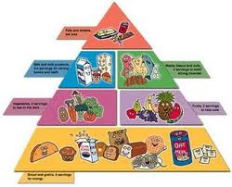
Meat, poultry, fish, dry beans, eggs, and nuts:
Eat two to three servings each day. One serving equals two to three ounces of a protein food such as:
Two to three ounces of cooked lean meat, poultry, or fish.
Two teaspoons of peanut butter.
One egg (eating two eggs counts as one serving).
One cup of cooked dry beans.

Slide 20
What are some other guidelines for a healthy diet?
Your child still learns from your eating habits.
Take a healthy diet by setting a good example.
Buy healthy foods for your family.
Encourage to eat regular meals and snacks even if he is busy.
Eat healthy meals together as a family as often as possible.
You may also need to help to plan your meals and snacks by packing a lunch.
You could also suggest that eat at restaurants that have healthy food choices.
Praise good food choices whenever you can.

Slide 21
Adolescents may want to follow a new fad diet (popular diet) if they see their friends or famous people following these diets.
These diets may not have all the nutrients your child needs to grow and stay healthy.
Dieting too often may also lead to eating disorders such as anorexia nervosa and bulimia nervosa. Anorexia nervosa is refusal (not wanting) to eat. Bulimia nervosa is binge eating followed by throwing up, using laxative medicine, fasting (not eating at all) or heavy exercise.
You should talk with your child about the reasons why eating a healthy diet is important. Talk with your caregiver if you are worried about your child's eating habits.

Slide 22
Risks:
Adolescents who do not eat a wide variety of foods are at risk of not getting enough nutrients.
Many adolescents eat foods that are high in fat and sugar very often.
High fat, high sugar foods may cause your child to become overweight or have other health problems.
High fat, high sugar foods may also cause your child to not get enough nutrients.
Dieting too often may cause adolescents to develop eating disorders such as anorexia nervosa and bulimia nervosa.

Slide 23
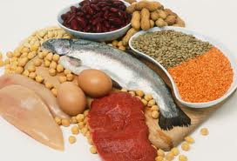
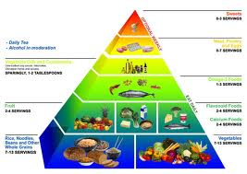
Normal Requirements :
Calories- females require 2200 Cal./day and males 2500-3000.
Protein- females 0.8g/kg/d males 1.0g/kg./d (30% of caloric intake) weight lifters only 1.6-1.7 mg/kg/d. Many teens meet or exceed this level, including vegetarians.
Fats- 30% of daily calories. Most adolescents get enough fats. Teenagers should be taught to read labels and learn about fat content of foods.

Slide 24
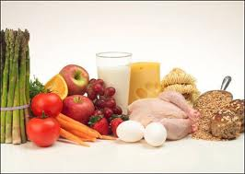
Zinc- 12-15 mgs/day. Found in meats, eggs, seafood, and dairy products
Fiber-20-25 grams/day. Found in fruits, vegetables, grains, beans, and cereals.
Vitamins-most commonly adolescents are deficient A, B6, E, D, C, and folic acid. Usually, adolescents who are eating normal daily requirements of nutrients are not deficient in vitamins. Vitamin supplements may be added to meet requirements.
Vitamin D – 400 IU/day. Found in fortified milk and cereal, egg yolks. Prevalence of deficiency is 14%; 20 times higher in non-Hispanic, black adolescents, twice as high in females and inversely related to weight (using the definition of vitamin D deficiency as a serum level of 25-hydroxy vitamin D <20 ng/mL)

Slide 25
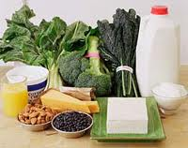
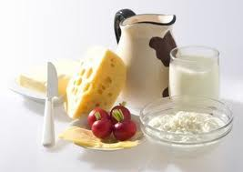
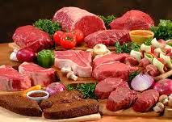
Calcium- The majority of bone mass deposition occurs during adolescence. Daily requirement 1500 mg/day. Sources include dairy products, calcium enriched orange juice, green leafy vegetables, sardines, soymilk, tofu or antacid tablets.
Iron- requirements are high during adolescence because of growth. Requirement higher in menstruating females. Good sources include meats, green vegetable, cereals fortified with iron, fish, poultry, eggs, and nuts

Slide 26
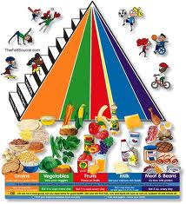
Overall diet: Fewer than 2% of adolescents consume enough fruits and vegetables. Intake of fruits and vegetables should total 3.5-6.5 cups per day. Adolescents should have 3 cups of skim/fat free milk per day. Sugar-sweetened drinks should be avoided as they displace more nutrient rich sources from the diet and 500 kcal per day of sugar-sweetened drinks is equal to 50 pounds per year. The AAP recommends limiting fast food consumption as a way to prevent obesity.

Slide 27
TIME MANAGEMENT
In this universe of abundant time, our time is still finite. God has allotted equal time to wealthiest and to the poorest, leaders and their followers, presidents and commoners.
Benjamin Franklin said ‘Time is money’. This is an under-statement. In fact, time is more than money. While money can be saved, time can not be saved for the future.
As we go up in our life the demand for our time would keep on increasing; however, its supply would be static.

Slide 28
The wealth and income of each one of us may go up and vary from person to person yet the time available to each one of us would remain static and exactly the same. i.e. 24 hours a day. While money lost can be recovered through special efforts, time lost is lost for ever.
Time can multiply money but money cannot multiply time.
We can however gain some time with money by delegating some work to others.
Let us therefore, manage our most precious asset in the most prudent way.

Slide 29
We can start managing our time by adopting the following practices:
Let us focus on results, not on activities.
Let us plan to do what is important rather than what is urgent most of the time.
Let us keep a diary and a ‘To Do’ list for each day- in order of priority.
Let us time our activities.
Let us learn to complete each job satisfactorily the very first time.
Let us choose our words judiciously, to be effective communicators. (Miscommunication causes maximum wastage of time).

Slide 30
Let us write everything in the right place in the very first time.
Let us have a place for everything and let’s make its place closet to where it is used.
Let us label everything.
Let us have a very efficient filling system for all our papers and records.
Let us learn to delegate effectively all the work which can be done by others.
Let us to learn to say ‘no’ without offending people.

Slide 31
Let Us Manage Our Lives Through Time Management
Since time management is life management, managing time is as complex as life itself.
To realize the value of one year: Ask the student failed his final exam.
To realize the value of one month: Ask the mother who has given birth to a one month premature baby.
To realize the value of one week: Ask the editor of the weekly newspaper.

Slide 32
To realize the value of one day: Ask the daily wage earner who has 10 mouths to feed.
To realize the value of an hour: ask the lovers who are waiting to meet.
To realize the value of a minute: Ask the person who has missed the train, the bus, or the plane by a minute.
To realize the value of a second: Ask the person who has survived an accident.
To realize the value of a millisecond: Ask the person who has won only a silver medal in the Olympics, missing the gold.

Slide 33
Life Time Goals
The first step in setting personal goals is to consider what we want to achieve in our lifetime (or, atleast in next five years) as setting Lifetime Goals give us an overall perspective that shapes all other aspects of our decision making.
To give a broad, balanced coverage of all important areas in our life, let us try to set goals in some of these categories (or in categories of our own, where these are important to us):
Education:
Is there any knowledge in particular we want to acquire? What information and skills will we need to achieve other goals?
Career:
What level we want to reach in our career?

Slide 34
Financial:
How much we want to earn and by what stage?
Physical:
Are there any athletic goal we want to achieve, or we want good health deep into old age? What steps are we going to achieve these?
Family:
Do I want to get married? If so, how I am going to be a good partner? How do I want to be seen by a partner or by member of my extended family?

Slide 35
Attitude:
Is any part of my mindset holding me back? Is my behaviour (or part of it) upsetting me or others? If so, let me set the goals to improve my behaviour or find a solution to the problem.
Pleasure:
How we want to enjoy our life? We should ensure that a good part of our life is for us?
Public Service:
Do we want to make world a better place? If so, how?

Slide 36
Let us spend some time brainstorming these and then select one goal on each category that best reflects what we want to do. Then consider trimming again so that we have a small number of really significant goals on which we can focus.
As we do this, make sure that the goals that we set are the ones that we genuinely want to achieve, not the ones that our parents, family, teachers or employees might want (If we have a life partner, we should also consider that what he or she wants; however we should make sure that we also remain true to ourselves).

Slide 37
Let Us Start Working On Our Lifetime Goals
Once we set our lifetime goals, set a 10 year plan of smaller gols that we would complete if we are to reach our lifetime plan. Then let us set 5 year plan and 1 month plan of progressively smaller goals that we would reach to achieve our lifetime goals. Each of these should be based on the previous plan.
Then let us create a list of things that we should do today to work towards our lifetime goals.
Finally, let us keep on reviewing our plans and make sure that they fit the way in which we want to live our life.

Slide 38
Staying On Course
Once we have decided our first set of plans, keep the processes going by reviewing and updating our to-do list on a daily basis. Periodically let us review the long term plans, and modify them to reflect our changing priorities and experience

Slide 39
Goal Setting Tips
State each Goal As A Positive Statement:
Let us express our goal positively. To become an effective public speaker let us say to ourselves – ‘Feel confident while speaking’.
Let Us Be Precise:
Set a precise goal, putting in dates, times and amounts so that we can achievement. If we do this, we will know exactly when we have achieved the goal and can take complete satisfaction from having achieved it.
Let Us Set Priorities:
When we have several goals, let us give each such goal a oriority rating. This helps us to avoid feeling overwhelmed by too many goals, and helps to direct our attention to the most important ones.

Slide 40
Let Us Write Down Our Goals:
This crystalise them and gives them more force.
Let us Keep Operational Goals Small:
Keep low level goals we are working towards small and achievable. If a goal is too large, then it can seem that we are not making progress towards it. Keeping goals small and incremental give us more opportunities for rewards.

Slide 41
Let Us Set Performance Goals, Not Outcome Goals:
We should take care to set goals over which we have as much control as possible.
There nothing much depressing than failing to achieve a personal goal for reasons beyond our control.
In business, there could be bad business environment or unexpected effects of government policy.
In sport for example, these reasons could include poor judgement, bad weather, injury or just plain bad luck.
If we base our goals on personal performance, then we can keep control over the achievement of our goals and draw satisfaction from them.

Slide 42
Let Us Set Realistic Goals:
It is important to set goals that we can achieve.
All sorts of people (employers, parents, media, society) can set unrealistic goals for us. They will often do this in ignorance of our desires and ambitions.
Alternatively we may set goals that are too high, because we may not appreciate either the obstacles in the way or understand quite how much skill we need to develop to achieve a particular level of performance.

Slide 43
Achieving Goals:
When we have achieved a goal, take the time to enjoy the satisfaction of having done so.
Absorb the implications of goal achievement, and observe the progress we have made towards other goals.
If a goal is a significant one, let us reward ourselves appropriately.
All this helps us build the self-confidence we deserve.

Slide 44
With the experience of achieving this goal, let us review the rest of goals:
If we achieved our goal too easily, make us make other goals harder.
If a goal take a dispiriting length of time t achieve, let us make the other goals a little easier.
If we learn something that would lead us to change other goals, let us do so.
If we notice a deficit in our skills despite achieving the goal, decide whether to set goals to fix this.

Slide 45
Failure to meet these goals does not matter much, as long as we learn from it.
Remember too that our goals will change as time goes on. So let us adjust them regularly to reflect growth in our knowledge and experience, and if goals do not hold any attraction any longer, then let us drop them.
Goal Setting is an Important Method of :
Deciding what is important for us to achieve in our life.
Separating what is important from what is irrelevant, or a distraction.
Motivating ourselves and
Building our self confidence, based on successful achievement of goals.

Slide 46
Let Us Try To Fill Our Day with What Is Important Rather Than Urgent
Urgent And Important
Repairing of vehicles
Telephone Repair
Electricity Repair
TV/Cable Repair
Preparing for forthcoming marriage of a family member
Resumption of water supply
Attending the marriage of someone close
Attending a funeral/cremation/condolence meeting
Replying business e-mail
Learning the intricacies of new job

Slide 47
11.Understanding the functioning of new machine
Inoculation of children
12.Visiting a dentist when having a toothache
13. Meeting the boss for some important instructions
14. Rushing to help someone who has met with an accident
15. Visiting a patient in hospital who is serious and.
16. Depositing insurance premiums
17. Buying gifts for an immediate event
18. Booking a cinema/railway/air/bus ticket
19. Sanitary fitting repair
20. Filling of income tax returns

Slide 48
Important But Not Urgent
House construction
Visiting someone in hospital who has been recovering
Learning a language
Pursuing a hobby
Replying friends emails
Buying life insurance policies
Learning meditation and pranayam
Undertaking regular medical check-ups
Coaching children
Meeting relatives or close family within the city
Getting the car serviced
Upgradation of office computer
Reading good book

Slide 49
Urgent But Not Important
Attending a phone call (Some of the calls may not be important)
Attending the visitors or strangers who have no serious business with us
Submitting the reports that may be required but not important
Meeting called by the boss in which your presence may not be necessary

Slide 50
Neither Urgent Nor Important
Gossiping
Reading glossy magazines
Shopping for fun
Watching the whole of a cricket match (Live)
Taking unnecessary interest in other’s personal matters
Channel surfing on T.V.
Watching movie that has already been watched
Internet surfing
Visiting friend and neighbours aimlessly
Making lengthy telephone calls aimlessly

Slide 51
Let Us Focus On results, Not Activity
Sometimes we take satisfaction from the endless activities we are engaged in and feel happy about our constant dynamism. But, at the end of the day, when we look at the end result of all the activities, there is no much to be pleased with. It appears that we have been busy doing with nothing.
A wise time manager delegates the routine and less important work to his team members and tries to focus on the more important tasks.
And a still wiser executive is the one who delegates even the more important tasks to his juniors and focuses on the most crucial decisions and problems.

Slide 52
We need to start any task with an end in mind. For example, reading a book is an activity and the end result is delight, knowledge or enhancement of our ability;
Jogging is an activity and keeping fit or reducing weight could be its end result;
Meditation may be an activity and it could be aimed at improving one’s mental and spiritual health.
While undertaking any activity, we should ask ourselves the question: ‘Why am I undertaking this activity?
By getting an honest answer to this question, we shall be able to delete from our time plan a lot of unnecessary activities that will ‘fill up’ our time.

Slide 53
Thank you…

Slide 55
Definition of Personality: “the quality or state of being a person”
Usually when we talk about someone's personality, we are talking about what makes that
person different from other people, perhaps even unique. However, this aspect of
personality covers only individual differences.
Personality is a characteristic way of thinking, feeling, and behaving. Personality
embraces moods, attitudes, and opinions and is most clearly expressed in interactions
with other people. It includes behavioral characteristics, both inherent and acquired, that
distinguish one person from another and that can be observed in people's relations to the
environment.

Slide 56
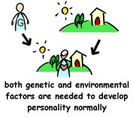
2. Factors affecting development of personality
Psychologists say that there are two main factors which affect the development formation
of a person's personality. They are:
Genetic Factors (some call this factor "Nature")
Environmental Factors (also referred as "Nurture")

Slide 57
Psychologists have, in the past, had disputes over the topic of "Nature VS Nurture".
"Nature VS Nurture" indicates that biological and environmental factors compete against
each other to develop a person's personality. Also, one of these two factors may be more
dominant than the other. Scientific discoveries have shown to us now, that both of these
two factors are needed for a person's personality to develop normally.

Slide 58
3.0. Tips for developing a pleasing personality
3.1. Have a Positive Self-Image
Our self-image is the complex impression we have about our physical appearance, social
rules, personal history and personality traits; and it matters a lot. The image we have of
ourselves is an important factor in the development of our skills and our personality, in
the maintenance of our emotional health and in the sheer enjoyment of life!
Those with a negative self-image tend to:
Lack self-confidence.
Feel insecure, skeptical and fearful.
Accept being ignored, hurt and rebuffed.
Have no pride in their achievements.
Feel embarrassed by compliments.

Slide 59
Those with a positive self-image tend to:
Accept themselves as they are.
Accept others as they are.
Feel secure and confident.
Have reasonable pride in themselves and their achievements.
Accept compliments gracefully.

Slide 60
a) I’m not O.K., you’re O.K. (The Sulk)
Such a person
Is an introvert and cannot accept himself.
Suffers from an inferiority complex and gets away from others.
Thinks his life is not worth much, so looks for support.
Gets negative strokes.
b) I’m not O.K., you’re not O.K. (The Loser)
Such a person
Rejects himself, so does not trust himself and others.
Cannot get along with others, easily gives up.
Thinks that life is not worth living, blame the whole world for his problems.
Gives and gets negative strokes.

Slide 61
c) I’m O.K., you’re not O.K.(The Arrogant)
Such a person
Forcibly asserts self-acceptance.
Is bossy and demanding, gets rid of others.
Thinks that his life is more important than that of others.
Gives negative strokes.
d) I’m O.K., you’re O.K. ( The Winner)
Such a person
Accepts himself and others as they are.
Gets along with others with mutual respect.
Thinks that life is worth living.
Gives and gets positive strokes.
We cannot be in one of these situations all the time. Depending upon our moods and the
circumstances, we fit into one or more of these categories.

Slide 62
So here is a 5-point technique of coming to grips with yourself to create a positive self
image.
Believe in yourself: Remember that your unique thumb impression makes
you a person uniquely gifted by God with special talents. So don’t compare
yourself to others. Compete only with yourself.
Rediscover yourself: Know your strength and build on them; also know your
weakness and correct them. The only person you can change is yourself. If
you don’t like the way you are, its time to change.
Discover others around you: Accept other people as they are because you
cannot change them but you can influence them to change only if you change
yourself.
Focus on Success: Unfortunately we choose to remember only bad times,
hardship and failures. Remember you were born to succeed. Think of your
past achievements and the good times you’ve had with your family and
friends.
Live and act for what you believe is right: A lot of people can tell you what
to do and what not to do, but nobody can really advise you correctly on ethics.
Set your own high personal moral standards and live up to them and you will
eventually be respected.

Slide 63
3.2. Aim at Excellence
Excellence means giving your best effort in whatever you do. Your best efforts are
different from another person’s best efforts and these cannot be compared because
everyone has strengths and weaknesses
Try the guidelines given below:
Be ambitious: Think big depending upon your personal strengths and
weaknesses. If you are strong in certain areas, keep it up; if you are weak in
certain other areas, get out of the rut by reducing your weaknesses. It is only
when you think and aim at something big that you will begin to act and
prepare in a manner that will bring you success
Set goals: Setting goals is like aiming at a target. It helps you plan activities
that will take you along the proper road to your destination.
Don’t be afraid of mistakes: There is nobody in this world who can honestly
and confidently say that he never makes mistakes. Nobody makes mistakes
for fun. All great discoveries and inventions have been made through trial and
error.

Slide 64
Have a positive attitude: Whenever we attempt anything there is a tendency
to be alert about the consequence of failure. Why not be alert to the
consequence of success also? After all we do not attempt anything in order to
fail, but we do get so obsessed with the consequences that we constantly have
starting trouble. There is always an element of risk in whatever we do.
Perseverance is the key: Whenever we don’t achieve what we have aimed at,
there is a tendency to give up. It is only in very exceptional cases that one
reaches the top in the first attempt. When you persevere, never give up; look
at the failure as lack of success or a temporary setback rather than a defeat.
Remember failures are stepping stones to success.

Slide 65
3.3. Improve your Memory
Good memory is not about learning things by heart. Research has shown that
memory depends upon two main factors:
a) Interest: We are determined to remember film songs and cricket statistics
because these interest us. We also remember the hates, the hurts and the
grudges that we have against people because we are interested in getting even
with them in future.
b) Practice: Together with interest and practice there is a strong desire to
remember things that we like. That is why we make it a point to remember
only those things.

Slide 66
So, if you want to cultivate a strong memory to remember your lessons, build a
positive attitude with the following tips:
Feel confident about yourself: Try to trust yourself and your memory, so
that you feel good about yourself and begin to read and learn with interest.
Have a reason for remembering: Nothing happens by chance. There is a
cause for every effect. So, when you want to remember anything, have a
strong and genuine reason. This helps you to motivate yourself particularly
when there is no support or backing from others. Many of our great leaders
have had a difficult childhood due to economic problems, but they had a
reason and a determination to become ‘somebody’ when they grow up; so
they persevered.

Slide 67
Use your senses as frequently as possible: Look for familiar characteristics,
listen to sounds and to what others are saying, sniff unusual smells or
fragrances, touch objects to get familiar and when it comes to food, taste it.
All our senses enable us to appreciate what is happening around us and when
these are unfamiliar, we tend to remember them, because they are exceptional.

Slide 68
Read or study systematically: Whenever you read your lessons, try to use
the PREP formula, which goes as follows:
P – Point: What is the theme of your lesson? What is the writer trying to bring to
your attention? Are there any other points that you should pay attention to?
R – Reason: What reasons does the writer give to justify his/her point? Do you
agree with the reasons? If you were the writer what reasons would you give?
Discuss this with your friends and come up with common ideas.
E – Examples: What examples does the writer give to strengthen the point and
the reason? Are these relevant to the subject? Can you cite other examples?
P – Point: Finally come back to the main point to remind yourself of what the
writer is stating in the theme of the lesson.
Device other acronyms when you study or read. It will make the exercise of
remembering a pleasure rather than a misery.

Slide 69
Follow up: Reading and learning anything once or twice is generally not
enough. It is necessary to read at least 8 to 10 times with concentration and
without disturbance so that the matter registers in your mind. After a break of about 2 months try to recall what you have read to test your memory. If you
find it difficult, then read again about 8 to 10 times to strengthen your
memory.
In your effort to create interest and to practice, you will need a lot of patience and perseverance. When you persevere, you put in efforts until you have achieved your target. When you fail to persevere, you tend to leave the job incomplete.

Slide 70
3.4. Nurture your Creative Power
Creativity is about doing ordinary task in an extraordinary manner.
All of us have creative bent, but what matters is how we identify this talent for creativity
and make use of it. Here are some suggestions:
Be aware: There is so much happening around us that we take things for
granted and just tolerate what is going on. It is important to be alert and
conscious or else we are merely existing rather than living.
Be curious: Keep asking questions. Find out why certain events take place
and their significance; like the numerous Indian festivals; or why people
behave the way they do, which sometimes defies logic and understanding.
Albert Einstein had the habit of lying down on the grass and looking up at the
sky. His teachers often told him that he would never succeed in life, yet he
introduced the Theory of Relativity for which he won the Nobel Prize for
Physics.

Slide 71
Be open to change: The world around us is changing rapidly because new
and imaginative ideas are being generated almost everyday in every field.
Be prepared to learn: Knowledge is not a monopoly of any person or a
group of persons. Learning is a lifelong process.
Keep trying: We seem to cultivate a tendency of giving up all efforts after a
few tries. In spite of the many odds that we face, patience and perseverance
has always been rewarded in the long run.

Slide 72
3.5. Use your Creative Power
All of us have creative talent, but we need to cultivate the right attitude to express our
creativity.
One of the tricks is: SCAMPER – acronym
S – Substitute: Use alternated methods and different means. There are many ways to
doing the same job. What we need is the proper result at an economical cost.
C – Combine: Unite, bring together, team up.
A – Adapt: Adjust to changing times, purpose, conditions and needs. Its time we gear
ourselves to a fast-changing world.
M – Modify: Increase, reduce, change the format or structure.
P – Play around: Try something new and bold even if it involves taking some calculated
risk.
E – Eliminate: Remove, omit or leave out. Our lives are geared around systems prepared
for us by “experts”. To add to that there are traditions to follow. So, we prefer to follow
tradition rather than risk criticism. Yet, you will appreciate that those who have created
history are the ones who dared to be different, particularly elimination.
R – Re-arrange: Reverse, re-order, and change the purpose of use.

Slide 73
4.6. Win over Other People
Accept others as they are: Everyone is different. No two human beings are
alike. While, I may not agree with their thinking, I should surely respect it,
because I cannot change anyone except myself.
Appreciate others: Everybody, young and old alike, desires and deserves
appreciation, because it motivates everyone to do better; unfortunately,
appreciation is lacking in many of us and as a result, people are not motivated
to put in their best efforts. When you show appreciation, you encourage others
to participate in activities with renewed enthusiasm.
Avoid open criticism: There are many people who cannot appreciate the
good in others but on the contrary they are quick to criticize and that too in the
presence of others. This only causes depression and frustration.
Listen carefully: When we listen with care we indicate to the other person
that we are attentive and interested.
Be friendly: When you offer your friendship genuinely, it is the first step in
helping the other find his/her self-confidence.

Slide 74
4.0. Importance of grooming and first impression
What is grooming?
To make neat or attractive
To take care of one’s external appearance
In what way does grooming help develop your personality?
Grooming helps in three major ways:
a. When you look good, you feel good,
b. When you look good, other people have a better impression of you and take
you more seriously
c. Grooming involves good hygiene that in turns leads to better health and
overall radiance.
Grooming does for a person what the sun does for the sky: it lights up everything.

Slide 75
Personality tells about competence. “This need not be a correct statement but normally
many people first judge a person based on appearance, verbal communication and
behavior. This may not be correct in many cases but it is normal. Many a time actual
performance and character of a person is ignored initially.
To improve ‘acceptance by people’ one has to work or groom in many areas.

Slide 76
4.1 First Impression –Does it matter?
It really matters as first impressions are lasting impression.
You have thirty seconds or less to make a first impression. People appraise your visual
and behavioral appearance from head to toe. They observe your demeanor, mannerisms,
and body language and even assess your grooming and accessories – watch, handbag,
briefcase etc. This first impression process occurs in every new situation. Within the first
few seconds, people pass judgment on you – looking for common surface clues. Once the
first impression is made, it is virtually irreversible. Whatever happens during that time
sets the stage for future relationships. You’re either creating positive impressions that
will open doors, or negative impressions with untold consequences. Many times, we
don’t know that people might think poorly of us because they simply avoid us. Or we’ve
unknowingly created obstacles in a relationship and have to work that much harder to
establish trust.

Slide 77
The process works like this:
If you appear to be of comparable business or social level, you are considered
suitable for further interaction.
If you appear to be of higher business or social status, you are admired and
cultivated as a valuable contact.
If you appear to be of lower business or social standing, you are tolerated but
kept at arm's length.
If you are in an interview situation, you can either appear to match the
corporate culture or not, ultimately affecting the outcome.

Slide 78
It is human nature to constantly make these appraisals, in business and social
environments. You may hardly have said a word, however once this thirty-second
evaluation is over, the content of your speech will not change it. When you make the best
possible first impression, you have your audience in the palm of your hand. When you
make a poor first impression, you lose your audience’s attention, no matter how hard you
scramble to recover it.

Slide 79
5.0 Tips on grooming and creating positive first impression
5.1 It starts with you:
Appearance: We cannot do much to our feature but well grooming surely
help to improve. Nail, hair, skin, moustache, spectacle, cloths, shoe, hygiene
are few elements that are visible from outside. It is necessary to give enough
importance to good grooming. Do not ignore personal hygiene because it
matters – remember those advertisements of toothpaste or talcum powder.
Take care of dress code to suit the occasion. Need not go for a designer outfit
but being tidy and well dressed goes a long way in creating an image to build
relation or finalize a deal.Do not forget to shine your shoe.

Slide 80
Attitude: Be positive in dealings. It talks about your intension and attitude. A
man with positive attitude enjoys the confidence of colleagues and respected
by everyone.
Confidence: A confident person always wins. It talks about you and everyone
prefers a self assured person rather than a confused one.
Take the initiative: Instead of waiting for others to form impressions of you,
determine how you want to be perceived. What three descriptive words do
you want others to associate with your name? Behave and speak in ways that
are consistent with those words.

Slide 81
Share what you can do, not what you cannot: Whatever you focus on tends
to expand. When you emphasize your strengths, they will grow and you will
be associated with success.
Practice the platinum rule: Communicate with other people as they want to
be communicated with, not based on your needs. Some people prefer just the
facts, while others prefer more socializing.
Punctuality: It is important as all other key factors. In case of official
meetings and public functions, people may not talk about your punctuality but
everyone remembers it.

Slide 82
5.2 Listening
Commit to listening: It is different from hearing. Listening is active and
requires intent, focus and energy. Hearing is passive and requires no special
skills.
Seek to understand first, and then respond: Judgment and criticism act as
barriers to effective listening.
Respond to the speaker’s whole message: Emotions and feelings are most
reliably conveyed through nonverbal communication, such as facial
expression, eye contact and posture. If you interpret a person’s message based
on his words alone, you will be missing half the message.
Develop a sense of empathy: Attempt to understand other people’s
perspectives and world views by imagining yourself in their shoes.

Slide 83
5.3 Words and phrases
Use positive words: You will come across as more positive as well.
Drop the word “try” from your vocabulary: The word “try” is a verbal
escape clause that communicates to your listeners a lack of commitment on
your part. Instead of trying to do your best, just do your best.
Demonstrate open-mindedness as well as flexibility by replacing the
words “always” and “never.”: Rarely are these words accurate descriptions
of a person or situation. Better choices of words are “sometimes,” “often” and
“occasionally.”
Acknowledge people who have helped you by saying thank you.

Slide 84
5.4 Delivering your message
Project Genesis
Analytical Skills
Infosys Confidential Page 11 HRD/TRG/07 11
Speak at a rate of about 150 words per minute: Figure out your rate of
speaking by reading 150 words of a book or article out loud and timing
yourself. Slow talkers are thought of as boring and unintelligent, while fast
talkers are often perceived as being dishonest.
Incorporate pauses: Pauses are verbal commas and are necessary to give
listeners a chance to digest information they are receiving. Instead of uttering
“um” between sentences, pause. Silence can be very commanding.

Slide 85
5.5 Telephone Etiquette
Smile when you are talking on the phone just as you would in person:
This adds warmth to your voice, which radiates through the line.
Resist multitasking while on the phone: If a caller hears you typing away on
the computer, talking to other people or eating, it sends the message that he is
unimportant.

Slide 86
5.6 Body Language
Consider what you are communicating through your physical
appearance: Do you look confident, competent and trustworthy? Clothing,
hairstyle and grooming all count toward your personal message.
Match your words with your actions: When speech and body language are
inconsistent, we believe what we see instead of what we hear. Actions really
do speak louder than words!
Maintain an appropriate personal space: Between four feet and 18 inches
is considered an acceptable distance for business situations and casual
socializing. Standing closer than 18 inches is considered too intimate.

Slide 87
6.0 Interview Facing Techniques
Confidence: Have confidence in your ability. First believe in yourselves &
then convince your interviewer.
Confidence is the great counterbalancing factor for entry level college grads.
The confidence factor is one of the most quickly recognized skills in the brief
on-campus interview and one of the most highly reliable predictors of future
performance.
Positive Thinking: Continuous positive reinforcement for self development.
First Impression Counts: In the first few minutes of your interview, you are
noted for the most critical aspects like your appearance, your grooming, your
handshake, your articulation, your eye contact, your personal presence and
your personality. The reason why you have been called for the interview is
your work experience and qualification; what really works during the
interview are the above mentioned factors.
Relax & Smile

Slide 88
6.1 Interview Questions
Credential Verification Question: Purpose is to verify the objective
measurement features of your background.
e.g. “How long were you at ….?
Experience Verification Question: Purpose is to verify experiential features
of your background.
e.g. “What were your responsibilities in that position?”
Opinion Question: Purpose is to subjectively analyze how you would
respond to a scenario.
e.g. “What your strengths & weakness?” or “What would you do in that
situation?”
Dumb Question: Purpose is to get past your pre-programmed answers to find
out if you are capable of an original thought. There is no right or wrong
answer.
e.g. “What kind of animal you would like to be?”

Slide 89
Math Question: Purpose is to evaluate not only your mental math calculation
skills, but also your creative ability in formulating the mathematical formula
for providing an answer.
e.g. “What is 1000 divided by 73?”
Case Question: Purpose is to evaluate your problem-solving abilities and how
you would analyze and work through potential case situations.
Behavioral Question: Purpose is to anticipate predictable future behaviors
based upon past responses.
e.g. “What were the steps you followed to accomplish that task?”
Competency Question: Purpose is to align your past behaviors with specific
competencies which are required for the position.
e.g. "Explain a way in which you sought a creative solution to a problem."

