Slide 1
TEXTILE FIBRES-
CHARACTERISTICS AND USES
Presented by
Dr. Ila Jogi
Head, Department of Home Science
Mahila Mhavidyalaya, Karad

Slide 2
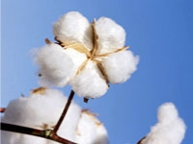
1. Natural Fibres
Cotton
Cotton, the natural fibre most widely used in apparel, grows in a boll around the seeds of cotton plants. A single fibre is an elongated cell that is a flat, twisted, hollow, ribbon-like structure.
Characteristics
Fair to good strength
Very little elasticity
Less resilient and prone to wrinkling
Comfortable and soft feel
Good absorbency
Conducts heat well
Damaged by insects, mildew, rot and moths
Weakened by extended sunlight exposure

Slide 3
Applications
Widely used in number of textile products
Commonly used in woven and knitted apparel
Home textile – bath towels, bath robes, bed covers etc.
Used as a blend with other fibres as rayon, polyester, spandex etc.

Slide 4
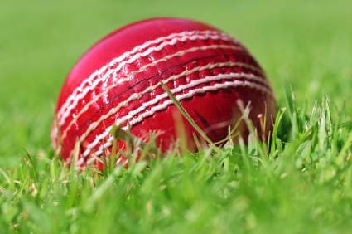
Linen
Linen, one of the most expensive natural fibres, is made from the flax plant. It is labour-intensive to produce, hence produced in small quantities. However linen fabric is valued for its exceptional coolness and freshness in hot weather.
It is composed of 70% cellulose and 30% pectin, ash, woody tissue and moisture.
Characteristics
Strongest vegetable fibre
Poor elasticity, hence wrinkles easily
Relatively smooth, becomes softer when washed
Highly absorbent
Good conductor of heat and feels cool
Lustrous
More brittle, constant creasing in the sharp folds,
tends to break
Damaged by mildew, perspiration and bleach
Resistant to moths and carpet beetles

Slide 5
Applications
Apparel - suits, dresses, skirts, shirts etc.
Home and commercial furnishing items – table cloths, dish towels, bed sheets, wallpaper / wall coverings, window treatments etc.
Industrial products - luggage, canvas etc.
Used as blend with cotton

Slide 6
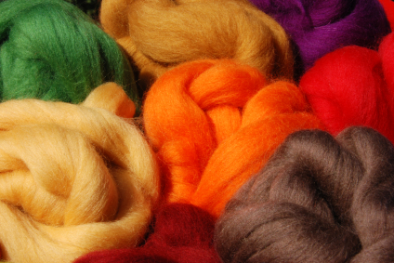
Wool
Wool fibre grows from the skin of sheep and is a relatively coarse and crimped fibre with scales on its surface. It is composed of protein. The fibre appearance varies depending on the breed of the sheep. Finer, softer and warmer fibres tend to be with more and smoother scales. Thicker, less warm fibres have fewer and rougher scales. Normally, the better wool fibres with finer scales are duller in appearance than the poorer quality fibres which have fewer scales.
Characteristics
Crimped in appearance
Elastic
Hygroscopic, readily absorbs moisture
Ignites at a higher temperature than cotton
Lower rate of flame spread, heat release and combustion heat
Resistant to static electricity

Slide 7
Applications
Clothing – jackets, suits, trousers, sweaters, hats etc.
Blankets, carpets, felt and upholstery
Horse rugs, saddle clothes

