Slide 1
WOOL, SILK,RAYON
CHARACTERISTICS AND USES
Presented by
Dr. Ila Jogi
Head, Department of Home Science
Mahila Mhavidyalaya, Karad

Slide 2
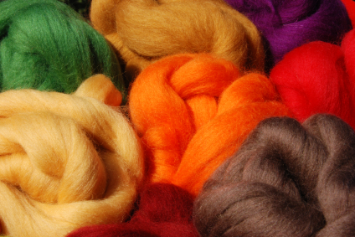
Wool
Wool fibre grows from the skin of sheep and is a relatively coarse and crimped fibre with scales on its surface. It is composed of protein. The fibre appearance varies depending on the breed of the sheep. Finer, softer and warmer fibres tend to be with more and smoother scales. Thicker, less warm fibres have fewer and rougher scales. Normally, the better wool fibres with finer scales are duller in appearance than the poorer quality fibres which have fewer scales.
Characteristics
Crimped in appearance
Elastic
Hygroscopic, readily absorbs moisture
Ignites at a higher temperature than cotton
Lower rate of flame spread, heat release and combustion heat
Resistant to static electricity

Slide 3
Applications
Clothing – jackets, suits, trousers, sweaters, hats etc.
Blankets, carpets, felt and upholstery
Horse rugs, saddle clothes

Slide 4
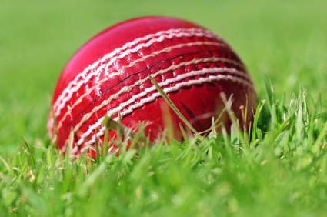

Slide 5
Linen, one of the most expensive natural fibres, is made from the flax plant. It is labour-intensive to produce, hence produced in small quantities. However linen fabric is valued for its exceptional coolness and freshness in hot weather.
It is composed of 70% cellulose and 30% pectin, ash, woody tissue and moisture.
Characteristics
Strongest vegetable fibre
Poor elasticity, hence wrinkles easily
Relatively smooth, becomes softer when washed
Highly absorbent
Good conductor of heat and feels cool
Lustrous
More brittle, constant creasing in the sharp folds, tends to break
Damaged by mildew, perspiration and bleach
Resistant to moths and carpet beetles
Applications
Apparel - suits, dresses, skirts, shirts etc.
Home and commercial furnishing items – table cloths, dish towels, bed sheets, wallpaper / wall coverings, window treatments etc.
Industrial products - luggage, canvas etc.
Used as blend with cotton

Slide 7
Wool fibre grows from the skin of sheep and is a relatively coarse and crimped fibre with scales on its surface. It is composed of protein. The fibre appearance varies depending on the breed of the sheep. Finer, softer and warmer fibres tend to be with more and smoother scales. Thicker, less warm fibres have fewer and rougher scales. Normally, the better wool fibres with finer scales are duller in appearance than the poorer quality fibres which have fewer scales.
Characteristics
Crimped in appearance
Elastic
Hygroscopic, readily absorbs moisture
Ignites at a higher temperature than cotton
Lower rate of flame spread, heat release and combustion heat
Resistant to static electricity
Applications
Clothing – jackets, suits, trousers, sweaters, hats etc.
Blankets, carpets, felt and upholstery
Horse rugs, saddle cloths

Slide 8
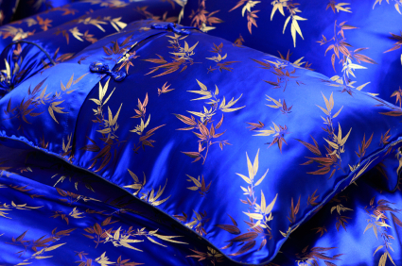
Silk

Slide 9
Silk
Silk is a fine, continuous strand unwound from the cocoon of a moth caterpillar known as the silkworm. It is composed of protein. It is very shiny due to the triangular prism-like structure of the silk fibre, which allows silk cloth to refract incoming light at different angles.
Characteristics
Lustrous, smooth and soft texture and not slippery
Lightweight, strong, but can lose up to 20% of its strength when wet
Elasticity is moderate to poor. If elongated, it remains stretched
Can be weakened if exposed to too much sunlight
May be affected by insects, especially if left dirty
Can regain up to 11% of its moisture
Applications
Shirts, ties, blouses, formal dresses, high-fashion clothes
lingerie, pyjamas, robes, dress suits and sun dresses
Many furnishing applications
Upholstery, wall coverings, and wall hangings

Slide 10
Jute
Jute is taken from a tall plant of the same name and it is easy to cultivate and harvest. It is the cheapest fibre and is used in great quantities.
Characteristics
It is not durable as it deteriorates rapidly
when exposed to moisture
Less strength
Cannot be bleached to make it pure
white due to lack of strength
Applications
Binding threads for carpets, coarse and cheap fabrics, heavy bagging etc.

Slide 11
Kapok
It is a white hair-like fibre obtained from the seed capsules of plants and trees called Ceiba Pentandra grown in Java and Sumatra (Indonesia), Mexico, Central America and the Caribbean, Northern South America and tropical West Africa.
It is called silk cotton due to its high lustre which is equal to that of silk.
Characteristics:
Smooth texture
Very lustrous
Weak
Short fibre length
Resistant to moisture, dries quickly when wet
Applications
Mattresses, cushions, upholstered furniture

Slide 12
Ramie
A woody fibre resembling flax and it is also known as rhea and China grass. It is taken from a tall flowering plant.
Characteristics
Stiff
More brittle
Lustrous
Applications
Canvas, upholstery, clothing, etc.

Slide 13
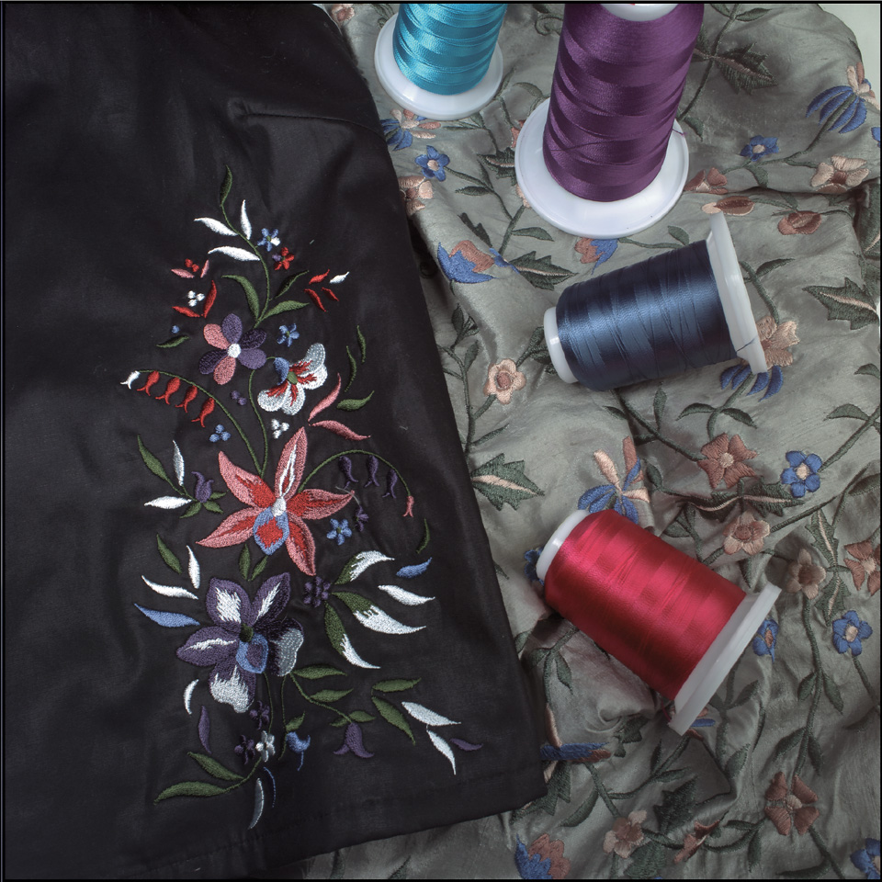
Man-made (Regenerated)
Cellulosic
They are derived either from the cellulose of the cell walls of short cotton fibres that are called linters or, more frequently from pine wood. There are three types of man made cellulosic fibres:
Rayon, acetate and tri-acetate ↓

Slide 15
Rayon
Rayon is made from naturally occurring polymers that simulate natural cellulosic fibres. It is neither a truly synthetic fibre nor a truly natural fibre.
There are two varieties of Rayon; viscose and high wet modulus (HWM). These in turn are produced in a number of types to provide certain specific properties.
Characteristics
Soft, smooth and comfortable
Naturally high in lustre
Highly absorbent
Durability and shape retention is low, especially when wet
Low elastic recovery
Normally weak, but HWM rayon is much stronger, durable and has good
appearance retention.
Applications
Apparel - blouses, dresses, jackets, lingerie, linings, suits, neck ties etc.
Furnishing items - bedspreads, bed sheets, blankets, window treatments, upholstery etc.
Industrial uses e.g. medical surgery products, non-woven products, tyre cord etc.
Other uses - feminine hygiene products, diapers, towels etc.

Slide 16
Acetate
Acetate consists of a cellulose compound identified as acetylated cellulose – a cellulose salt. Hence it possesses different qualities compared to rayon.
Acetate is thermoplastic and can be formed into any shape by application of pressure combined with heat. Acetate fibres have good shape retention.
Characteristics
Thermoplastic
Good drapability
Soft, smooth and resilient
Wicks and dries quickly
Lustrous appearance
Weak, rapidly loses strength when wet, must be dry-cleaned
Poor abrasion resistance
Applications
Primarily in apparel - blouses, dresses, jackets, lingerie, linings, suits, neck ties, etc.
Used in fabrics such as satins, brocades, taffetas, etc.

Slide 17
Tri-acetate
Tri-acetate consists of acetylated cellulose that retains acetic groupings, when it is being produced as triacetate cellulose. It is a thermoplastic fibre and is more resilient than other cellulosic fibres
Characteristics
Thermoplastic
Resilient
Shape retentive and wrinkle resistant
Shrink resistant
Easily washable, even at higher
temperatures
Maintains creases and pleats well
Applications
Primarily apparel
Used in clothing where crease / pleat retention is important e.g. skirts and dresses
Can be used with polyester to create shiny apparel

Slide 18
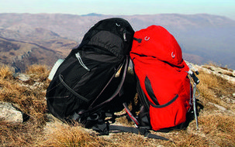
Man-made – Non-cellulosic
Polymer Fibres
This group of fibres is distinguished by being synthesised or created from various elements into larger molecules that are called linear polymers.
The molecules of each particular compound are arranged in parallel lines in the fibre. This arrangement of molecules is called molecular orientation.
The properties of such fibres are dependent on their chemical composition and kinds of molecular orientation.
Nylon

Slide 19
In nylon, the fibre forming substance is a long-chain synthetic polyamide in which less than 85% of the amide linkages are attached directly to two aromatic rings. The elements carbon, oxygen, nitrogen and hydrogen are combined by chemical processes into compounds which react to form long-chain molecules, chemically known as polyamides and are then formed into fibres. There are several forms of nylon. Each depends upon the chemical synthesis.
They are: Nylon 4; 6; 6.6; 6.10; 6.12; 8; 10; and 11.
NYLON
Characteristics
Highly resilient
High elongation and elasticity
Very strong and durable
Excellent abrasion resistance
Thermoplastic
Has the ability to be very lustrous, semi-lustrous or dull
Resistant to insects, fungi, mildew and rot
Applications
Apparel – pantyhose, stockings, leggings, etc.
Home furnishing
Industrial applications - parachutes, tyre cords, ropes, airbags, hoses, etc.

