Slide 1
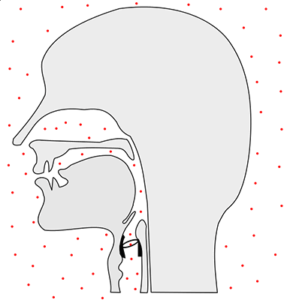
Articulatory System

Slide 2
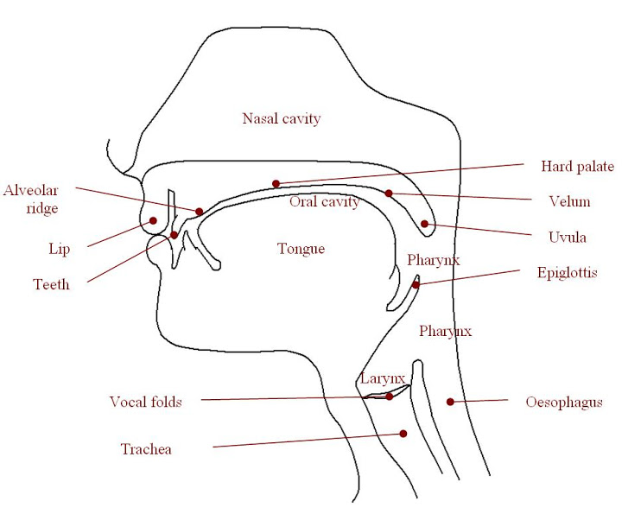
Articulatory System Consists
of :
  Pharynx
Nasal Cavity
Oral Cavity ( Tongue, Teeth, Roof of the Mouth and Lips)

Slide 3
Place of Articulation of Consonants is determined by --
Active Articulators: Tongue, Lower Lip, Sometimes Soft
Palate
Passive Articulators: Upper Lip, Upper Teeth, Teeth Ridge/
Alveolar Ridge, Hard Palate, Sometimes Soft Palate

Slide 4
Chief Places of Articulation are as Follows:
Bilabial Labio-Dental
Dental Alveolar
Post-Alveolar Palato – Alveolar
Palatal Velar
Glottal

Slide 5
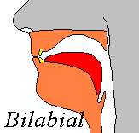
Bilabial Sounds : /p, b, m, w /
( As in Pen, Ball, Man, Win)
Active Articulator:
Lower Lip
Passive Articulator:
Upper Lip

Slide 6
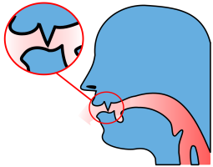
Labio-Dental / f , v /
(As in Fan, Van)
Active Articulator:
Lower Lip
Passive Articulator:
Upper Teeth

Slide 7
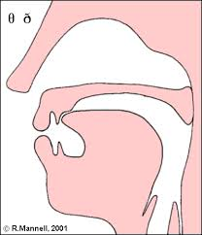
Dental / ϴ , ð /
(As in Think, They)
Active Articulator:
Tip of the Tongue
Passive Articulator:
Upper Teeth

Slide 8
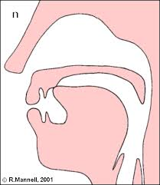
Alveolar / t, d, l, n, s, z /
(As in : Ten, Day, Lip, Not, Sap, Zen)
Active Articulator:
Tip of the Tongue
/ t, d, l, n/
Blade of the Tongue
( s, z)
Passive Articulator:
Alveolar Ridge

Slide 9
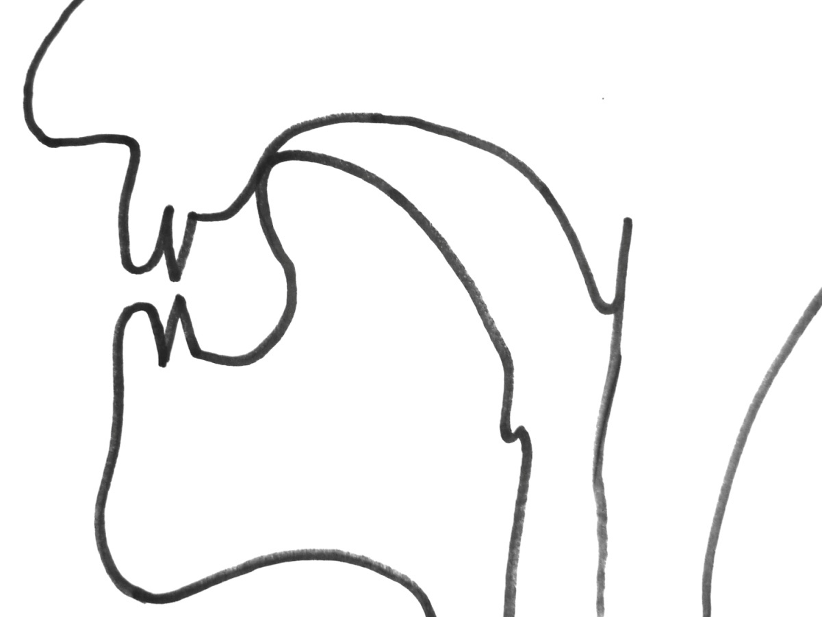
Post Alveolar / r /
(As in Right)
Active Articulator:
Tip of the Tongue
Passive Articulator:
Back of Teeth Ridge

Slide 10
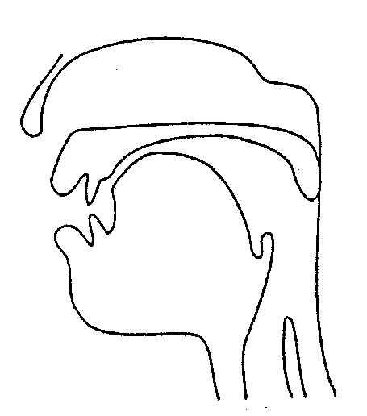
Palato-Alveolar / ʧ, ʃ , ʒ, ,ʤ /
(As in Chair, Shine, Pleasure, Job)
Active Articulator:
Front of the Tongue
Passive Articulator:
Hard Palate

Slide 11
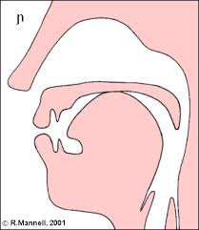
Palatal / j /
( As in Yes)
Active Articulator:
Front of the Tongue
Passive Articulator:
Hard Palate

Slide 12
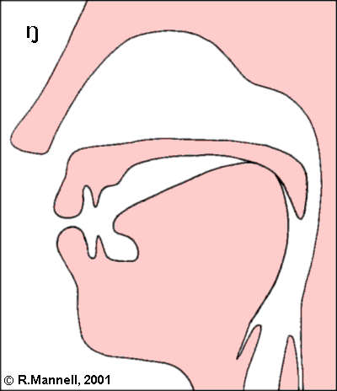
Velar / k , ɡ , ŋ /
(As in Can, Go, King)
Active Articulator:
Back of the Tongue
Passive Articulator:
Soft Palate

Slide 13
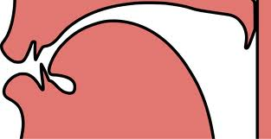
Glottal / h /
(As in Home)
The articulators are the two vocal cords
Vocal Cords

