Slide 1
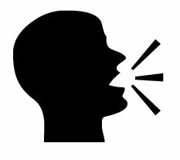
Manner of Articulation

Slide 2
Production of sound depends on : a kind of closure & narrowing.

Slide 3
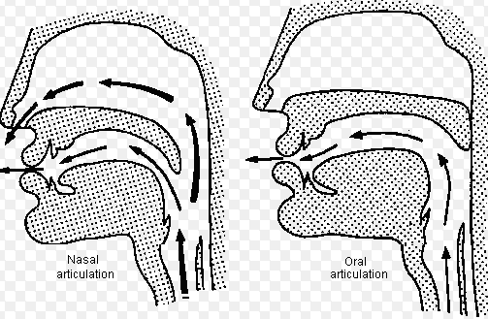
Nasal and Oral Articulation

Slide 4

Plosives

Slide 5

Fricatives

Slide 6
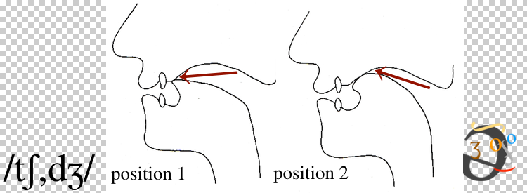
Affricates

Slide 7
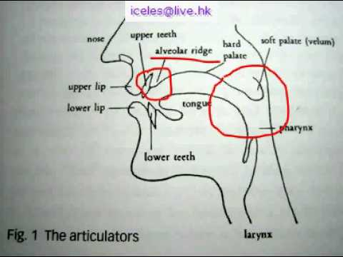
Trill / Roll

Slide 8
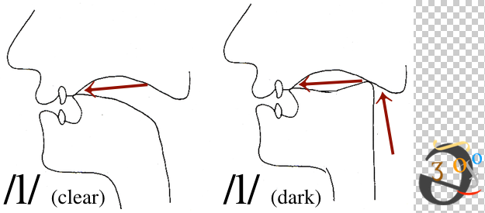
Lateral

Slide 9

Nasal

Slide 10
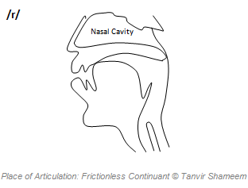
Frictionless Continuant

Slide 11
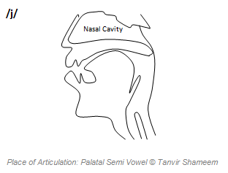
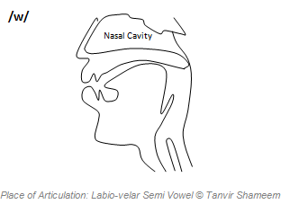
Semi Vowels

